Slide 1

supporting the reproductive health needs of immigrant families
The Columbia Basin Health Association (CBHA) Experience
___________________________________________________________________________________________________________________________________________________________________________________
Leo Gaeta, Vice President of Programs
Karina Silva, Family Planning Coordinator
Columbia Basin Health Association
March 4, 2020

Slide 2
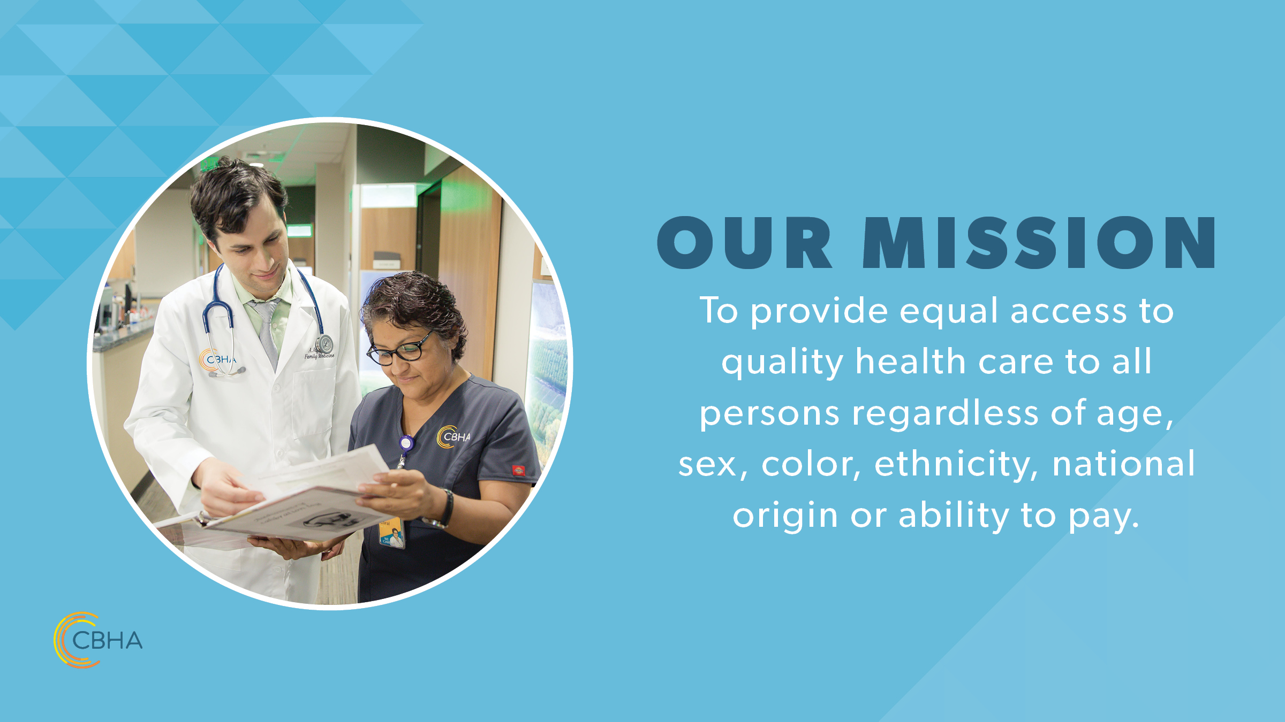

Slide 3
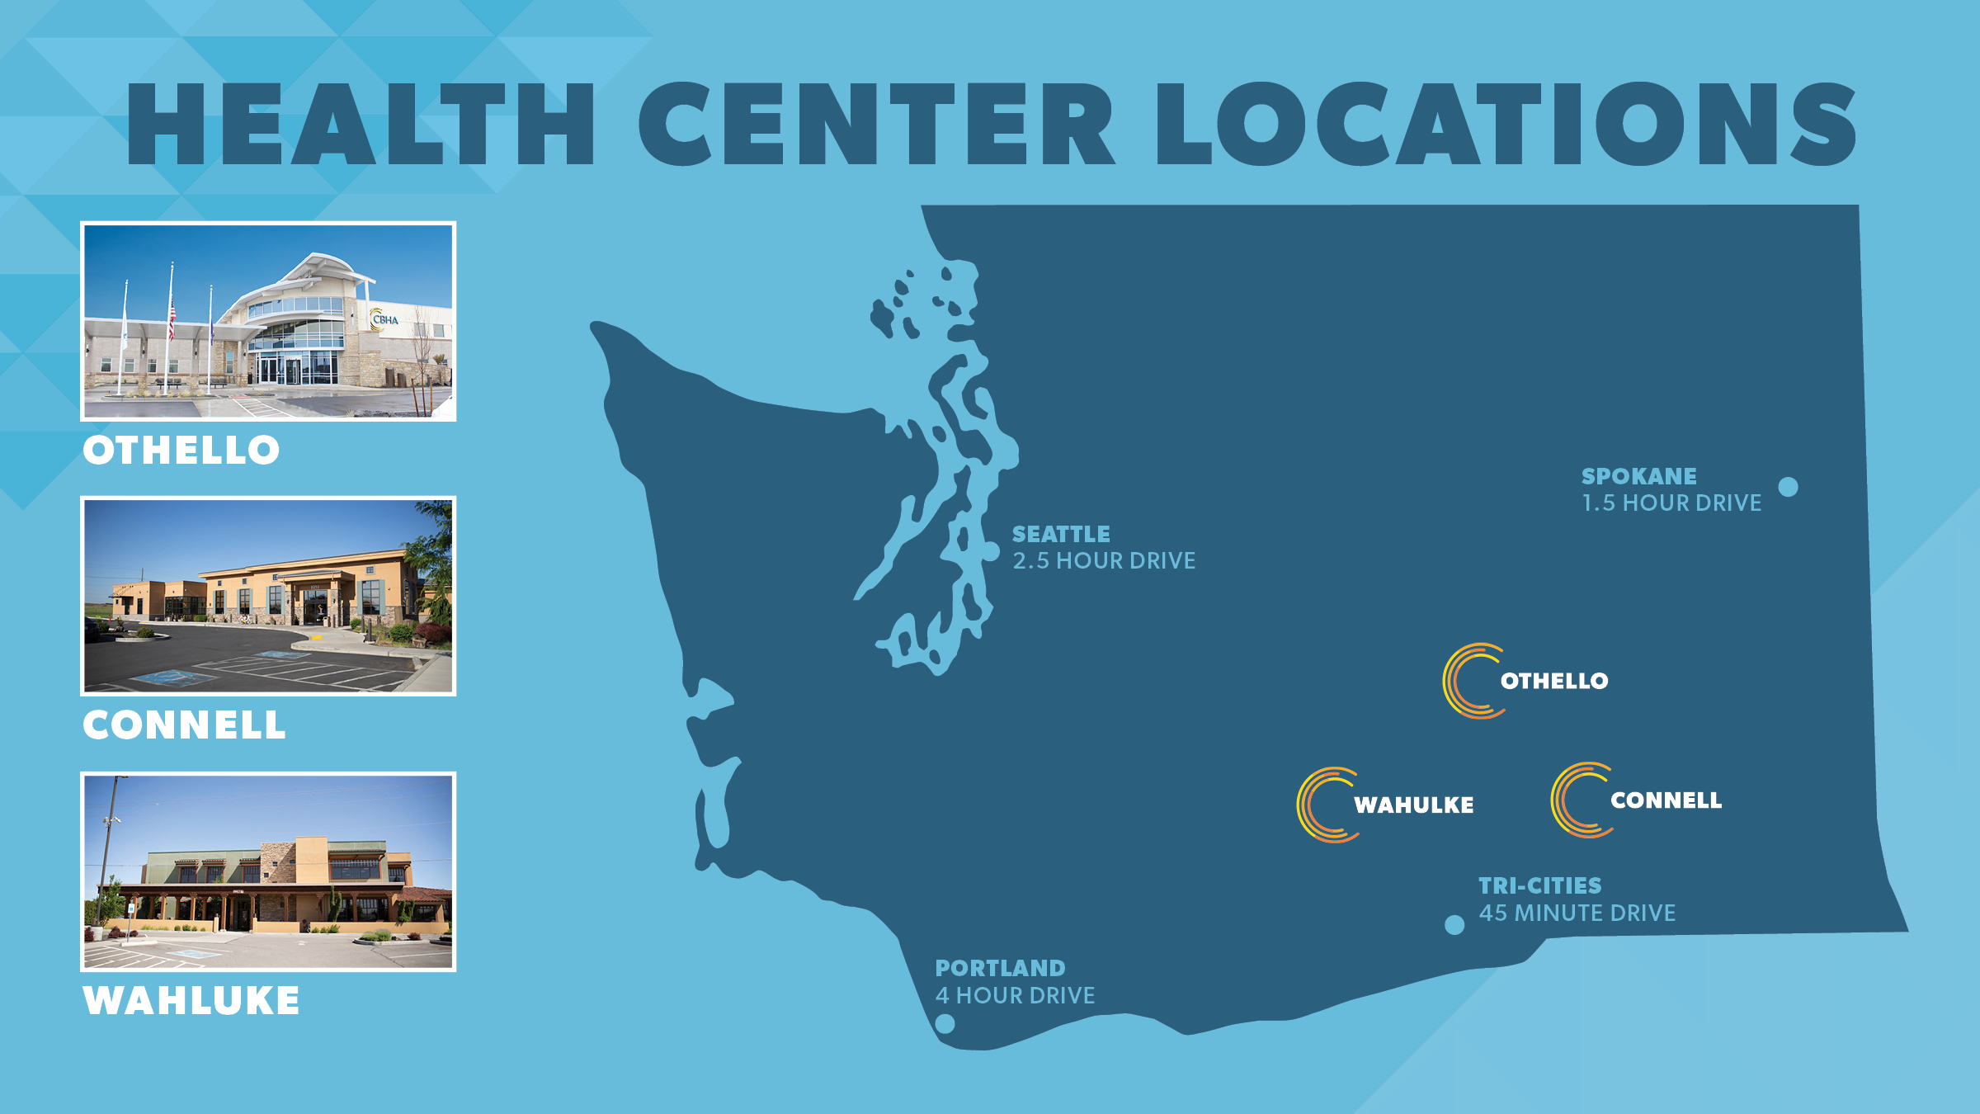

Slide 4
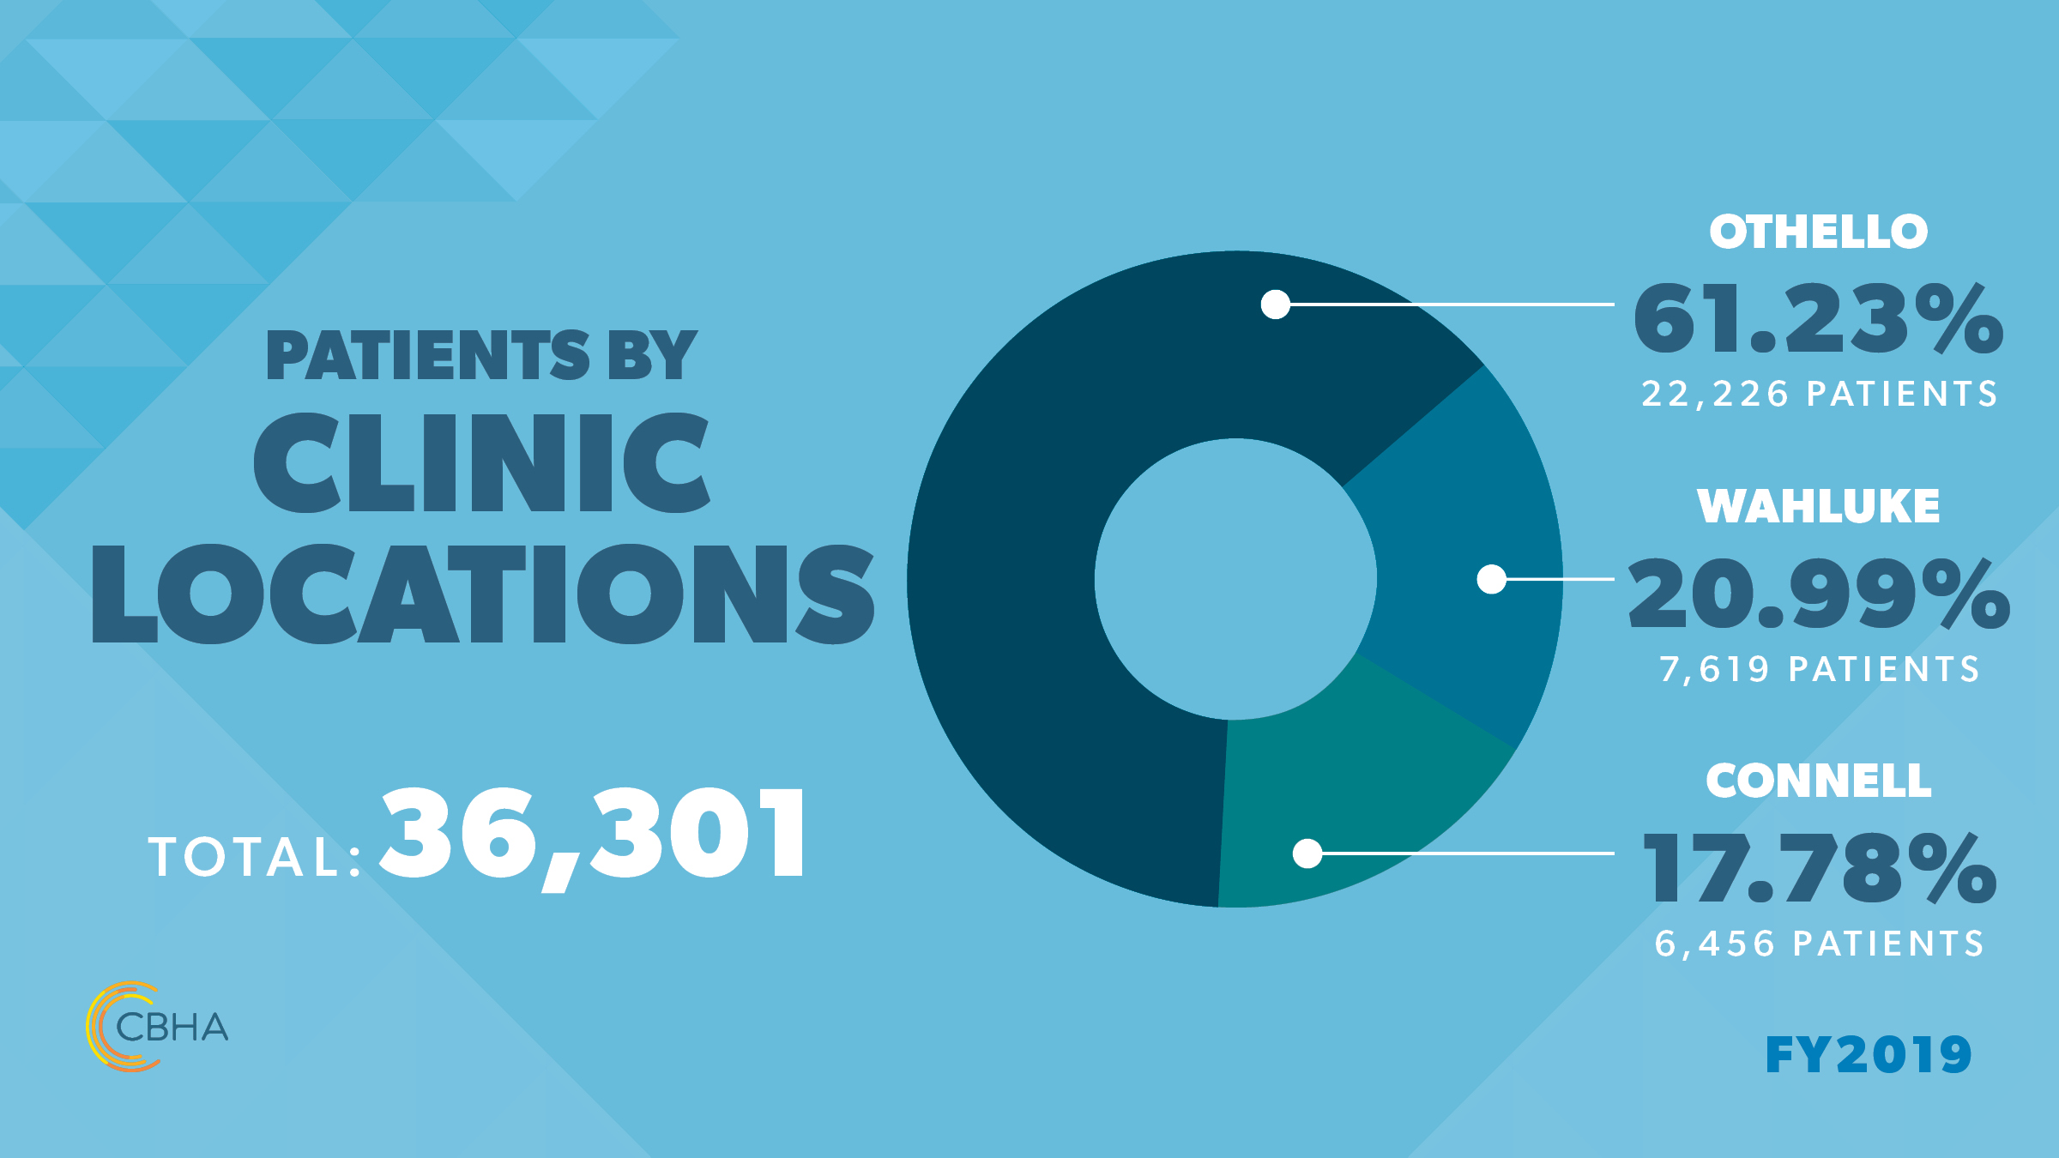

Slide 5
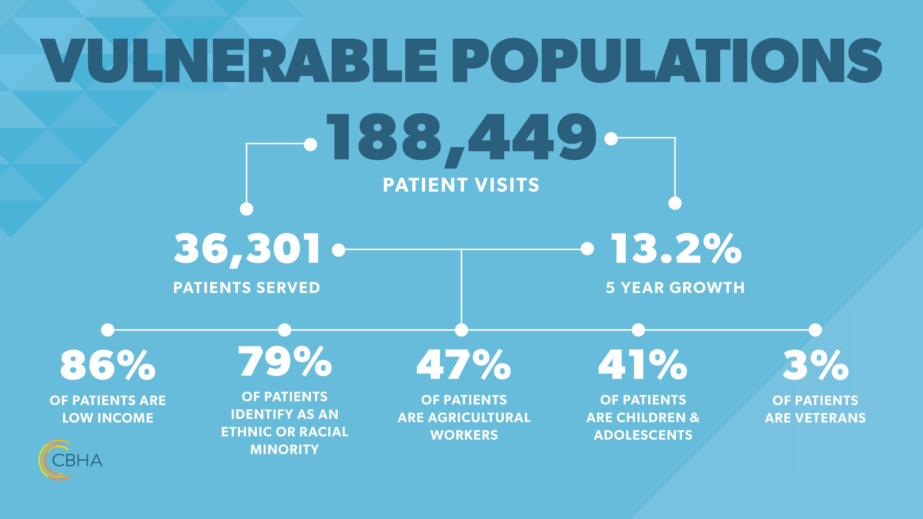

Slide 6
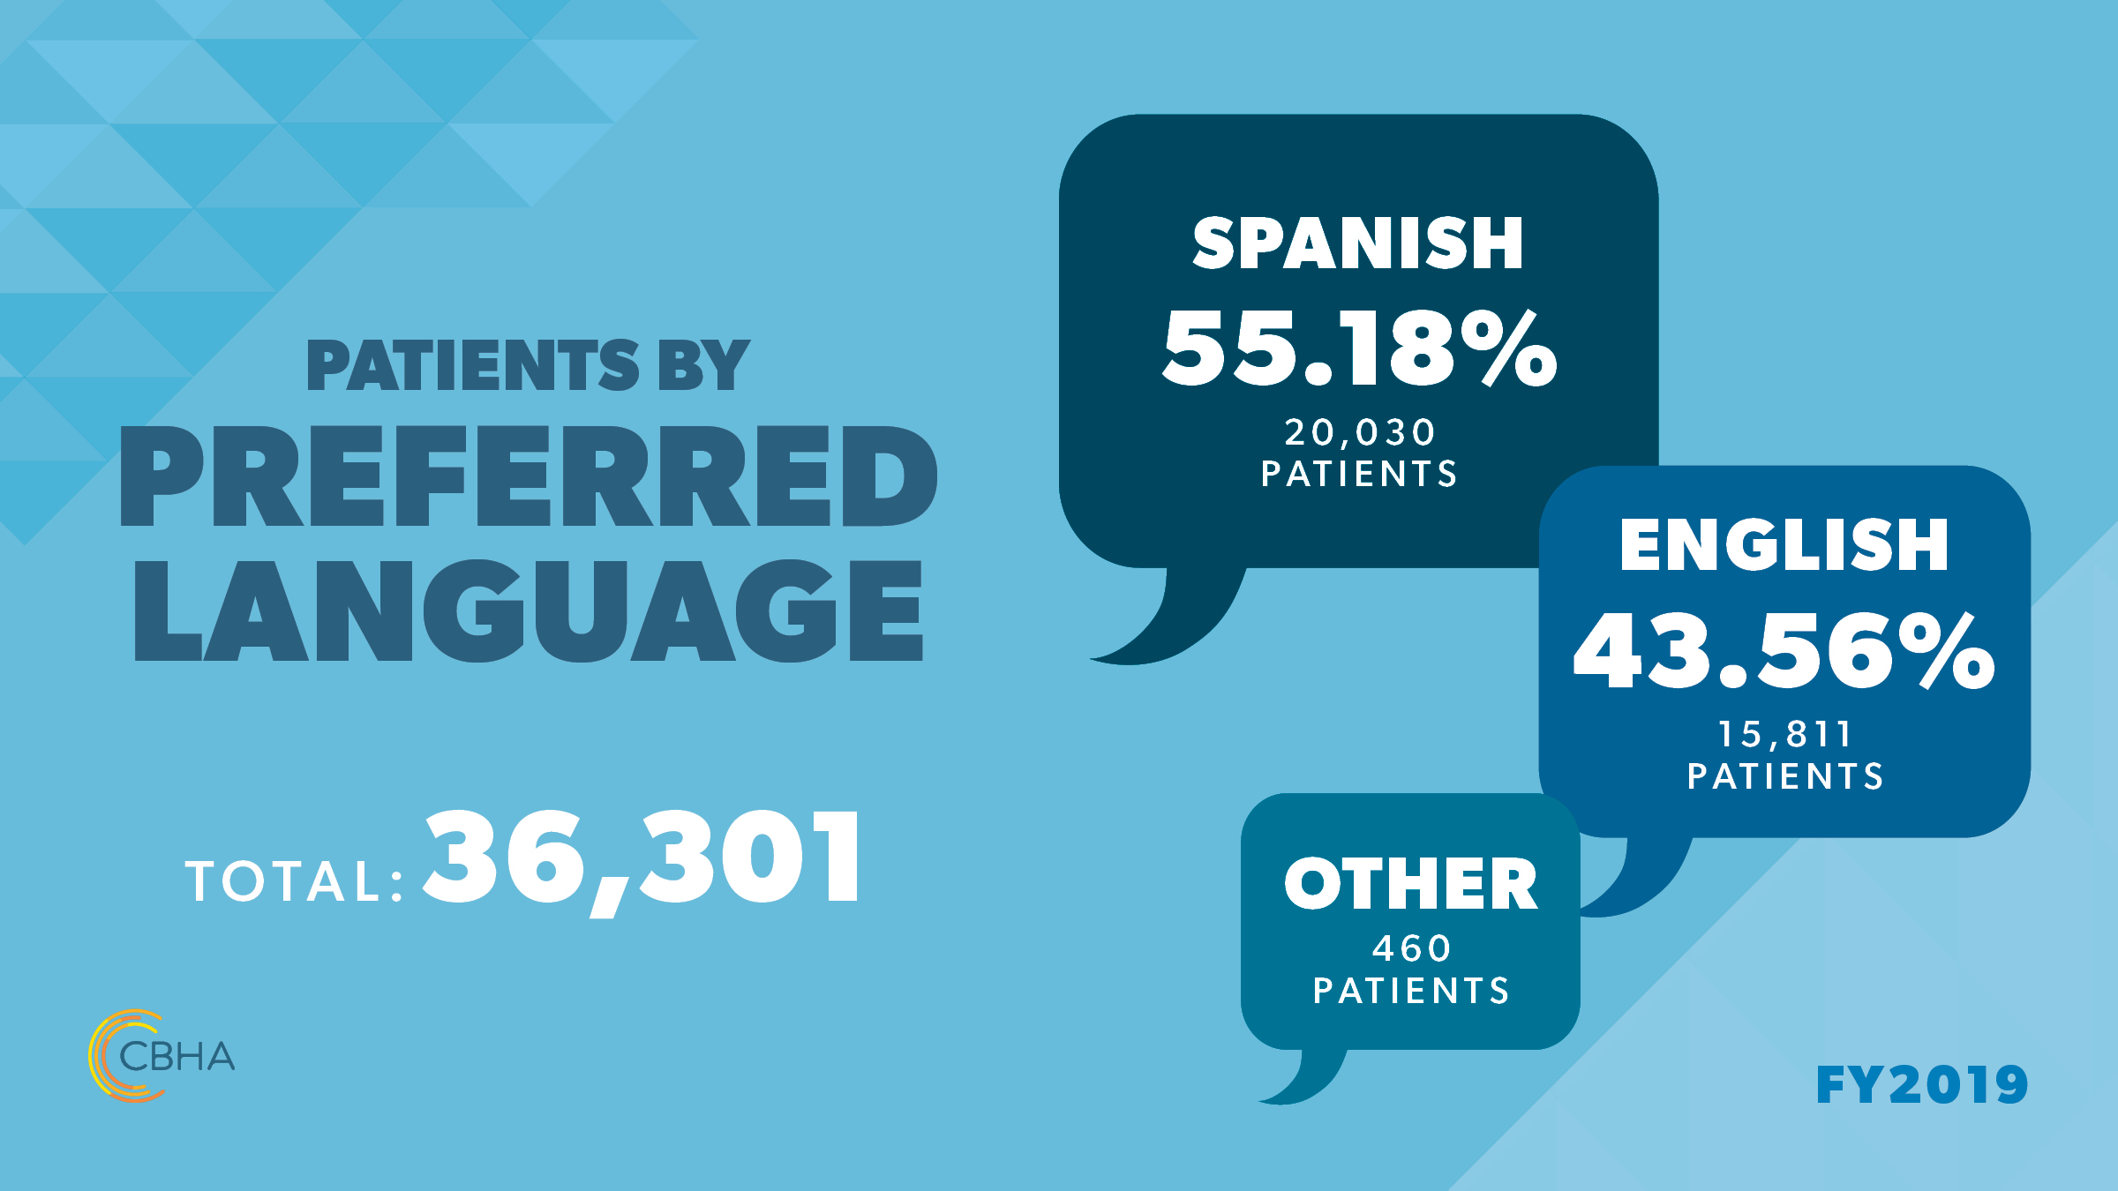

Slide 7
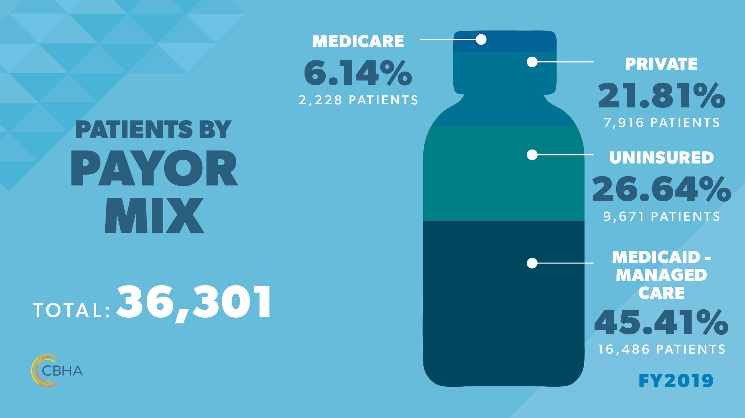

Slide 8


Slide 9
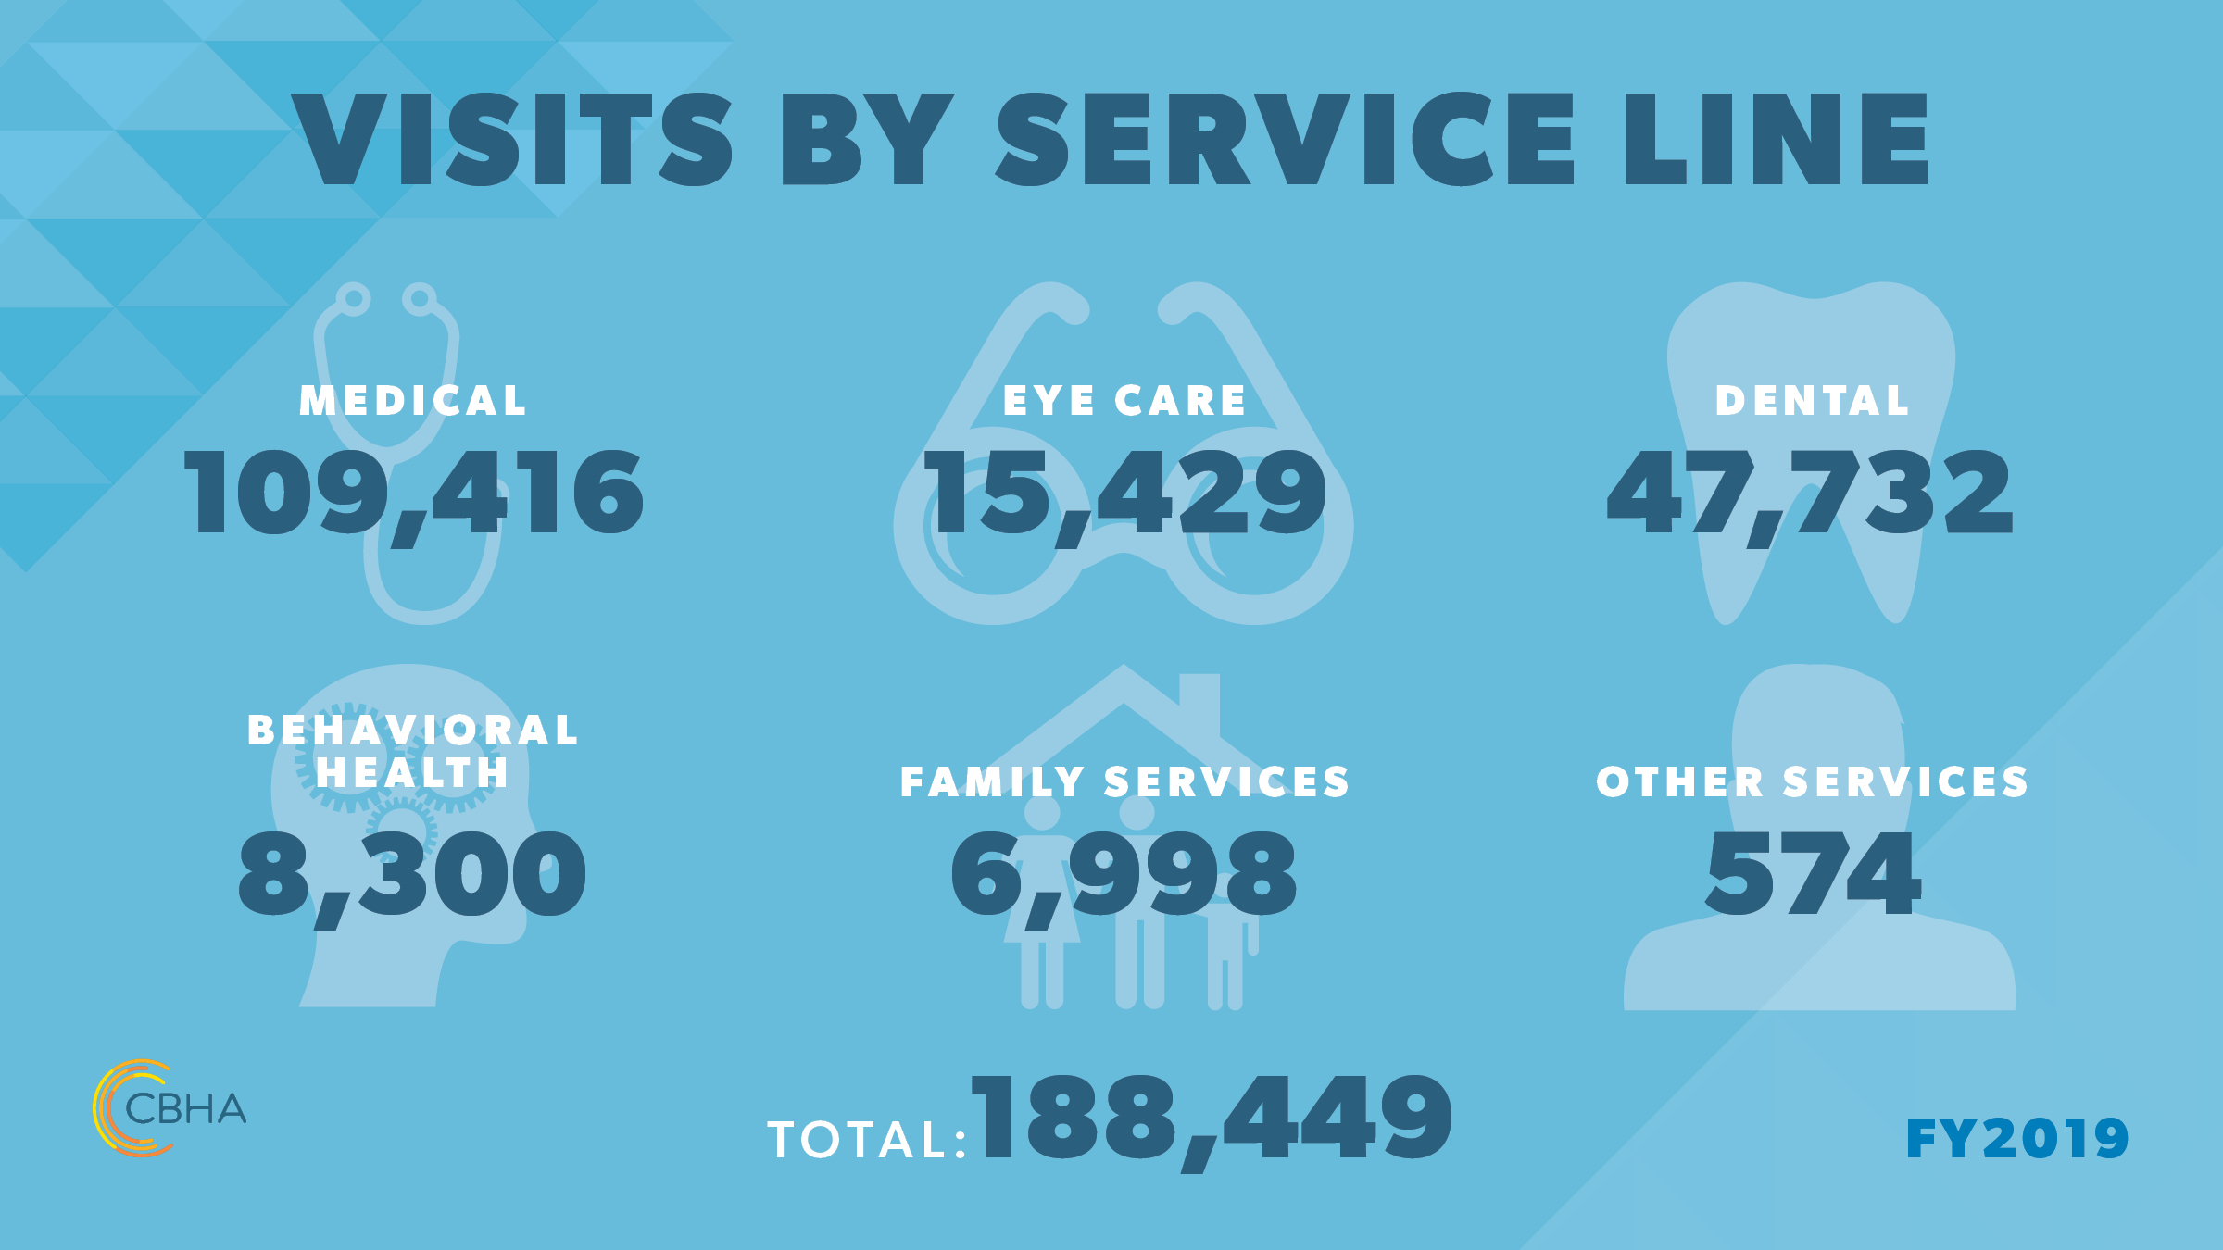

Slide 10


Why Focus on Family Planning Services
High incident of teen pregnancy - Adams, Grant, and Franklin Counties have some of the highest teen pregnancy rates in the state.
  Adams Co. teen pregnancy rate = 54/1000 vs. WA state teen pregnancy rate of 34/1000 ¹
48% of patients < 100% federal poverty level (FPL) and 91%<200% FPL ²
Rural communities = limited resources & opportunities for families
(1-Washington State Pregnancy Data: Vital Registration System Annual Statistical Files, Births 1980-2011, 2012; 2- CBHA UDS Data, 2018)

Slide 11
Model of Care – Integrated Care/Patient Centered Reproductive Health
Patient Centered Reproductive Health
Support Staff
Medical Care Team

Slide 12

FP Program Structure & Implementation
Family Planning Program Components
  Clinical
  Outreach
Patient Engagement
  Pregnancy Intention Screening
  Women’s Wellness Exams
  Prenatal and Postpartum Care
  Health Education
  Free Pregnancy Tests
  Community Outreach
Documentation
  Electronic Medical Record (EMR)
  Client Visit Records (Ahlers)

Slide 13
Family Planning Stats
25-44 (N=1,319)
12-24 (N=710)
45 & over (N=77)
Conducted a total of 2,106 Family Planning interventions (February 2019-February 2020)
Age
Notes:
64% enrolled during pregnancy
77% Teen parents
87% low income
70% low education
Language: English = 24, Spanish = 51, Mixteco = 40
Risk Factors: 1 = 4, 2 = 40, 3 = 53, 4+ = 18
Conducted 2,160 home visits

Slide 14
Patient Obstacles
Patient knowledge and comfort level regarding contraception use
Cultural beliefs and myths
Access and affordability
Public Charge
Community
Medical care team workflows
Staff knowledge and comfort level regarding contraception counseling

Slide 15

Questions Contact Information
Karina Silva
Family Planning Coordinator
1515 E Columbia St | Othello, WA 99344
Tel: 509.488.5256 E-Mail: karinas@cbha.org
Leo Gaeta
Vice President of Programs
1515 E Columbia St | Othello, WA 99344
Tel: 509.488.5256 E-Mail: leo@cbha.org

