Slide 1
ESD 113 True North Student Assistance Model
Bree Collaborative, October 9, 2024
Sara Ellsworth, MA, LMHC, SUDP, Clinical Director
Brittany Spencer, MA, SUDP, LMHCA, Clinical Supervisor
Jackie Yee, MA, SUDP, Clinical Supervisor
Erin Wick, MBA, SUDP, Executive Director
Dr. Eric Bruns, PhD, Associate Director, UW SMART Center
Notes:
Erin/Sara to do introductions

Slide 2
Youth Behavioral Health: What we know
Behavioral health services benefit academic performance & achievement
School-based prevention and early intervention services are accessible and effective
Nationally, most children and adolescents who receive behavioral health services do so at school
Notes:
Sara
The benefits of a Student Assistance model extend beyond behavioral health. While they do benefit students social and emotional development they also improve academic performance and achievement by reducing non-academic barriers to success. We also know that school-based services are both accessible and effective and that most children under 18 who do receive behavioral health services get these services at school.

Slide 3

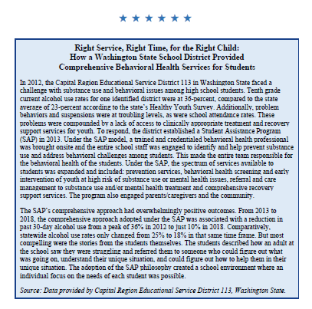
WHAT WE KNOW
Notes:
Sara
Student Assistance was featured in the most recent version of the Office of National Drug Control Policy’s National Drug Control Strategy as effective model of Prevention and Early Intervention

Slide 4
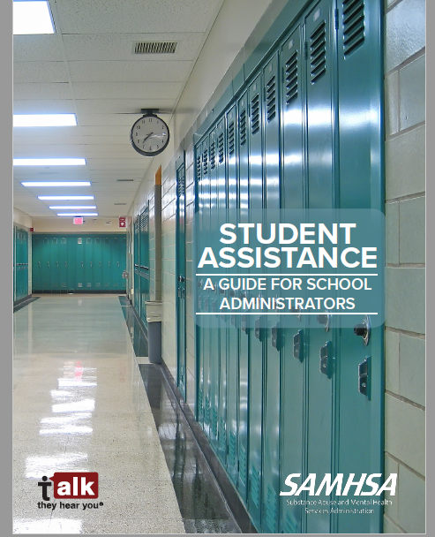
Notes:
Sara
Want to point out a useful resource. The Student Assistance Administrator’s Guide is a good overview of the Student Assistance framework and aligned with our True North model.

Slide 5
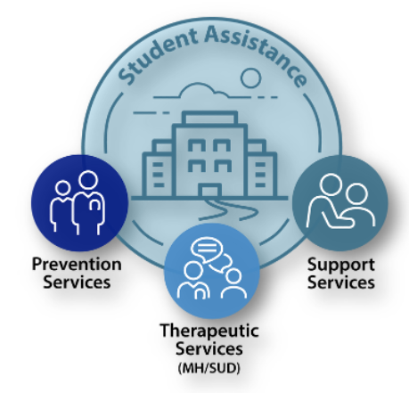
What is a Student Assistance Program?
Services include:
Education
Prevention
Early identification
Evidence-based intervention
Referral processes
Guided support services
Notes:
Brittany
Features of a quality student assistance program include the following, may want to provide a brief example of each

Slide 6
Who does a Student Assistance Program Serve?
ALL students benefit from a Student Assistance Program
  Substance use prevention
  Mental health promotion
  Classroom presentations
  Information campaigns
Students experiencing substance use or misuse and/or mental health challenges are best suited to receive Student Assistance interventions
Notes:
Brittany
While the number of students who receive interventions may be somewhat small (10-15% of the student population), all students benefit from having a student assistance program in their school. Student Assistance reaches all students through a combination of substance use prevention and mental health promotion, effective education, and universal campaigns.

Slide 7
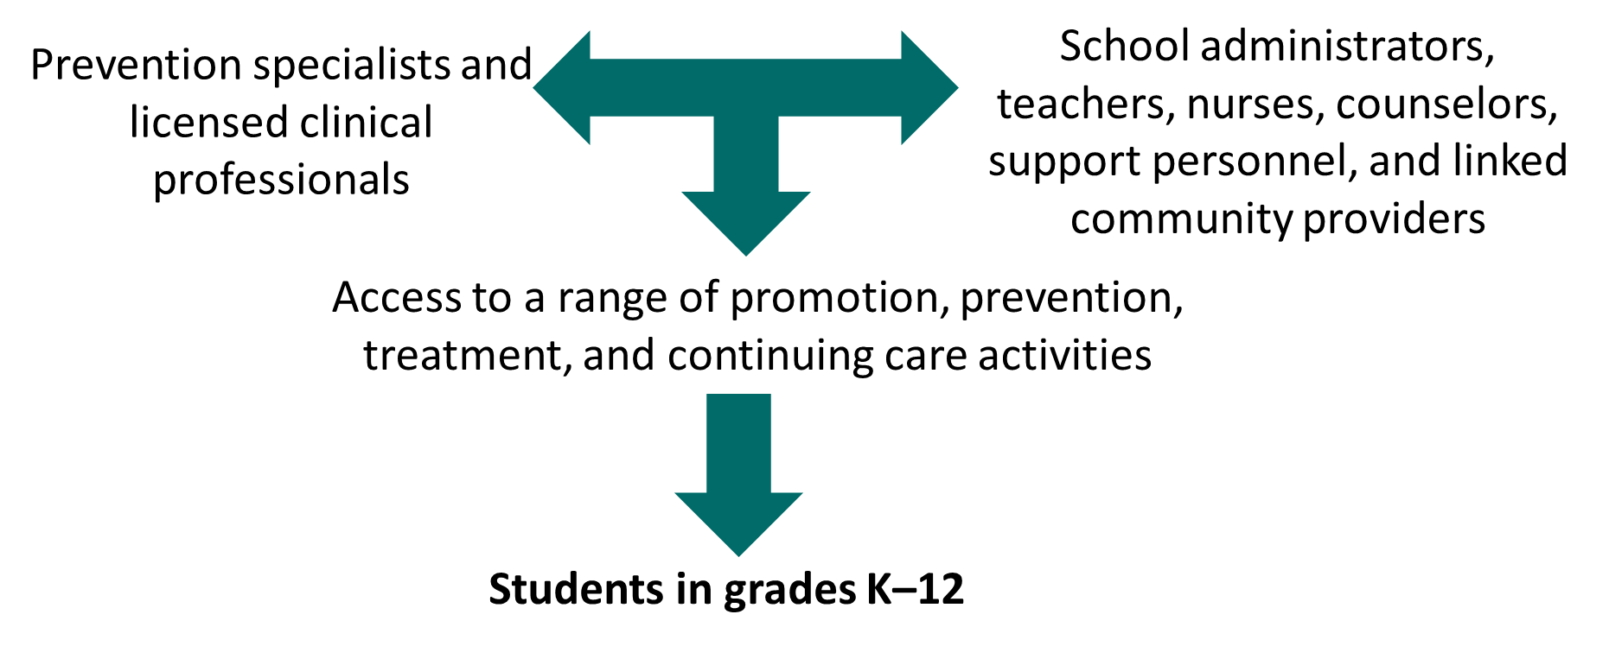
How Do SAPs Work?
Notes:
Brittany
In SAPs, a combination of prevention specialists and licensed clinical professionals work in collaboration with school administrators, teachers, nurses, counselors, support personnel, and linked community providers to enable access to a similar range of promotion, prevention, treatment, and continuing care activities for students in grades K–12. SAPs provide a critical framework for preventing substance use and mental illness and assisting students in need by coordinating activities across school- and community-based initiatives.

Slide 8
Identification and Referral Process
Identification/referral by…
Teachers, administrators, and interdisciplinary team members OR
Students and/or families
Process:
Provide brief description of concerns.
Students receive notification from designated SAP team member(s).
SAP team member(s) meets with student and assesses current concerns or risks.
Notes:
Brittany
Vulnerable students are identified by teachers, administrators, and interdisciplinary team members who refer students to designated referral sources with a brief description of concerns to allow for case consultation on the best outreach approach. Students then receive a notification from a designated member of the SAP team who meets with the student and assesses current concerns or risks.
A self-referral component is also included, which enables students and/or families to request help whether or not the student is identified through the school’s screening and data collection procedures.
Through an interdisciplinary team, which includes school staff (e.g., school psychologists, school counselors, social workers, certified nurses, and teachers) and community partners (e.g., clinical psychologists, social workers, addiction and mental health specialists, and resource officers), SAPs offer a safe and supportive way for students to receive assistance to address problems they are struggling with and build the skills necessary to succeed in school. Student assistance services are matched to students’ developmental levels and the targeted reduction of known conditions of risk while also building assets and protective factors for enhancing positive youth development.

Slide 9

True North Student Assistance Program
}
Tier 3: Behavioral Health Service (Treatment)
CR-ESD 113 True North Enhancement
FEW
}
Tier 2: Targeted Interventions (Selective/Indicated)
SOME
Traditional Student Assistance
Tier 1: School-Wide Practices
(Universal)
ALL
Notes:
Brittany
The traditional student assistance model focuses on Tier 1 and Tier 2, while the True North model enhances that framework by providing substance use treatment in many of our sites. We believe that effective prevention and early intervention leads to identification of students with more intensive needs. Our goal is to reduce barriers and ensure access to services for students in need.

Slide 10
True North Services Impact
Student Wellbeing
Symptom Reduction
  33% fewer students reported feeling they couldn’t “stop or control” their worrying
  35% fewer students reported feeling “worthless or inferior”
  35% fewer students reported feeling “unhappy, sad, or depressed”
Increased Coping
  61% more students reported they had healthy strategies to help manage negative emotions
  53% more students reported knowing how to ask for help when they need it
Based on 2023-2024 Student Assistance Outcomes Data , 357 students with matched pre/post tests
Notes:
Jackie
This is a summary of our 2023-2024 school year outcomes across our True North programming. 357 students completed matched pre/post-tests. These outcomes are typical and consistent with most academic years.

Slide 11
True North Services Impact
Student Behaviors
Decreased substance use
  Alcohol – 19% reduction
  Binge Drinking – 23% reduction
  Marijuana – 26% reduction
  Other Drug Use – 44% reduction
  Vaping – 24% reduction
Decreased problem behaviors
  Got in trouble at school – 28% reduction
  Skipping school – 23% reduction
  School suspensions – 48% reduction
Based on 2023-2024 Student Assistance Outcomes Data , 357 students with matched pre/post tests
Notes:
Jackie
This is a summary of our 2023-2024 school year outcomes across our True North programming. 357 students completed matched pre/post-tests. These outcomes are typical and consistent with most academic years.
**Other drug or substance including acid, mushrooms, MDMA, inhalants, cocaine, amphetamine, heroin, opium, spice

Slide 12
True North Services Impact
Increased school attendance
  38% of participants report they are more likely to attend school because of SAP services
Satisfaction with services
  93% reported they were glad they participated in SAP services
Based on 2023-2024 Student Assistance Outcomes Data , 357 students with matched pre/post tests
Notes:
Jackie

Slide 13
Challenges
Interaction of the school system that serves ALL and the Medicaid system that serves SOME
Infrastructure that only funds medically necessary (Tier 3) services
Fee-for-service models that do not reflect service delivery trends in a school setting
Notes:
Jackie
All students are served by public schools, but only some are covered by Medicaid. As the primary funder of treatment services not all students have access to care due to funding limitations.
Moreover, the behavioral health system only pays for medically necessary services, meaning those that meet diagnostic standards, with no funding for preventive or early intervention care. This is in contrast to the healthcare system that pays for the full spectrum of care.
Fee for service is challenging in a school system that experiences natural ebbs and flows of the school calendar.

Slide 14
Opportunities
Existing model and infrastructure that can be built upon
ESD network creates opportunities to build and sustain a statewide system
Coordination, collaboration, and expansion of partnerships with School-based Health Centers
Fully fund a system of care that works
Notes:
Jackie
We have a model that is effective and scalable. The AESD network is a great opportunity to expand services across the state (Erin will be talking more about that in a minute).
As School-Based Heath Centers expand across the state there is a real opportunity to scale student assistance.
Finally, it is most cost effective to pay for a full spectrum of care that includes prevention and early intervention, rather than waiting to pay for costly care as youth get sicker.

Slide 15
Behavioral Health Student Assistance Program (BH-SAP)

Slide 16
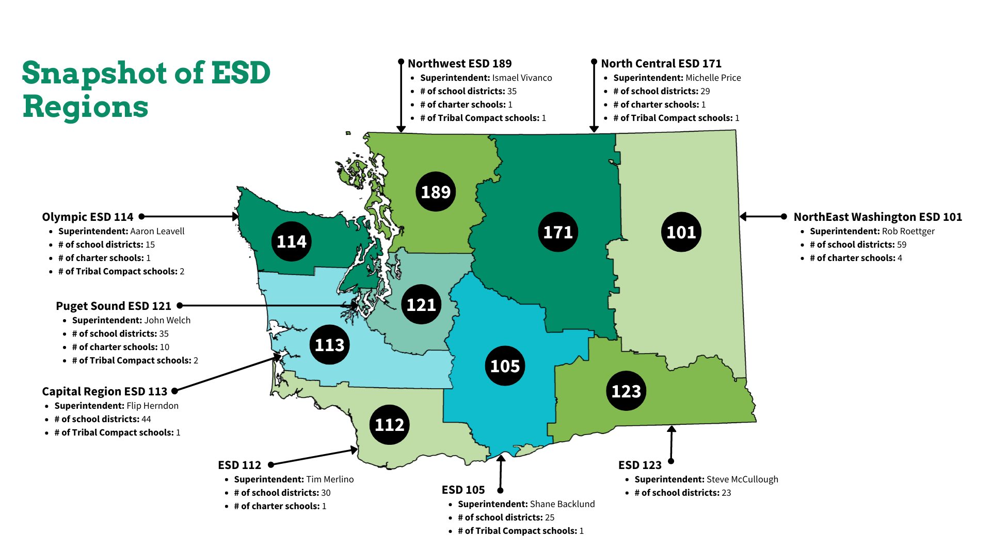

Slide 17
Our Statewide Initiatives
A regional delivery system for statewide programs & services
Learning | Student Supports | Operations
Beginning Educator Support Training (BEST) Educator Networks (Fellows, etc.) Early Learning Teacher & Principal Evaluation (TPEP) Native Education / Region 16 Comprehensive Center Content Professional Learning English Language Arts Mathematics Science & Climate Science Inclusionary Practices Computer Science System & School Improvement | Attendance & Reengagement Behavioral & Mental Health – System supports & Direct student services Career Connected Learning Early Learning Education Advocates / Institutional Education Migrant Education Multi-Tiered Systems of Support Regional School Safety Centers School Nurse Corps Special education | District Operations Communications supports Fiscal support services School construction Hiring supports (i.e., fingerprinting) Information services (WSIPC) Insurance pools Program evaluation Public Health Coordination/Support School Accreditation Special education Student transportation
Notes:
Michelle

Slide 18
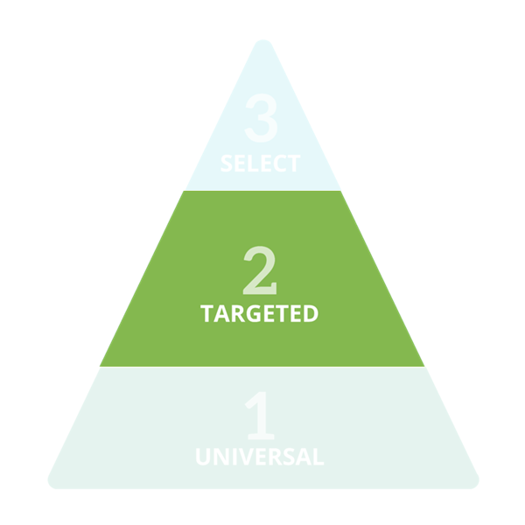

The AESD BH SAP model – Infrastructure
Key Staff
Statewide Coordination & Evaluation – responsible for ensuring program fidelity and outcomes
SAP Coordinator - responsible for program implementation and oversight at each ESD
Student Assistance Professionals – responsible for providing direct student assistance services
Direct Student Services
Family & Community Training
Staff Engagement & Awareness
School-wide Awareness
* Tier 3 services not funded as part of this project
Full AESD BH-SAP Fidelity Rubric Available Here!
Notes:
Tier 1 – Universal, School-wide practices
Tier 2 – Targeted/selective/indicated interventions
Tier 3 – treatment *not included in SAP

Slide 19
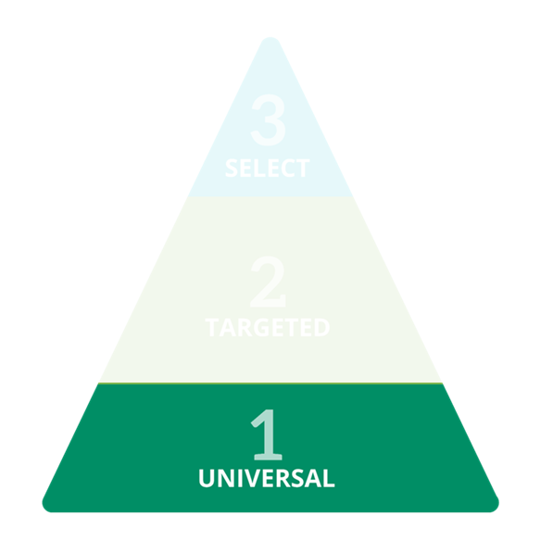
The SAP model – Tier 1 Student Services
Implement quarterly Universal Awareness Campaigns
  Suicide Prevention
  Bullying Prevention
  Substance Use Prevention
  Mental Wellness
Conduct Classroom Presentations
  Mental Health Awareness & Literacy
  Substance Use Prevention Education
  Stress, Anxiety and Coping Skills
  Vape Education
Facilitate or partner with a Youth Prevention Club

Slide 20
The SAP model – Tier 2 Student Services
Conduct screenings for students referred for services
Implement individual and group interventions
  Mental Health intervention curriculum:
    TRAILS Coping Skills
  Substance Abuse intervention curriculum:
    ATOD Education
    Intervention/Abusers
    Affected Others/COSAPS
    Recovery Support
Provide referral, coordination and follow up with outside resources as needed

Slide 21
4,026 BH-SAP Prevention activities conducted
1,507
1,315
374
Notes:
Awareness: During the 2023-24 school year, the most common prevention activities focused on Awareness (1,507 sessions), with the majority delivered to students (1,195). This category includes mental- and behavioral- health awareness presentations and campaigns, information dissemination efforts, and presentations about program services.
Curriculum: In addition to awareness events, SAPs taught important social-emotional and life skills through 374 evidence-based lessons with 2,260 students. This year’s student curricula included: 21st Century Skills Academy, Character Strong, Friends for Life, Kelso’s Choices, Life Skills, ReThink Ed, Second Step, teen Mental Health First Aid, and The Know.
Education: 401 Education Sessions were delivered to students including 257 presentations from the Prevention education series and 123 presentations on Stress, Anxiety and Coping Skills.
Peer: SAPs coordinated 56 Behavioral Health Leadership Clubs during 397 Peer Sessions to encourage youth engagement, empowerment, and peer leadership.
Planning: Planning activities (1,315) include Policy and procedure development and implementation, Technical assistance/consultation, as well as Screening and referral services, and were primarily conducted with staff (1,253).

Slide 22
Nearly 3,000 Students Directly Served via BH-SAP
In the 2023-24 school year:
  Over 2,700 students received direct early interventions (Tier 2)
  Most students accessed interventions through a personal referral (self, family, peer)
  Most referrals were not disciplinary (81%)
  Evaluation data was robust and representative of all students served (82% of eligible intervention students had a matched pre/post evaluation)
Notes:
I don’t think we want this slide specifically but I do think we should have a slide with how students are making it to our program in the outcomes section.

Slide 23
Substantial Impact on Individual Students’ Lives
66% | Lowered anxiety symptoms (“can’t stop or control my worrying”)
66% | Lowered depression symptoms (“feel unhappy, sad, or depressed”)
67% | Increased self-worth (reduced feeling “worthless or inferior”)
Improved mental and emotional wellness
Source: Student pre/post survey responses in AESD Behavioral Health Student Assistance Program (BH-SAP) 2023/24 school year. Represents improvements among students with identified need at baseline.
Notes:
66% lowered anxiety (N=679)
66% lowered depression symptoms (N=577)
67% increased self worth (N=446)

Slide 24
Substantial Impact on Individual Students’ Lives
66% | Decreased physical fighting
65% | Decreased suspensions
62% | Gained healthy strategies to calm down
59% | Gained ability to ask for help when needed
80% | Reported being more likely to attend school (among those with low attendance)
Marked improvement for students with existing behavior problems
Elevated help-seeking & self-regulation
Source: Student pre/post survey responses in AESD Behavioral Health Student Assistance Program (BH-SAP) 2023/24 school year. Represents improvements among students with identified need at baseline.
Notes:
66% decreased physical fighting (N=308)
65% decreased suspension (N=335)
62% GAINED healthy strategies to calm down (N=1002)
59% improved ability to ask for help when needed (N=898)
80% reported being more likely to attend school (N=772)

Slide 25
School partners report BH-SAP was Invaluable
2023–24 Snapshot
99% | Feel it is ‘very important’ or ‘of the highest importance’ to have a Student Assistance Professional available in their school
97% | Feel services improved the school’s ability to respond effectively to students’ behavioral health needs
Among
N=140 School and District Staff…
96% | Found services increased students’ self-regulation and social skills
94% | Feel the program positively influenced school climate
Source: School Staff survey responses in AESD Behavioral Health Student Assistance Program (BH-SAP) 2023/24 school year

Slide 26
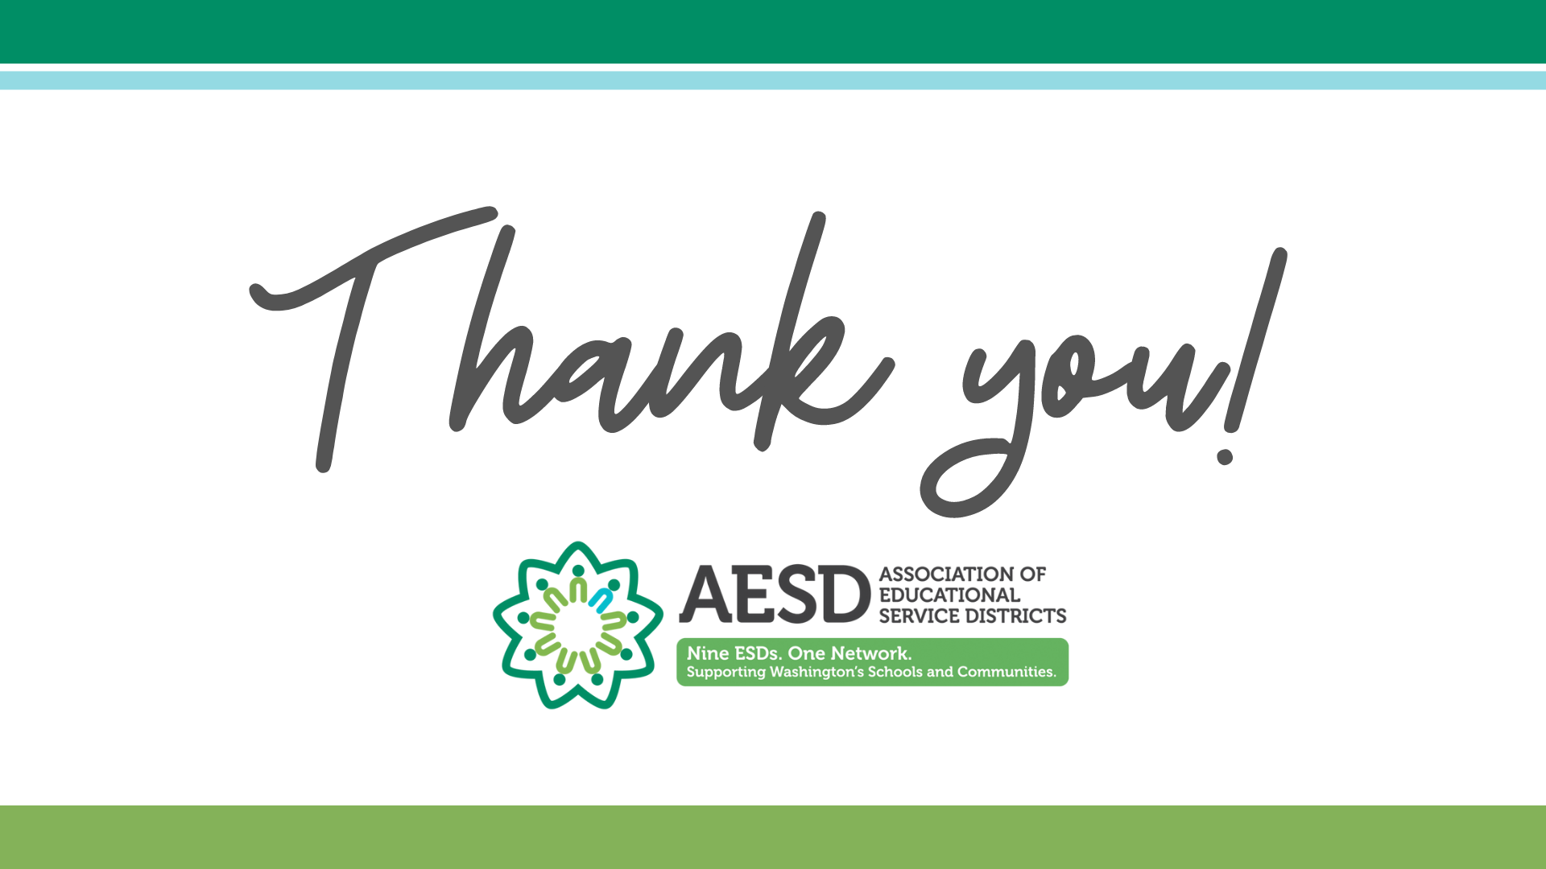
Please reach out for more information:
Erin Wick – ESD Network Behavioral Health Student Assistance Program Lead ewick@esd113.org

