Slide 1
Bree Collaborative Meeting
July 23rd 1-3PM
Hybrid

Slide 2
Before We Begin…
The meeting is hosted as a Zoom Webinar
When you log on, you are automatically an “Attendee”
As an attendee, you are automatically muted and are unable to turn on your video or sound.
Bree Staff will promote Bree Members to a “Panelist” so they are able to speak and share their video with the meeting group
Please notify Bree staff in the chat if you are attending the meeting on behalf of a Bree Member. Bree staff will promote you to “Panelist”

Slide 3
Public Comment
As a member of the public, you are an “Attendee” in the meeting and cannot unmute yourself or share your video.
If you would like to provide a public comment, please raise your hand by clicking the button at the bottom of your screen.
Bree staff will call on you to speak and promote you to a “Panelist.”
As a “Panelist”, you will be able to unmute yourself and share your video to provide your comment.
After you have commented, Bree staff will move you back to an “Attendee” for the meeting.

Slide 4
Agenda
Welcome & Introductions
Action Item: Adopt May Minutes
LGBTQ+ Report Updates & Reaffirm
Evaluation Updates
2026 Topic Nominations, Discussion & Vote
Next Steps and Close
Notes:
Welcome and Introductions
Staff Updates
Action Item: Adopt July Minutes
Proposed Bree Topics for 2024
Review
Discussion
Public Comment
Vote on Final 3 topics
Next Steps and Close

Slide 5
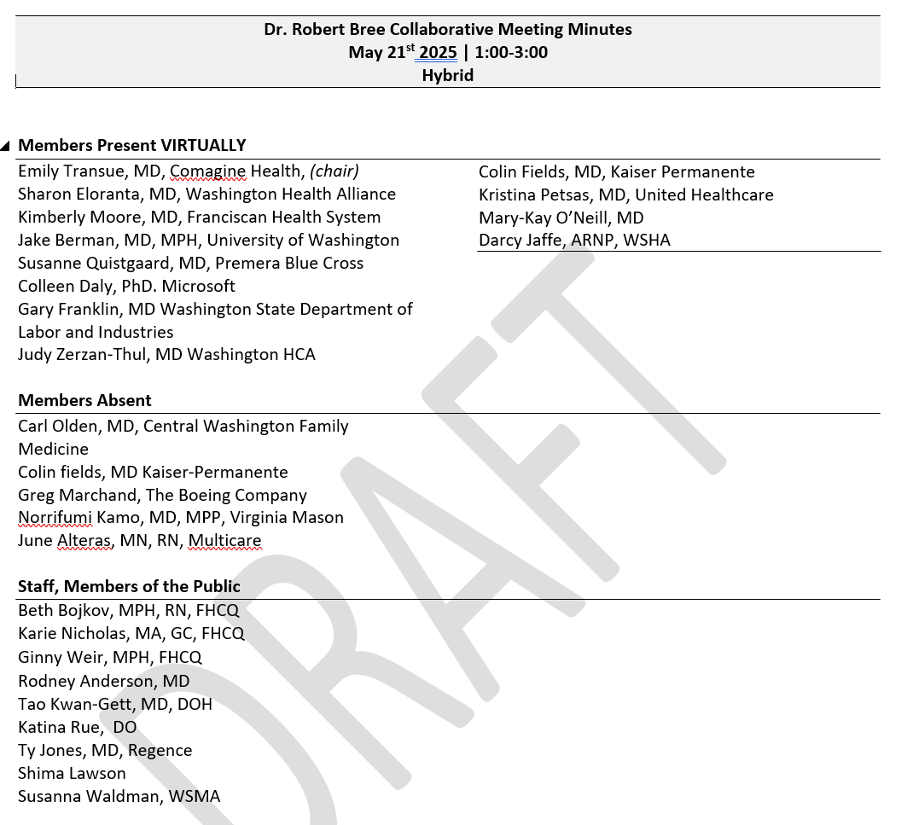
Minutes

Slide 6
LGBTQ+ Report Updates

Slide 7
Report Categorization
Active/Reaffirmed | Needs Review | Inactive
AGE: < 5 years old EXTERNAL PARTNERS: External partners should actively implement and evaluate STAFF IMPLICATIONS: Can do active evaluation and implementation work Reaffirming is restricted to the stakeholder specific guidelines in each report, excluding background/problem statement sections | AGE: 5+ years EXTERNAL PARTNERS: Do not roll back implementation of previous guidelines, Follow more updated guidance if available – Bree members can point to where that might be if possible STAFF IMPLICATIONS: Passive implementation and evaluation efforts | AGE: 5+ years EXTERNAL PARTNERS: labelled on website as inactive; Bree staff indicate other relevant sources with more updated information STAFF IMPLICATIONS: halt implementation and evaluation efforts

Slide 8
LGBTQ+ Report Updates(2018)
Pediatrics HEADSSS assessment
Recommended syphilis screening frequency
For individuals on Apretude, HIV screening recommended every 2 months.
Approval of Lenacapavir Q6month injection for PrEP (FDA approved mid June 2025). HIV screening recommended every 3 months.
Doxy-PEP Recommendations
Recommendations needed for anal cancer screening, conducting a DARE, anal cytology, and high resolution anoscopy (ANCHOR Study published)
Immunization for HPV recommended through age 45 for people living with HIV
Cervical cancer screening recommended every 3 years for people living with HIV
Goal: Reaffirm the LGBTQ+ Report and Guidelines

Slide 9
Primary Care Providers: HEADSSS
H: Home
E: Education & Employment
A: Activities
D: Drugs, Smoking & Alcohol
S: Sex & Relationships
S: Self-Harm, Depression & Self-Image S: Safety & Abuse
Notes:
List reference

Slide 10
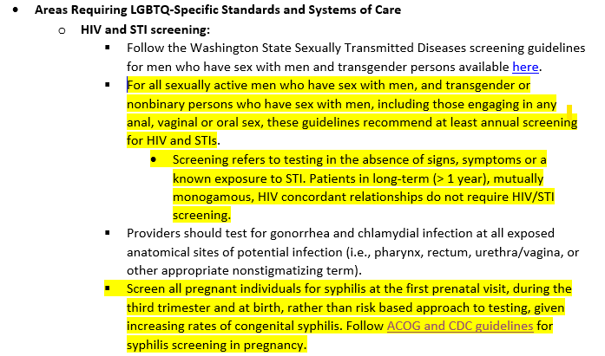
Primary Care Providers: HIV/STI Screening
Notes:
Updated USPSTF guidelines for syuphilis infection in nonprenant agults and adolescents – screening, and screening for syphilis in prengnat from ACOG 2024

Slide 11
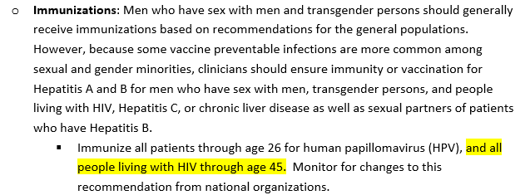
Primary Care Providers: HPV Immunization
Notes:
AIDS institute guideline published 2022 Screening for Cervical Dysplasia and Cancer in People Living with HIV

Slide 12
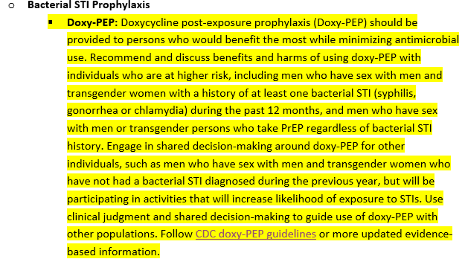
Primary Care Providers: Doxy-PEP
Notes:
CDC Guidelines on the use of doxycycline postexposuyre prophyulasix for bacterial sexually transmitted infection prevetntion 2024

Slide 13
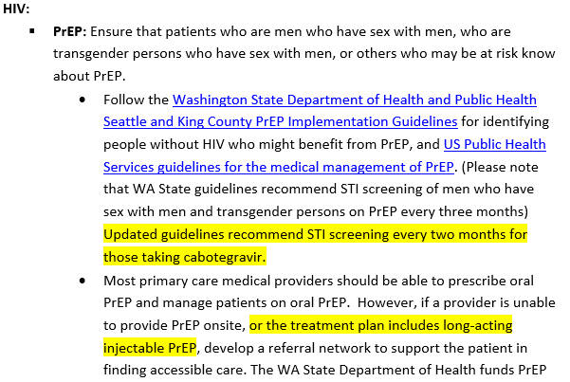
Primary Care Providers: PrEP

Slide 14
Primary Care Providers: Cervical Cancer Screening for People Living with HIV
Notes:
AIDS institute guideline published 2022 Screening for Cervical Dysplasia and Cancer in People Living with HIV

Slide 15
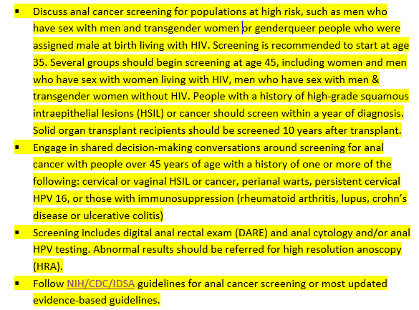
Primary Care Providers: Anal Cancer Screening
Notes:
Last to draft is updated guidance related to STI screening for people on PrEP with new medication approved by FDA in June, (lenacapavir) waiting ot hear back from Colin on changes
Anchor (anal cancer HSIL outcomes research) study published in 2022 showing among participants with biopsy proven anal high grade squamous intraepithelial lesions (or HSILs) the risk of anal cancer was significantly lower with treatment for anal HSIL than with active monitoring.
Updated anal cancer screening guidelines according to NIH/CSC/IDSA and IANS guidelines for anal cancer screening or most updated evidence-based gudielines

Slide 16
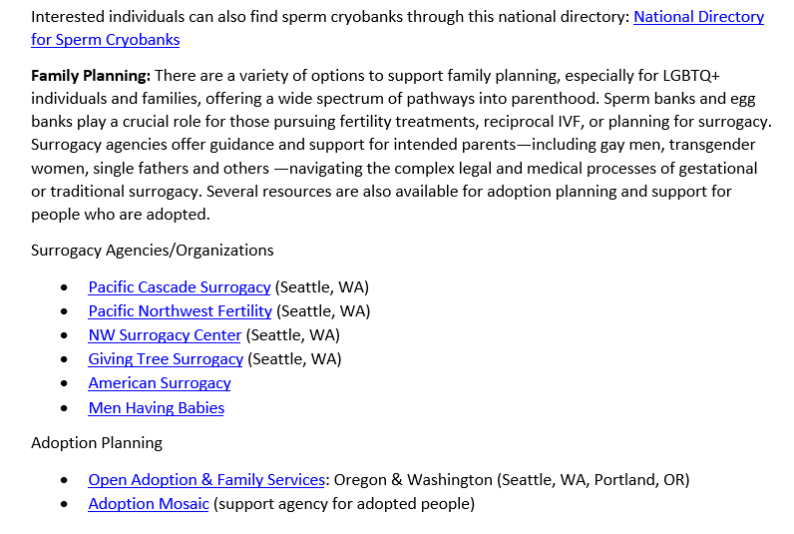
Appendix E: Family Planning and Fertility
Notes:
Updated Family planning and fertility appendix

Slide 17
Public Comment
Notes:
Allow 2-4 minutes for public comment,
If there are any considerations Bree members would like to raise or topics that were not discussed that they would like on the voting block, please let us know.

Slide 18
BREE MEMBERS ONLY – Vote for Reaffirmation
Motion to Reaffirm
Vote: Aye/Nay
Results

Slide 19
Evaluation Insights

Slide 20
Key Challenges and Barriers
Alignment of topics with other organizational initiatives in Washington State
State and federal budget constraints
Federal changes to requirements, regulations, and standards
Measurement and data
Staffing
Licensing scope – CEU available
Innovation

Slide 21
Setting ourselves up for success
Usefulness to organizations that can make systems transformation
Availability of utilization data
Availability of outcomes/impact data
Clear distribution path or support
Clear strategy on how to evaluate or influence resource distribution
Clear goal
Clear value add
Notes:
These are some of the things that stakeholders have talked about
Example of usefulness to organizations that can make systems transformation is our opioid work, as a whole – are there topics that will be a value at to previous work?

Slide 22
Feedback from stakeholders
Employer payors are ahead of the curve on their benefits design
Topics that are a priority to companies with a global footprint and to small, rural organizations
Legal/regulatory barriers not addressed in Bree recommendations
Room for innovation
Profitability
Importance to providers
Notes:
Feedback from multiple stakeholders –
is there a place to make change using the heft of employer/purchasers – employers have been active in creating an employer “framework” for making recommendations that are actionable.
This centers mostly on whether or not vendors are available, can be partners, and how they can evaluate their fidelity with best practices (what should they look for)
Large providers are looking at national priorities and small providers are looking at patient priorities. – example of discord are things like SDOH, behavioral health (if resources simply don’t exist in rural communities' others are less likely to take it up)
Some topics have not been implemented because they are not innovative enough for some stakeholders and they are too innovative for others (i.e. they don’t have time or resources) – examples Perinatal Behavioral Health.
Feedback from critical access hospitals includes recommendations that the Bree, HCA, and WSHA priorities and measures to be aligned. Although stakeholders recognize that profitability should be a secondary concern, it is a necessary component for them. Many stakeholders feel that BOTH importance to providers and to patients is key to successful buy-in.
Garnering provider support and understanding of the topic is a factor for ALL stakeholders.

Slide 23
Can we evaluate the outcomes and impact?
What | How
Tools | Score cards, evaluation frameworks, collaborative banks,
Evaluation processes | Evaluation subcommittees, awards program
Changes to guidelines development | Retirement and revision, employer “score card” - things that support better evaluation
Measurement | Aligned process measures, aligned outcomes measures
Outreach | Initiatives, webinars, forums
Examples of Implementation | Evaluation submissions, dashboards, case studies,
Data collection | Leveraging FHCQ program data, automated system for score cards, event attendance, etc.
Notes:
Will the people who are implementing this topic be able and willing to utilize tools to measure success? Access to data, staff time, staff understanding, evaluation resources.

Slide 24
2026 Topic Selection

Slide 25
Where have we seen adoption?
24 with over 42 different delivery sites report partial or complete adoption of Bree Guidelines (June 2025)
Organizations represent health plans, health systems, hospitals, employers, educational service districts, critical access hospitals, networks, QI organizations, chiropractors, and state agencies.
Data limited, reflects more recent guidelines
Topics | Percent Implementing
Behavioral Health | 85.7%
Chronic Disease Management | 47.6%
General (e.g., Primary Care, LGBTQ+, SDM) | 42.8%
Oncology | 38.1%
Managing Pain | 21.4%
Aging | 14.3%
Infectious Disease Management | 14.3%
Care transitions | 11.9%
Surgery | 9.5%
Reproductive and Sexual Health | 7.1%
Notes:
Below are summaries of the categories and specific reports for those that have participated in the reporting initiative so far. These data do not reflect the total uptake across the State of Washington, particularly for those reports that have other implementation mechanisms such as SCOAP and Spine COAP, OB COAP, Cardiac COAP, etc. and they are subject to reporting bias. However, these data are useful to help us better understand general trends among those who did report, which includes organizations that are not typically represented in Bree workgroups or on the Bree board itself.

Slide 26
Who submitted the data?
Notes:
https://www.qualityhealth.org/bree/evaluation/bree-collaborative-reporting-initiative/

Slide 27
2026 Topic Nominations

Slide 28
Process Overview
Review nominations from Bree members and the public
Discussion by Bree Collaborative members
Overview of topic selection worksheet
More detail on 10 topics selected from the above by Bree Steering Committee
Public Comment
Voting: Each Bree member votes for 3 topics (no preference order)
Top 6 topics developed further for final decision in September

Slide 29
Keep in Mind…
For each potential topic, ask yourself:
What key gaps or barriers are preventing improvement in Washington?
What unique role would Bree have in improving outcomes for each of these topic ideas?
What are the relevant initiatives in Washington? Could we build on existing efforts?
What knowledge gaps remain before confirming this as a topic for 2026?

Slide 30
Bree Topic Nominations
Behavioral Health
Perinatal Opioid Use and postpartum opioid use disorder treatment for birthing parent and newborn
Reproductive Health
Perimenopause and Menopause
Gestational Diabetes
Transitions of Care
Transitioning care for people released from carceral settings
Chronic Conditions
Medical Management of Overweight and Obesity
Kidney Health
Managing Pain
Treatment of chronic pain in patients with opioid use disorder
Notes:
13 total nominations from Bree members
Highlighted ones are the nominations with cross over

Slide 31
Bree Topic Nominations
General
Identifying and addressing health-related social needs in care delivery
Access to claims data on BH/MH
Trauma-informed care
Oncology
Tobacco/Nicotine Cessation and Lung Cancer Screening
Prostate Cancer Screening REVISION
Oncology Care REVISION
Infectious Disease
Vaccinations: current status in WA for children and adults, and best practices
Screening and treatment of STIs, particularly syphilis, given WA high rate of congenital syphilis

Slide 32
Public Topic Nominations, N=24
Notes:
Most delivery system respondents were health system, clinicians or Hospital/ER
Payors were both employers
Patient/community, some were from nonprofit org
State agencies were HCA, DOH, and OIC

Slide 33
Public Topic Nominations
Behavioral Health
Improve primary care quality and reporting capacity for depression using measurement based care
Influencing prescribing and monitoring practices for SSRIs
Pediatric autism diagnosis and support post diagnosis/support for rural communities
Prescribing opioids for post-op pain revision
Chronic Conditions
Kidney Care
Prediabetes
GLP-1s for weight loss/GLP-1 receptor agonists usage for health conditions including obesity in adults and children
Transitions of Care
Transitions of care to the community after inpatient hospitalization

Slide 34
Public Topic Nominations
Reproductive Health
Perimenopause and Menopause
Paying for perinatal care driving/incentivizing evidence-based clinical care and outcomes and equity
STIs
Surgery
Lumbar fusion revision
Managing Pain
Low back pain revision

Slide 35
Public Topic Nominations
General
Management of clinically uncertain diagnoses
Collective wellbeing/strengthening families and communities
Governor Board and Commission Oversight
Vaccine hesitancy/immunizations
Access & affordability of dental care – annual maximums – dental fear and hesitation/preventive services
Social Needs
Loneliness/social isolation
Health literacy
Food security and nutrition
Housing/homelessness

Slide 36
Topics with Overlap (Bree + Public)
Topic Name
Weight Health
Kidney Health
Perimenopause/Menopause
STIs (syphilis specifically)
Vaccinations

Slide 37
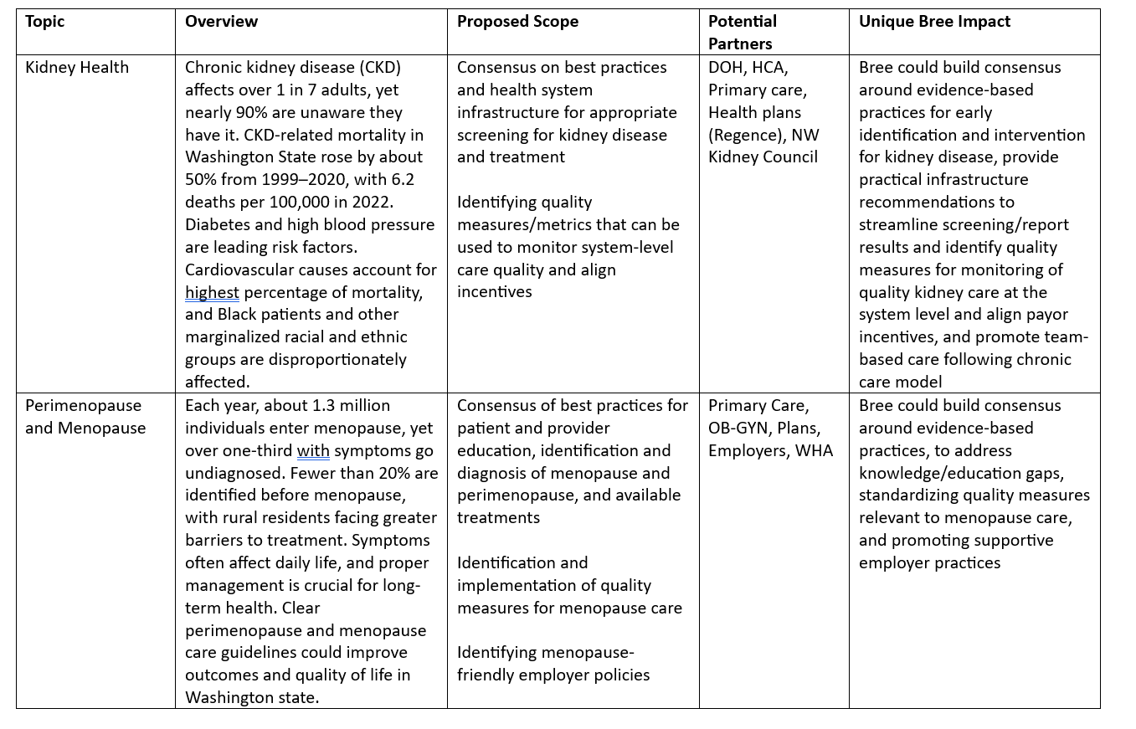
Topic Selection Worksheet
Oncology Care Revision
Alzheimer’s and Other Dementias Revision
Kidney Health
Perimenopause and Menopause
Measurement-based Depression Care
Treatment of Chronic Pain for People with OUD
Gestational Diabetes
Lung Cancer Screening/Tobacco Cessation
Pediatric Autism
Weight Health
Notes:
Topic selection worksheet
Next up we have several slides that focus on reviewing the overview and potential scope of each topic

Slide 38
Perimenopause and Menopause
Over 1 million people enter menopause each year, yet many experience symptoms for months/years before diagnosis with many peoples’ symptoms remaining un-mitigated, impacting quality of life, longevity, and overall health.
Bree’s Unique Impact
Address broad variation in care associated with major changes in evidence recent years
Build consensus on best practices, address knowledge/education gap
Standardize quality measures relevant to menopause care
Promote shared decision making
Address roles and impacts across the spectrum (provider, employer, etc.)

Slide 39
Kidney Health
Kidney disease often goes undiagnosed, disproportionately impacts marginalized communities, and has been causing increased mortality/morbidity and cost in Washington state, largely driven by cardiovascular causes.
Bree’s Unique Impact
Elevate awareness of huge missed opportunity to reduce population morbidity/mortality and costs
Consensus on & streamline infrastructure to support early identification and intervention
Identify quality measures, align payor incentives, and promote team-based care

Slide 40
Alzheimer’s and Other Dementias Revision
By 2040, dementia cases are predicted to double in Washington, many of which can be prevented or delayed through addressing modifiable risk factors and cared for better through improved diagnosis and wrap-around care models.
Bree’s Unique Impact
Uniquely positioned to convene the many partners needed to support patients and families with this complex condition
Update state of the science and develop consensus on best practices
Promote coverage model supporting caregivers and team-based care

Slide 41
Oncology Care Revision
Nearly 40% of people will be diagnosed with cancer in their lifetime, and rising rates of preventable emergency room visits/hospitalizations highlight the need to address complications/side effects of novel cancer therapeutics
Bree’s Unique Impact
Update consensus guidelines on best practices to avoid ED/hospitalization for patients receiving novel cancer therapeutics, bringing perspectives and addressing roles of multiple partners in the system
Align payor strategies to support and/or reward prevention of avoidable admissions/ED visits

Slide 42
Measurement-Based Depression Care
Almost 1 in 4 people in Washington experienced depression in 2020; measurement-based depression care can effectively reduce symptoms severity but requires sustained system-level implementation support for widespread adoption.
Bree’s Unique Impact
Promote evidence-based guidelines for measurement-based depression care
Support implementation of quality measurement and reporting
Facilitate use of depression remission in VBP arrangements

Slide 43
Treatment of Chronic Pain for People with OUD
About half of people living with OUD also experience chronic pain, facing compounded stigma and limited provider expertise in managing co-occurring conditions
Bree’s Unique Impact
The Bree and AMDG are uniquely situated to fill an important knowledge gap for providers
Reduce cost-related barriers to non-opioid and nonpharmacological treatments
Address compounded stigma and bias in the healthcare system through education, training and policies

Slide 44
Gestational Diabetes (GDM)
Gestational diabetes affects about 7% of pregnancies, disproportionately impacts marginalized communities, and raises risk for both parent and child; early prevention, identification and management can significantly improve outcomes
Bree’s Unique Impact
Multi-partner approach needed to improve outcomes
Build consensus on prevention, screening and care through pregnancy and beyond
Reduce administrative or cost barriers to care
Sustainability of change through VBP arrangements/quality monitoring

Slide 45
Lung Cancer Screening (LCS)/Tobacco Cessation
Early detection significantly raises lung cancer survival rates, but few eligible people get screened; smoking-related healthcare costs are in the millions, and evidence-based interventions are inconsistently offered and used.
Bree’s Unique Impact
Provider and system barriers could be addressed through multi-stakeholder approach
Address patient and provider knowledge gaps
Build consensus on standards and systems for screening, documentation and referrals
Reduce payor barriers to cessation products and LCS, and address quality infrastructure for LCS

Slide 46
Pediatric Autism (ASD)
Autism affects about 1 in 31 8-year-olds in the U.S., disproportionately impacts marginalized populations and with significant challenges in accurate diagnosis and access to evidence-based therapies
Bree’s Unique Impact
Reduce clinical variation in screening and diagnosis
Identify existing evidence-based interventions/promising practices
Provide practical guidance for patients with limited care access
Align payors providing access to interventions with best evidence and support for patients and caregivers

Slide 47
Weight Health
Over 65% of Washingtonians experience overweight or obesity, facing stigma in healthcare and disparities in evidence-based care; comprehensive medical management can support weight health optimization and reduce chronic disease risk
Bree’s Unique Impact
Build consensus on best practices for patient-centered medical management of weight
Address systemic weight stigma and disparities in preventive care
Uplift comprehensive coverage for a range of weight management options
Promote inclusive employer practices

Slide 48
Bree Member Additional Input
Notes:
Other ideas that were not submitted already
This is your time as Bree members, if there are ideas that were not presented at all, or advoacyac for any particular topic, please share here

Slide 49
Public Comment
Notes:
Allow 2-4 minutes for public comment,
If there are any considerations Bree members would like to raise or topics that were not discussed that they would like on the voting block, please let us know.

Slide 50
Voting Instructions & Next Steps
Only Bree Members confirmed by the Governor’s office may participate in official voting
Pick your TOP 3 TOPICS
The order does not matter
Results will be displayed for further discussion

Slide 51
CONFIRMED BREE MEMBERS ONLY Voting Round 1

Slide 52
RESULTS

Slide 53
Keep in Mind…
For each potential topic, ask yourself:
What key gaps or barriers are preventing improvement in Washington?
What unique role would Bree have in improving outcomes for each of these topic ideas?
What are the relevant initiatives in Washington? Could we build on existing efforts?
What knowledge gaps remain before choosing this as a topic for 2026?

Slide 54
Public Comment

Slide 55
CONFIRMED BREE MEMBERS ONLY Voting Round 2
Notes:
Need 7 members that are appointed by the governor to maek quorum

Slide 56
RESULTS

Slide 57
Next Steps & Closing

Slide 58
Awards
Notes:
We will write a report summary. These organizations will present at the Washington Patient Safety Coalition Conference. Physical awards will be given at the September Meeting.

Slide 59
Bree Member September Retreat
September ^{24th}, 11AM-3PM IN PERSON
Location TBD, Lunch provided!
*Hybrid/virtual options will be available if unable to attend in person
Please let Bree Staff know if you are interested in presenting one of our topic choices in September!

Slide 60
Upcoming Events
Wednesday July 30th 12-1PM - Using Bree Collaborative Guidelines and Metrics to Inform Provider-facing Opioid Prescribing Dashboards
Wednesday July 30th 1-2PM - Errors, Emotions and Ethics: CRP & Caring for the Caregiver
October 16-17th 8AM-1PM – 22nd Annual Washington Patient Safety Conference
Notes:
Upcoming Events

