Slide 1
Health Disparity Action Plans
Report to QRL
Diabetes Disparity Action Plan
11/2025

Slide 2
Diabetes Disparity Action Plan
One year pilot project started in 10/2024 and ended in 10/2025
In two locations: Wenatchee Internal Medicine and East Wenatchee Family Medicine
Aim of Plan: Decrease the rate of uncontrolled Diabetes Mellitus in Hispanic and American Indian patients to reduce the disparity in rate of uncontrolled DM by 50% over the course of one year by introducing continuous glucose monitoring technology to those who are eligible for coverage by their medical plan and use of ADA standards of medical care for pharmacotherapy.
Two educational talks were given to each location on insulin dosing and administration, cgm interpretation, and use of newer classes of diabetes medications.
Endocrinologist did chart reviews and gave recommendations quarterly for every Hispanic, Black or American Indian patient who had uncontrolled diabetes and sent treatment recommendations to the patient’s primary care provider.

Slide 3
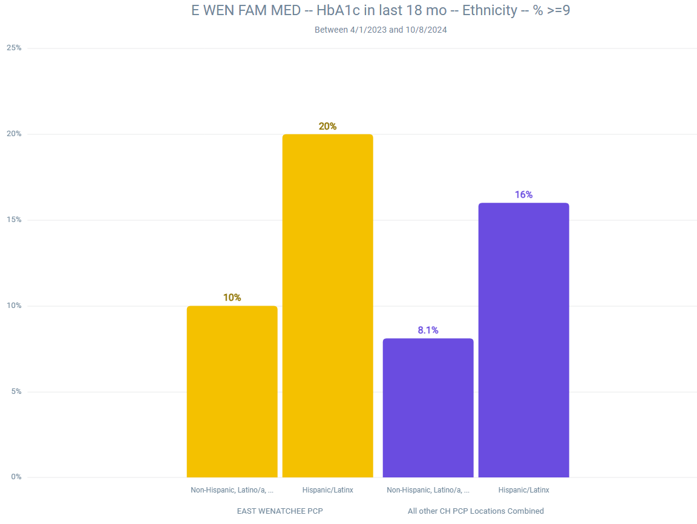
10/2024
Start of Pilot project in East Wenatchee Family Medicine
51/255
112/1120

Slide 4
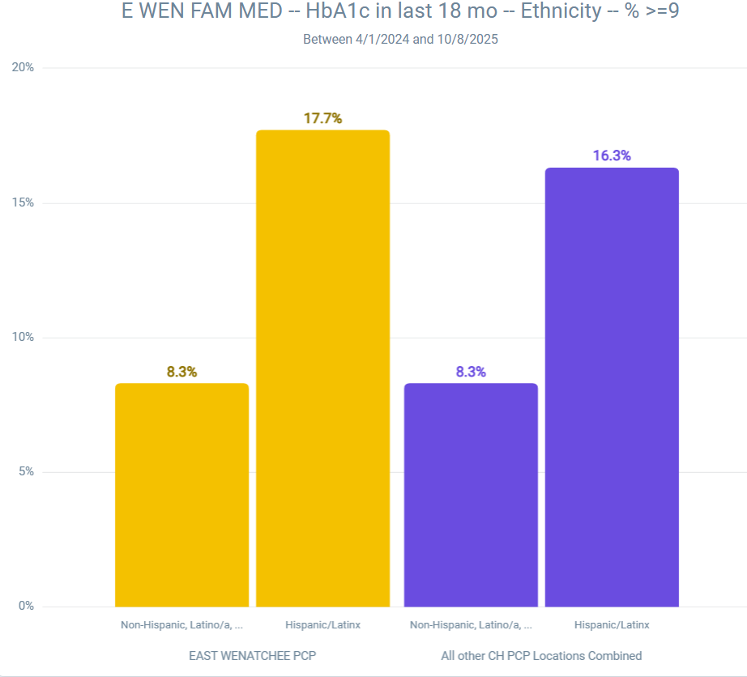
End of project-
East Wenatchee
Family Medicine
October 2025
51/288
308/1893
100/1203
644/7730

Slide 5
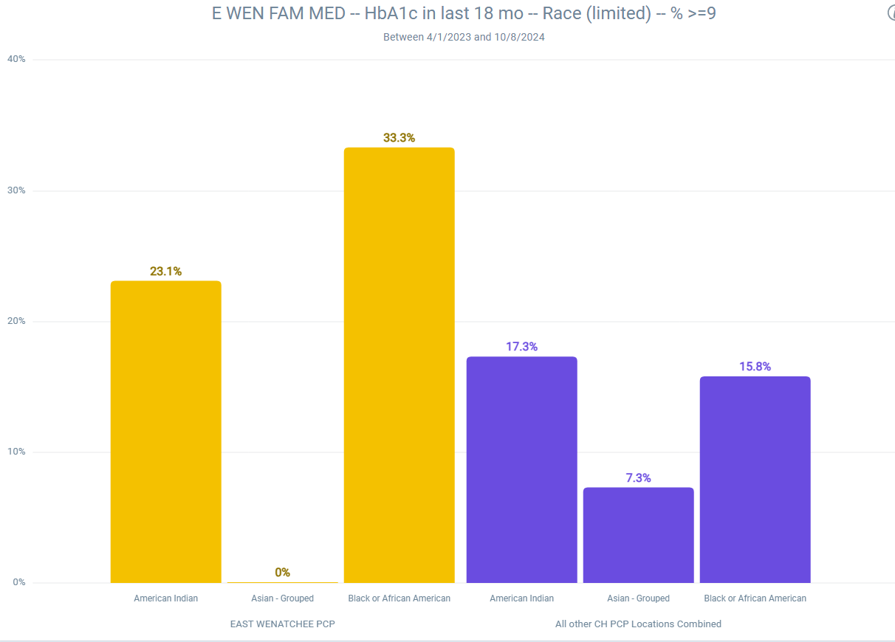
10/2024
Start of project
In East Wenatchee Family Medicine
3/9
3/13
0/17

Slide 6
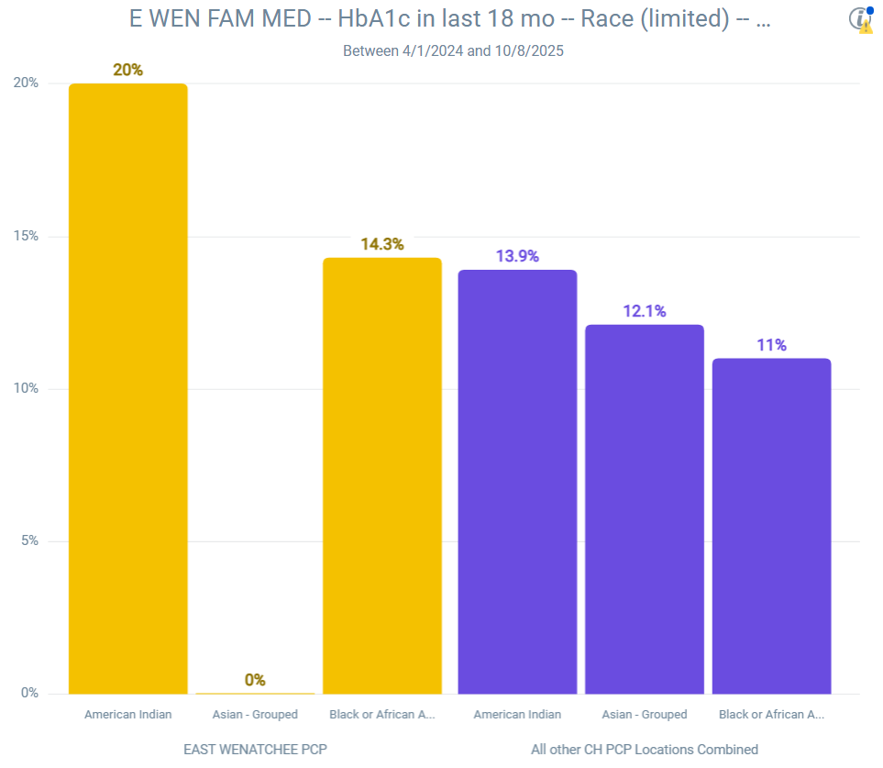
East Wenatchee
Family Medicine
October 2025
3/15
1/7
23/165
19/157
8/73
0/15

Slide 7
Diabetes Disparity Action Plan Results
East Wenatchee
Decrease in Percentage of Uncontrolled diabetes between 10/2025 to 10/2024
11.5% reduction in uncontrolled diabetes for Hispanic patients
17% reduction in uncontrolled diabetes for Non-Hispanic patients
57% reduction in uncontrolled diabetes for Black patients
13% reduction in uncontrolled diabetes for American Indian patients

Slide 8
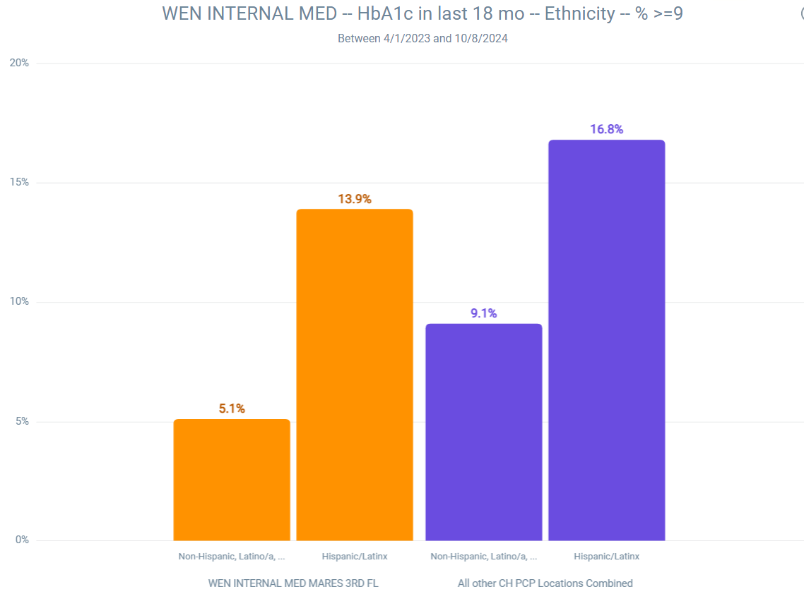
10/2024
Start of project in Wenatchee
Internal Medicine
22/158
78/1541

Slide 9
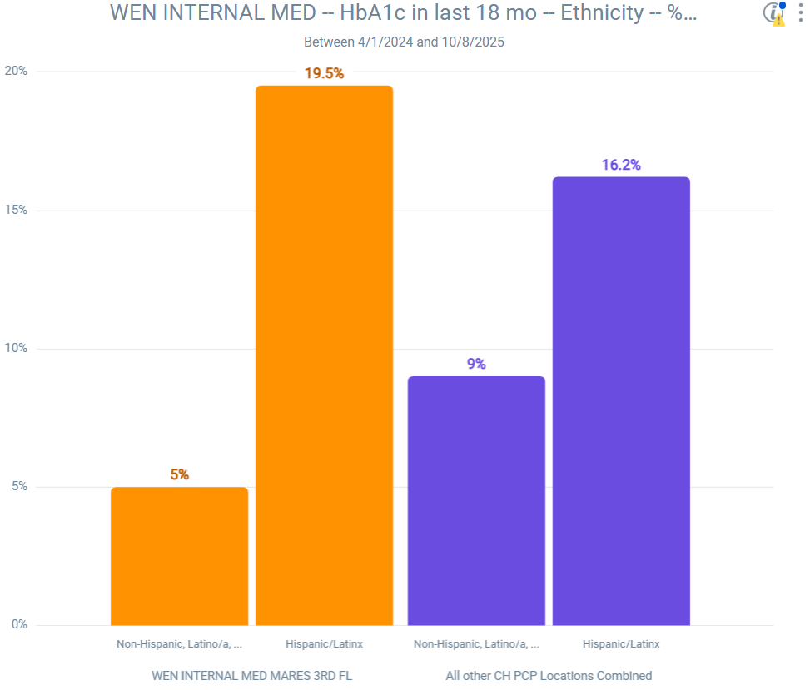
Wenatchee
Internal Medicine
End of project
October 2025
36/185
323/1996
664/7344
80/1589

Slide 10
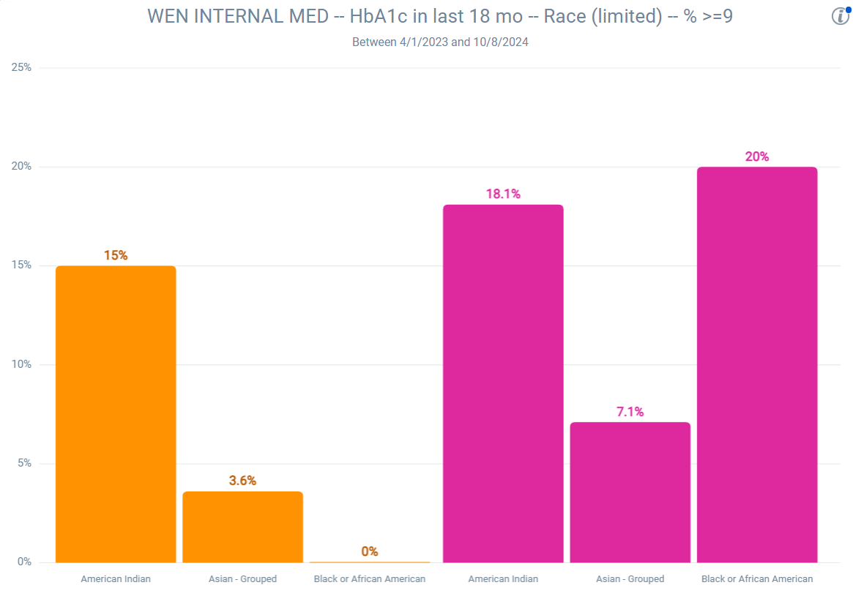
10/2024
Start of project in Wenatchee Internal Medicine
3/20
0/6
1/28

Slide 11
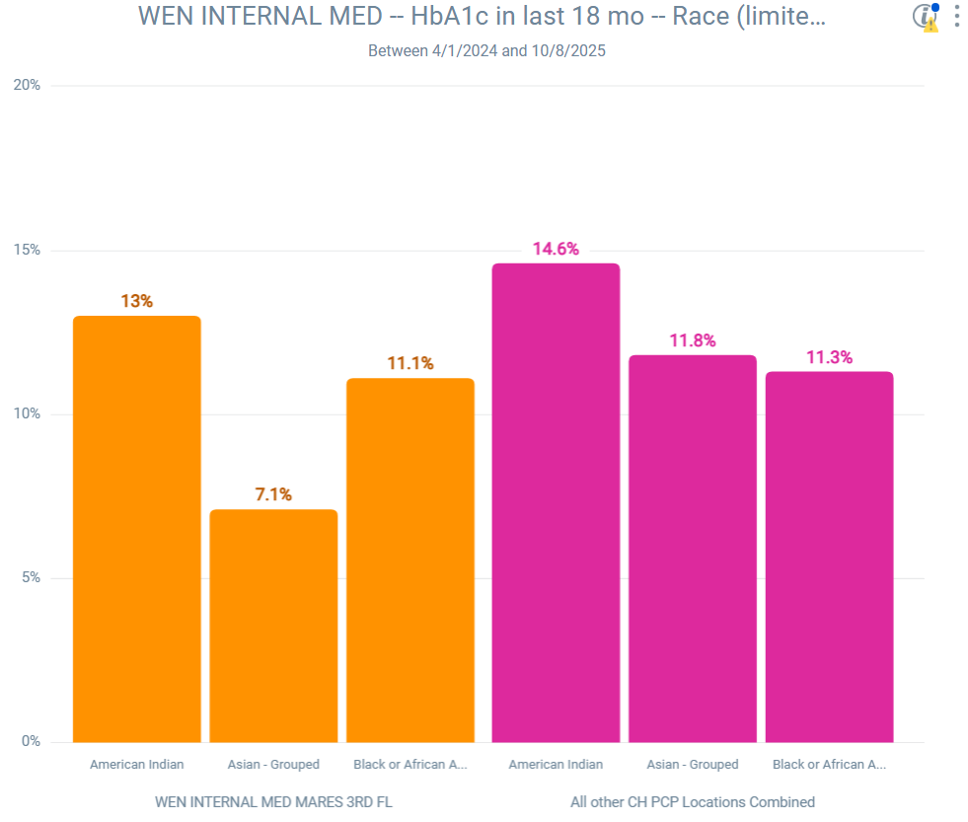
Wenatchee
Internal Medicine
End of project
October 2025
23/157
3/23
1/9
17/144
8/71
2/28

Slide 12
Diabetes Disparity Action Plan Results
Wenatchee Internal Medicine
Change in Percentage of Uncontrolled Diabetes between 10/2024 to 10/2025
40% increase in Uncontrolled diabetes for Hispanic patients
2% decrease in Uncontrolled diabetes for Non-Hispanic patients
13% decrease in Uncontrolled diabetes for American Indian patients

Slide 13
Analysis of results
Both clinics lost their embedded clinical pharmacists who managed a lot of patients for their diabetes during this period of time and they were not replaced.
East Wenatchee Family medicine had a workflow for downloading continuous glucose sensors and ordering sensors that was working fairly well.
Wenatchee Internal Medicine did not have a consistent workflow for ordering and downloading continuous glucose sensors.
Wenatchee Internal Medicine also had a lot of changes in clinic staffing and one provider was out on maternity leave for much of this period of time and many of her patients did not have follow up and fell within the category of Hispanic patients with uncontrolled Diabetes.

