Slide 1
ED and Outpatient visits for kids with asthma Observations during Wildfire Smoke episode in September of 2025
Bindu Nayak, MD

Slide 2
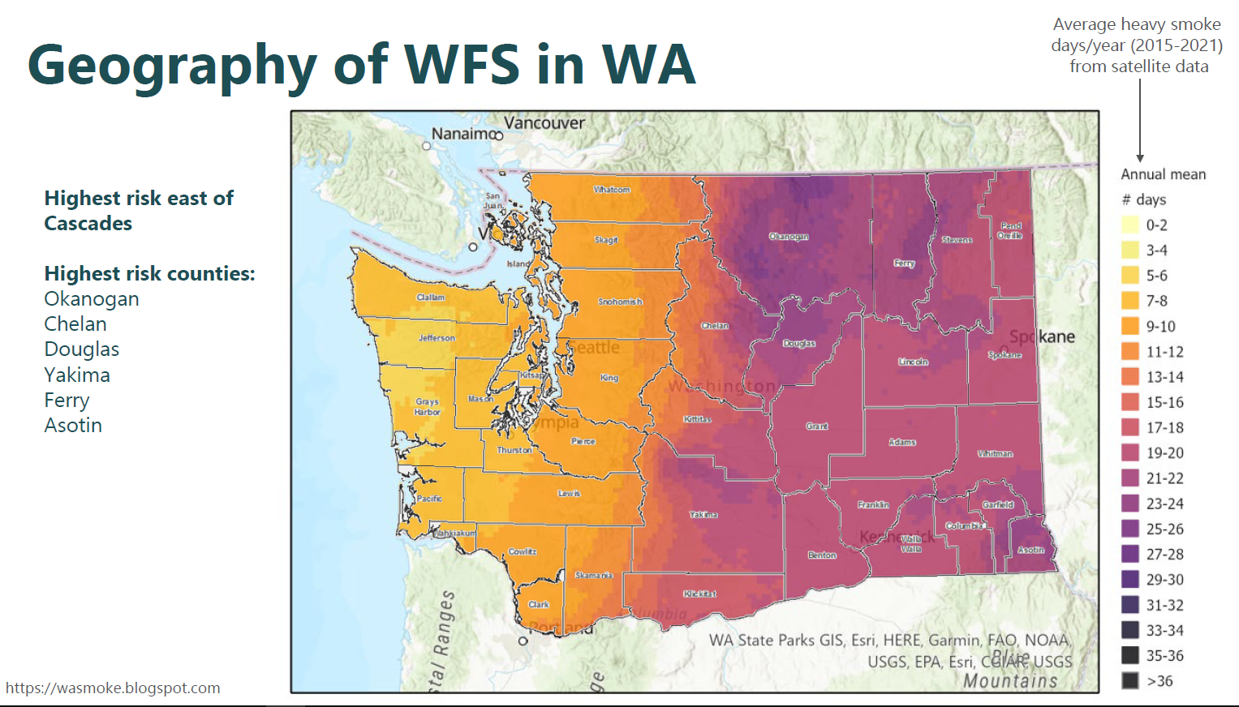
Recommendations of CGM use with disparity action planning
Continuous glucose monitoring is considered standard of care for people with diabetes on insulin.
Standard of care is a legal term- from a risk management perspective, a clinician should be able to demonstrate that their professional obligations to their patients are met.
Medicare and Medicaid cover the cost of continuous glucose monitors at variable levels for people with diabetes who use insulin.
Primary care clinics should be prescribing continuous glucose sensors for their patients with diabetes who are on insulin.
It will be important to understand that implicit bias does affect decision making when continuous glucose sensors are prescribed.
Among our patients who have diabetes mellitus, the incidence of uncontrolled diabetes is double for Hispanic/Latino individuals, American Indian individuals and for Black individuals.
It will be important to prescribe continuous glucose sensor use for all patients with diabetes who are on insulin.

Slide 4
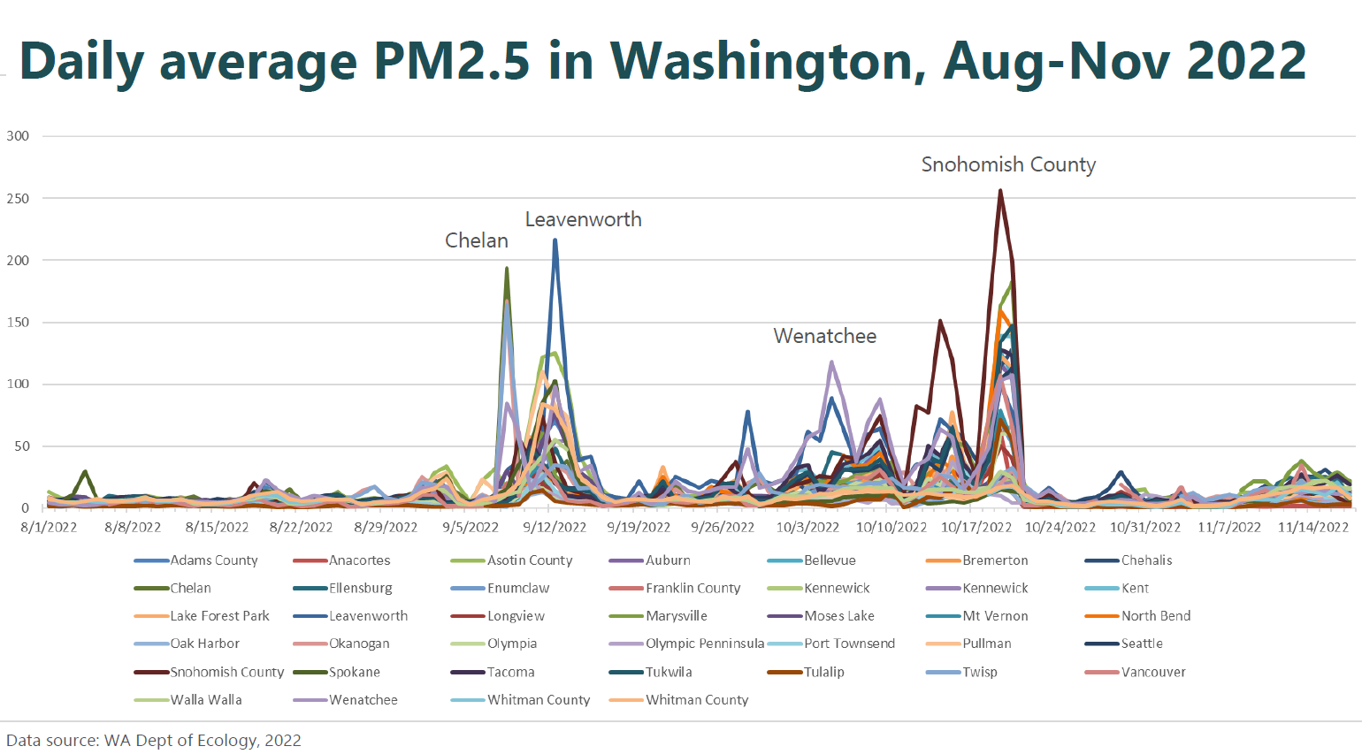

Slide 5
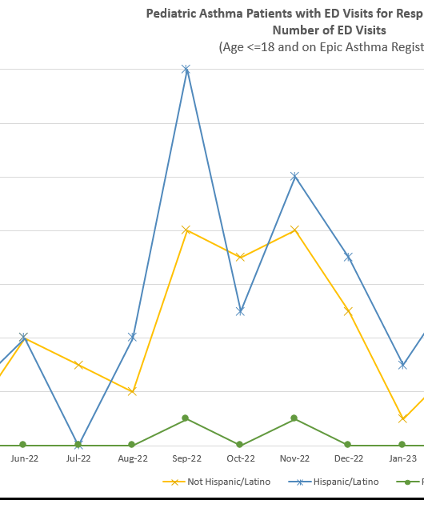
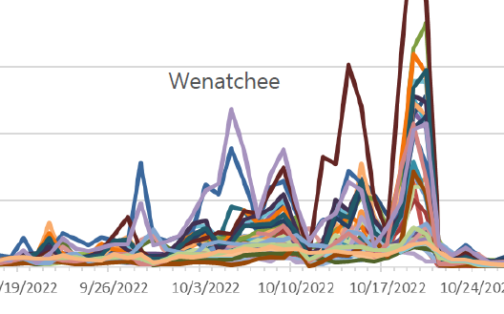
Comparison of Wildfire smoke PM2.5 and ED visits at Central Washington Hospital for kids with asthma

Slide 6
Root Cause Analysis
Within Confluence Health
Incidence of Asthma in primary care clinics
Completion of Well Child visits for kids with asthma
Assess difference in completion by ethnicity
Payer Distribution for kids with asthma with emergency department visits for asthma
Regional Historical Effects of Wildfire Smoke on Pediatric Asthma
Cardiopulmonary Effects of 2012 Wildfire Smoke in North Central Washington State, report by Department of Health

Slide 7
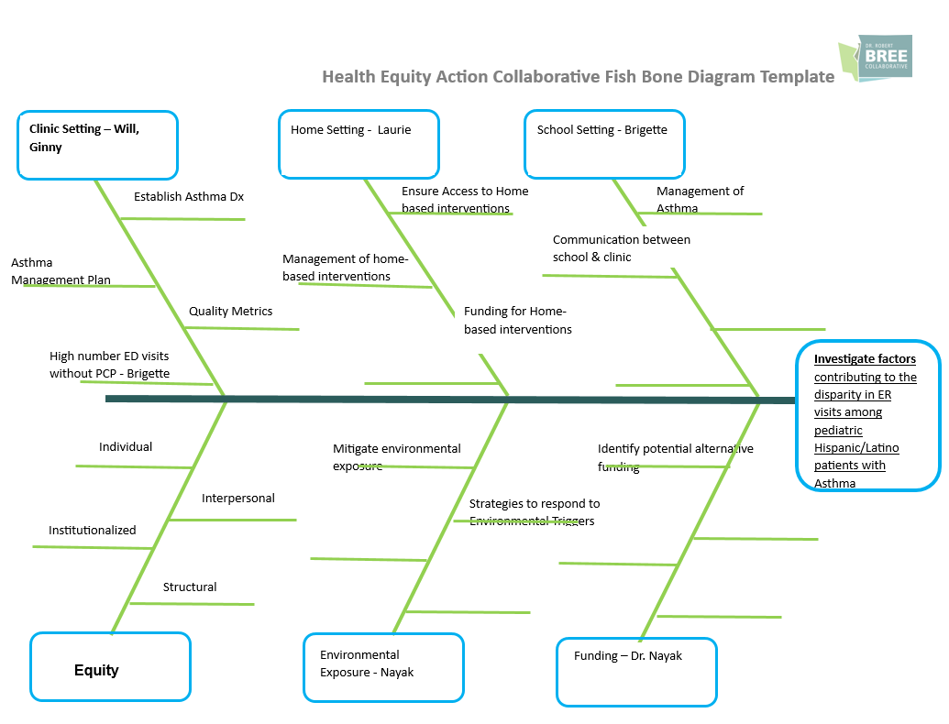
Bree Collaborative: Disparity in Respiratory distress ED visits for kids with asthma by ethnicity: Disproportionately higher visits for Hispanic/Latino kids with asthma

Slide 8
Analysis of Disparity in ED visits for kids with asthma
On the pediatric asthma registry, Hispanic kids with asthma had higher rates of well child visits with the primary care office.
Higher incidence of ED visits for Hispanic children with asthma
Analysis of practice in Primary care/pediatric clinic: asthma control visits are not regularly scheduled, and asthma action plans are not being utilized.
Effect of wildfire smoke data from 2012 wildfire confirmed a doubling of patient care visits for children under 18 with asthma in North Central Washington
Doubling of ED visits for children with asthma in wildfire season 2022 likely due to wildfire exposure also
For the majority of ED visits for children with asthma, the payer was Medicaid.
CDC study data from 10/2020 reveals greater percentage of low income households among Hispanic/Latino households surveyed in Wenatchee/East Wenatchee vs. Non-Hispanic households
Children with asthma living in low-income homes are disproportionately affected by environmental factors that can trigger asthma exacerbations.

Slide 9
Incorporating Bree Collaborative Pediatric Asthma Recommendations in Pediatrics Clinic
1. Clinic Setting
Asthma control visits: Starting Preventative visits for asthma control at least annually
Providing an Asthma action/management plan for all kids with asthma
Providing a Wildfire Smoke Action Plan for families with a child with asthma
2. Equity
Analyzing medical center’s data and tracking asthma disparities disproportionately affecting Hispanic children with asthma in the region
Providing more culturally appropriate education on asthma to families in clinic
3. Collaboration
Coordinate with community-based and government social and health programs:
Coordinating with Community based organization, CAFÉ, regarding educational outreach
Coordinating with Chelan Douglas Health District regarding distribution of box fan filters for use in wildfire season to families with children with asthma
Advocating for better coverage by Medicaid for HEPA air cleaners for children with asthma, especially considering that children with asthma in Washington state from low-income households are more at risk from exposure to fine particulate matter from wildfire smoke.

Slide 10
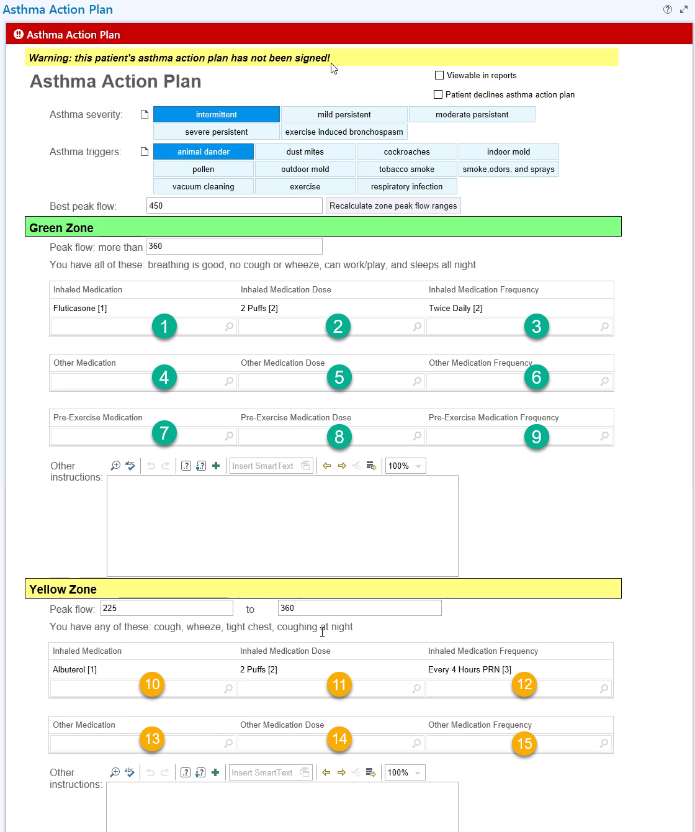
Asthma Action Plan
Available since 8/2024 for Confluence Health providers as a fillable form in the electronic health record in the pediatrics clinic
This gives the patient and family instructions on what to do with their asthma medications when they are having a mild, moderate or severe flare up of their asthma.

Slide 11
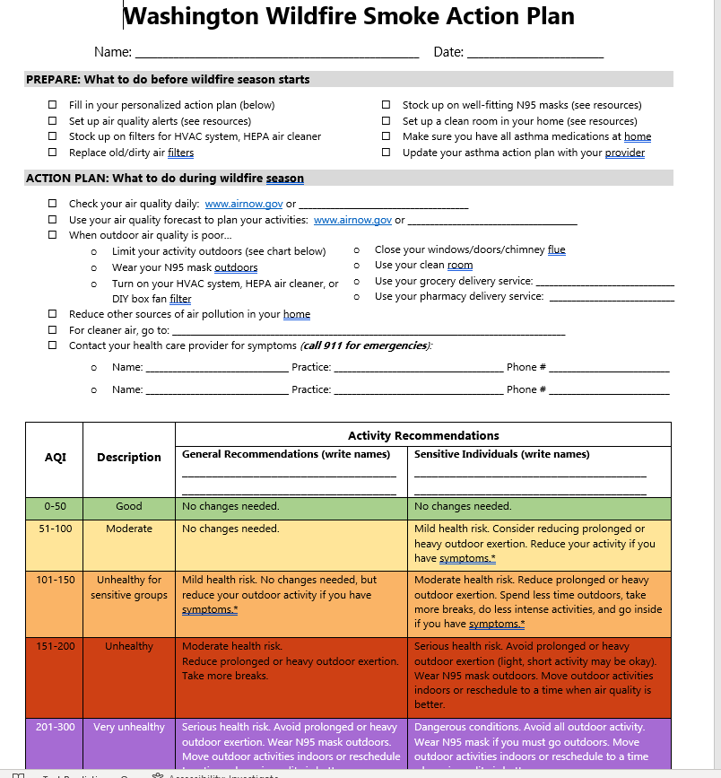
Created by Mary Crocker, MD, MPH- Pediatric pulmonologist at Seattle Children’s Hospital and researcher at University of Washington

Slide 12
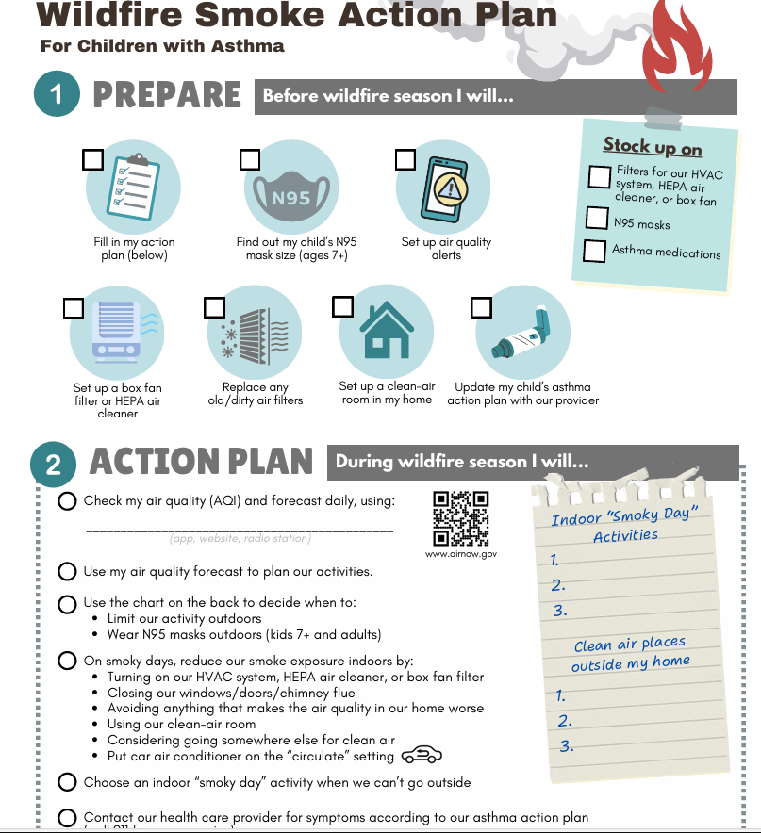
New edition version of the Wildfire Smoke Action Plan 2025
-created by Dr. Crocker with the Pediatric Environmental Health Specialty Units
Wildfire Smoke Action Plan 2025-08-06

Slide 13
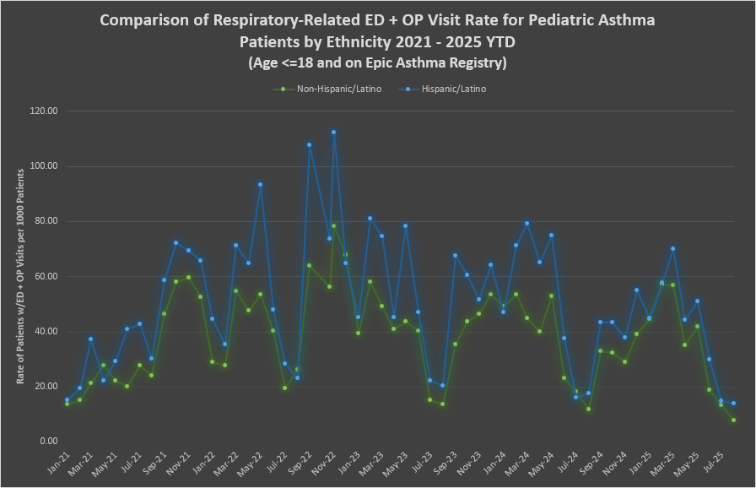
Wildfire smoke episode starts on Sunday, August 30, 2025 and continues

Slide 14
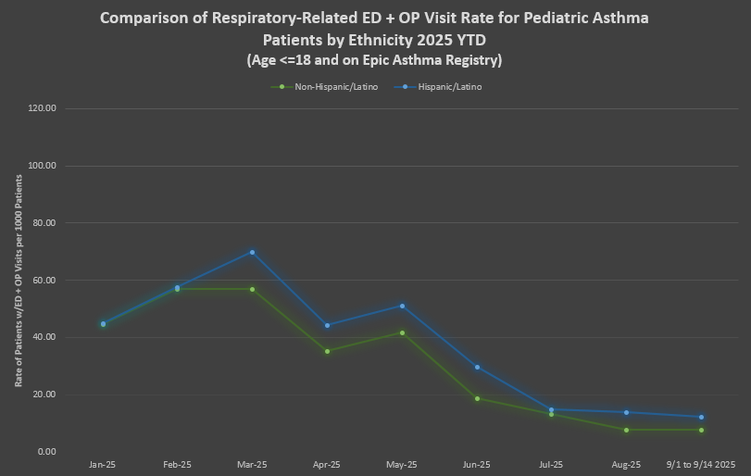

Slide 15
Wildfire Smoke episode starts on September 1, 2025 in Wentachee and much of North Central Washington

Slide 16
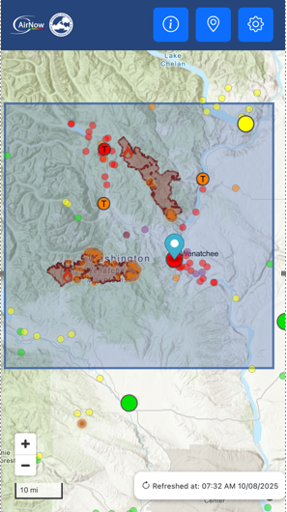
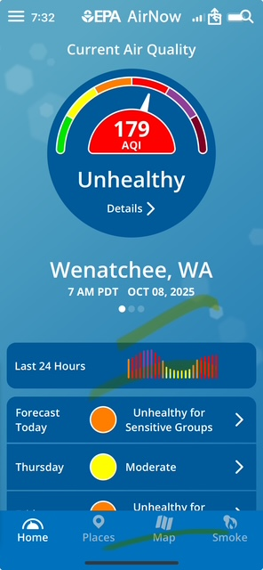

Slide 17
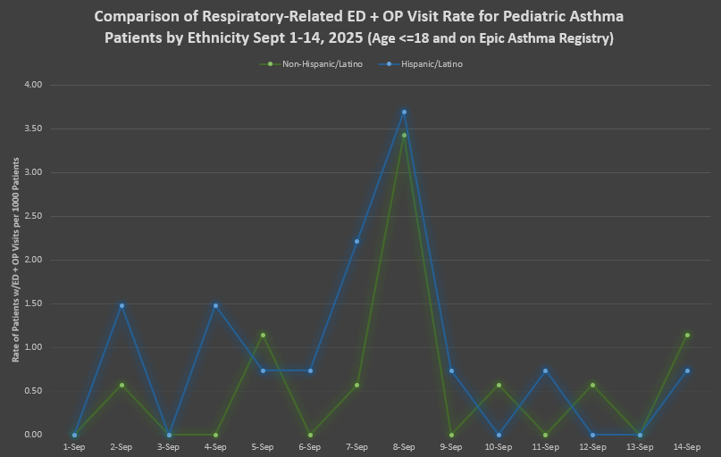

Slide 18
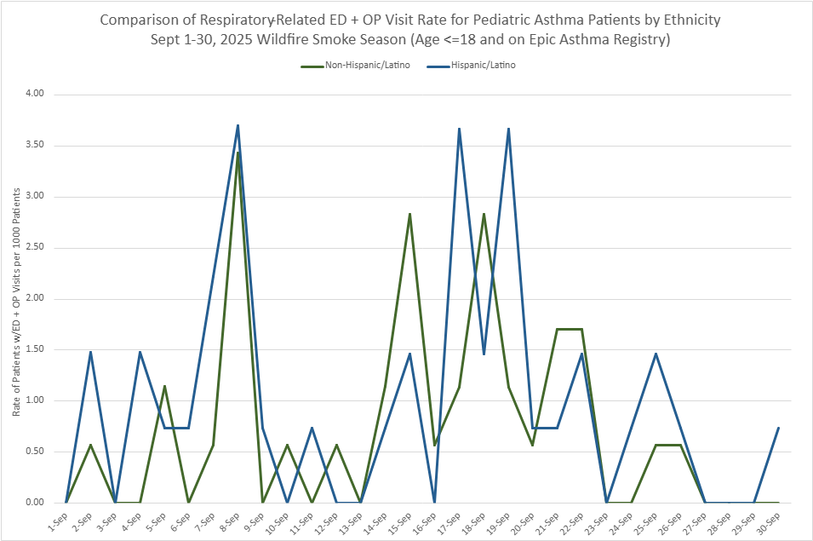

Slide 19
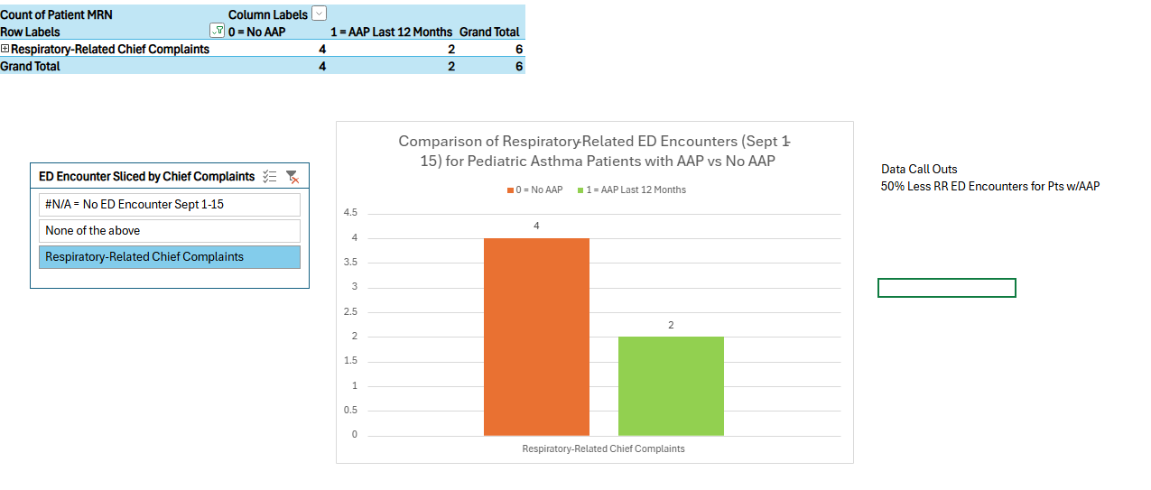
50% Less Respiratory related Emergency department visits for children with asthma who had an asthma action plan compared to children with asthma who did not have an asthma action plan on days 1-14 of the Wildfire smoke episode in 9/2025

Slide 20
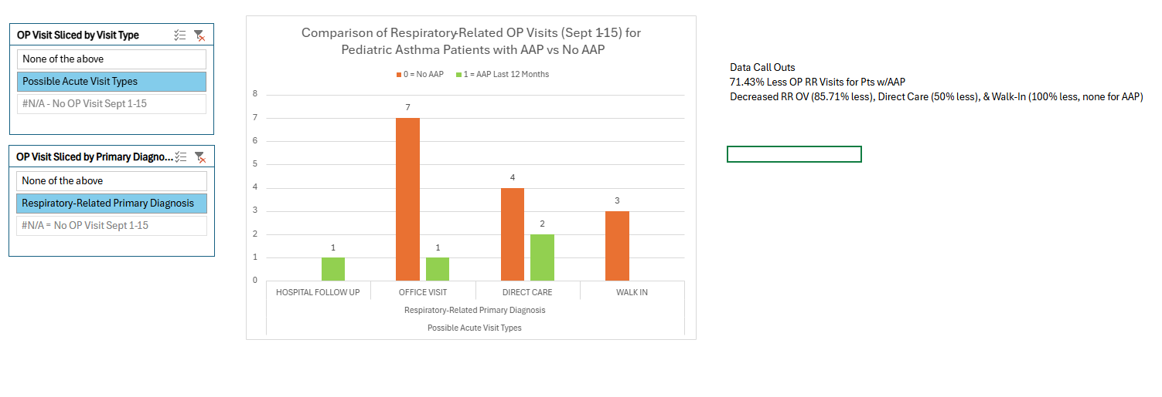
Outpatient visits for children with a diagnosis of asthma who have a Confluence Health PCP for respiratory problems between September 1-15, 2025
71% less outpatient visits for children with asthma who had an asthma action plan in place vs. children with asthma who did not have an asthma action plan in place between September 1-15, 2025.

Slide 21
Asthma Action Plan use and number of ED or outpatient visits
September 15-28, 2025

Slide 22
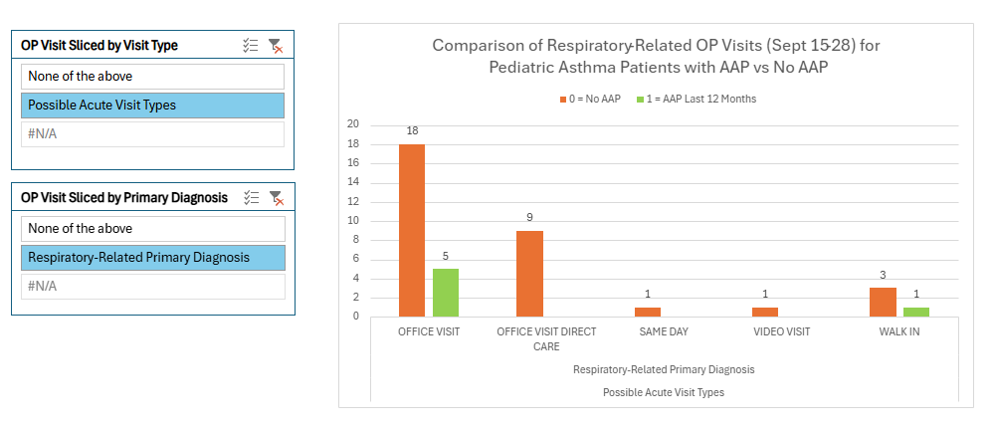
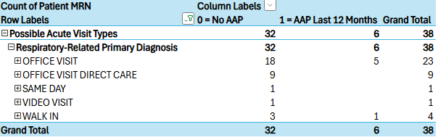
Outpatient visits for children with a diagnosis of asthma who have a Confluence Health PCP for respiratory problems between September 15-28, 2025
Patients with asthma who had an asthma action plan in their electronic health record had 81.25% less outpatient visits for respiratory problems in this two week period.

Slide 23
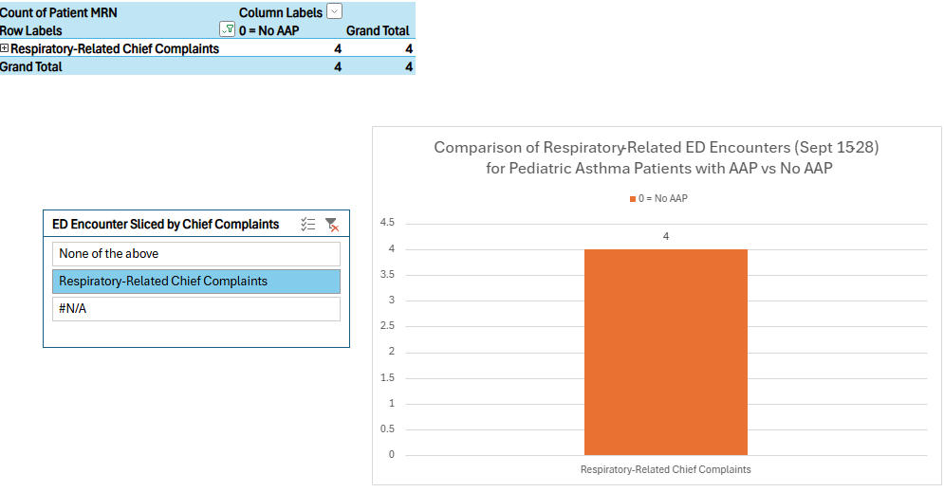
Between September 15-28, for patients with pediatric asthma who have a Confluence Health PCP, there were no kids who had an AAP who were seen in the ED. All four children who had asthma and a CH PCP and were seen in the ED did not have an AAP.

Slide 24
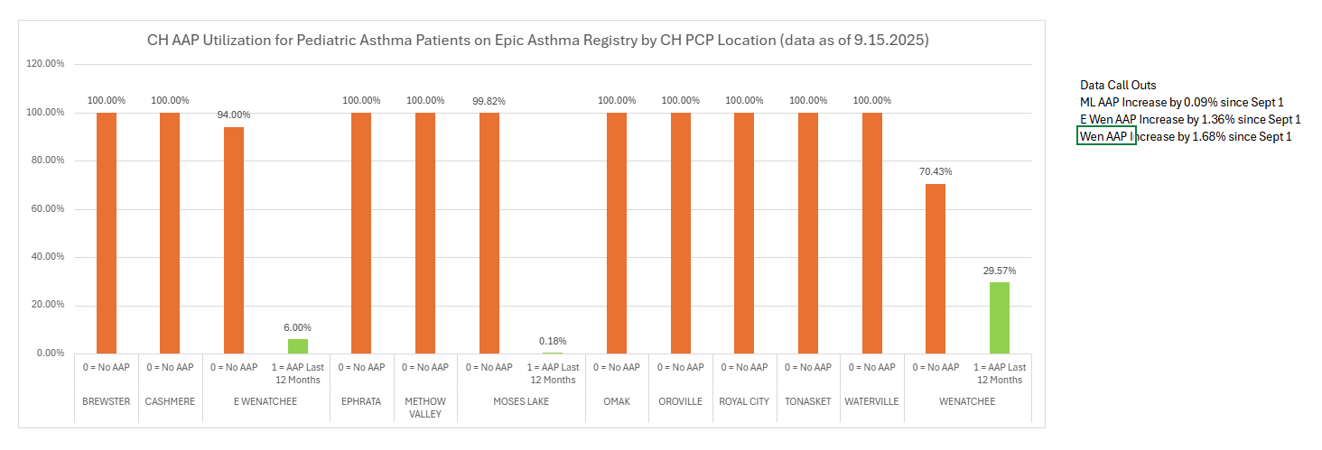
As of 9/15/2025, Wenatchee Pediatrics had the most uptake of Asthma Action Plans for kids with asthma with 30% of children with asthma having asthma action plans in place

Slide 25
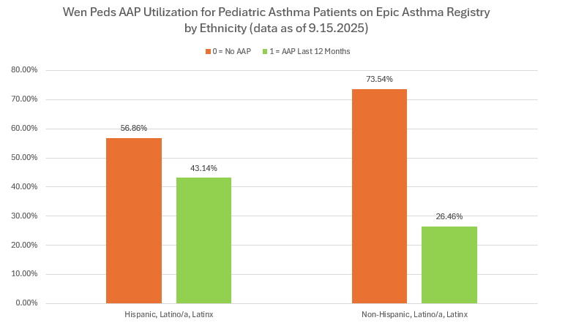

Slide 26
Results from 2 weeks post wildfire episode
50% Less Respiratory related Emergency department visit for children with asthma who had an asthma action plan compared to children with asthma who did not have an asthma action plan on days 1-14 of the Wildfire smoke episode in 9/2025
71% less outpatient visits for children with asthma who had an asthma action plan in place vs. children with asthma who did not have an asthma action plan in place during the first 14 days of wildfire smoke episode of 9/2025
Significant reduction in disparity of outpatient care visits for respiratory problems for children with asthma between Hispanic children with asthma and Non-Hispanic children with asthma at Confluence Health in comparison to 2022 wildfire smoke episode.

