Slide 1
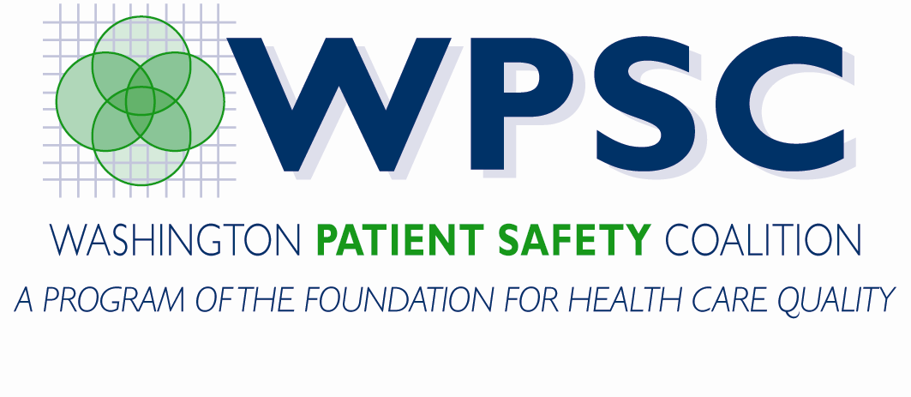
Medication Safety and You
Insert Speaker Information here
Insert your logo here
Notes:
Note: Often as a part of the introduction it is useful to ask how many people carry a medication list with them early on, to gauge your audience. If most of them carry a medication list already, you can use the talk to emphasize why, the importance of keeping it up to date and applauding them instead of starting at the basics.

Slide 2
Introduction¹
Adverse drug events are the sixth leading cause of death in hospitals and are responsible for 7% of all admissions.
Health & Human Services estimates that medication errors cost medicare 1.2 billion dollars
Over half of adverse drug events are preventable, a significant cause is incomplete medication information.
Keeping an accurate and up to date medication list will decrease your risk of an adverse drug event.

Slide 3
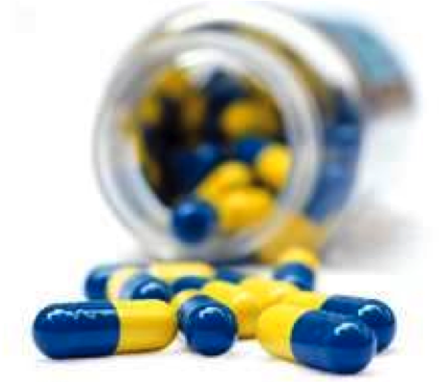
Overview of Presentation
Definitions
Medications
Be a Safe Patient
Simplify Your Medication Life
Conclusions
Questions

Slide 4
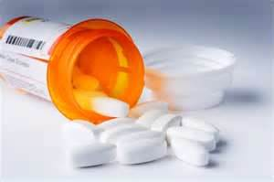
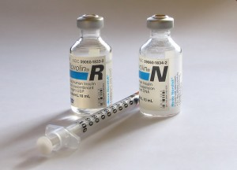
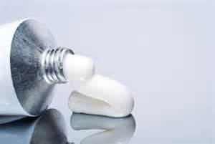
Definitions
Medication
  Prescription
  Herbals
  Supplements
  OTC
  Topical
  Brand vs. Generic
Notes:
Prescription: A medication that you can only take under a doctor’s guidance, they must write a prescription for this medication before it can be given to you. E.g. antibiotics, blood pressure meds.
Herbals: Medications that are derived directly from plants. These medications have often been used for thousands of years with little change. E.g. St. John’s Wort, Gingko Biloba
Supplements: These are often possible to get through your diet, but not always in as high of quantities as you body needs. E.g. Vitamins, Calcium.
OTC: Over the counter. These medications are available over the pharmacy counter instead of behind it (vs. rx drugs which are kept behind counter. These medications do not always require monitoring or guidance by a doctor to be used safely. E.g. Cough and cold meds, allergy medications, some pain relievers.
Topical: Usually creams and ointments, these are medications that have an effect exactly where you place them, like on your skin. Unlike systemic medications, medications often taken by mouth or injected that act all throughout the body, these medications are minimally absorbed and only treat the tissues that they touch. E.g. hydrocortisone cream, eye drops, flonase.
Brand vs. Generic: All medications have a brand and generic name. The generic name is the name of the active ingredient of a medication, for example acetaminophen. The brand name is the name of the medication when it is made by specific company, for example Tylenol. When a medication is new it is only available brand name because only the company that designed that medication is allowed to make it when it is new; later it will be available by the generic name as well. Some medications have more than one brand name, for example acetaminophen is most commonly known as Tylenol, but it can also be call Mapap, Q-Pap, Non-Aspirin Pain Reliever and many more, but they are all the same medication, acetaminophen.

Slide 5
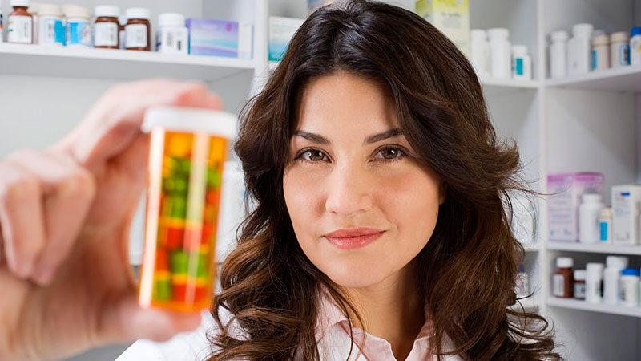
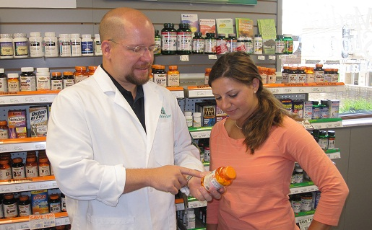
Definitions
Pharmacist
  A medication expert
Pharmacy
  Community
  Mail order
  Inpatient
Notes:
To become a pharmacist someone must attend a minimum of two years of college plus four years of pharmacy school. The degree that is given to new pharmacist is a Doctor of Pharmacy degree. Pharmacist have spent four years studying only medications, compared with physicians who only spend a fraction of their time in med school learning about medications. This is why pharmacists are considered medication experts. A pharmacist primary function is making sure that the right medication, at the right dose, with the right directions is given to the right patient at the right time. They also make sure that new medications will not cause problems with your existing medications or disease states. Another very important function of a pharmacist is teaching patients about their medications; we love to share our expertise so that you understand your medications better and can get the best possible results from them.

Slide 6


Definitions
Provider:
  Physician
  Dentist
  Naturopath
  Nurse Practitioner
  Physician’s Assistant
  Pharmacist in Clinic
Notes:
Think of a provider as someone who could write a prescription for you.

Slide 7
Medications
Notes:
Medications are one tool we use in our overall healthcare experience. They are employed for a variety of uses, and they have the potential to be both very beneficial and very harmful. While pharmacists are the medication experts, it doesn’t mean we want to put everyone on medications. In fact, if you talk to most pharmacists, they are more interested in the safe use of medications and ensuring patients are educated about what they are putting in their bodies.

Slide 8
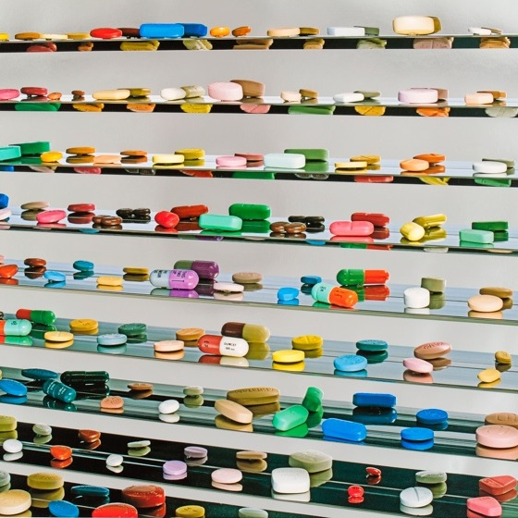
Role of Medications
Chronic
Acute
Preventive
Goal of Medications:
  Safe
  Efficacious
  Cost and time effective
  Benefit outweigh risk
Notes:
Chronic medications are also called maintenance medications. These are the kind of medications that once you start them, you often take them for the rest of your life. A common example of chronic medications are the medications used to lower blood pressure.
Acute medications are used to treat short term health concerns, often pain or infection. E.g. antibiotics or pain relievers.
Preventative medications are used to help prevent a health problem that you might experience in the future. One commonly used class of preventative medications are the statins, or medications used to lower cholesterol. With these medications the goal is not just to lower cholesterol, but to help prevent a serious health risk such as a heart attack or stroke.
Goals:
Safe: As always with medicine, we want to first do no harm. This means only using medications that are safe for you. For example, avoiding classes of medications that you have an allergy to, or avoiding medications that can increase the risk of falls.
Efficacious: Medications should do their job. If your are taking a medication to help lower your blood pressure, but your blood pressure is still too high, then that medication is not efficacious for you. It is not working. This may mean we need to alter the dose, review why it’s not working (
Cost and time effective: Medications should improve the quality of life. Continuing with the blood pressure example, if I told you I had a medication that would lower your blood pressure by 2 points but it costs $500 per month and requires weekly infusions, would you want to take it? Probably not. Medications should help make life better, not be an added burden.
Benefit vs risk: Finally the benefit of a medication should outweigh the risk. For example some medications that treat blood pressure also significantly increase the risk of falls. For a medication like this we would look at how high someone blood pressure is vs how high their risk of falls is. If increasing someone risk of falling is worse for their health than their blood pressure we would choose not to use that medication. But if the person’s blood pressure was very high and we were worried about heart attack or congestive heart failure it might be worth it to use the medication even though it can increase fall risk.

Slide 9
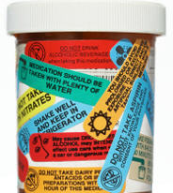
Adverse Events of Medications
Side effects: all medications have side effects
Some medications may not be appropriate in older adults.²
Decreased kidney or liver function as you age can increase your risk of an adverse drug event
Drug Interactions
Notes:
Side effects: All medications have side effects. Even water has side effects, if you breathe water it could cause you to drown! There is no perfectly safe medication, but your pharmacist will help ensure that you get the medications that are the safest for you.
Beers Criteria: a list of recommendations of medication that might not be safe in older adults. This list exists to help provider pick alternative medications that are safer or to fully explain the risks of a medication to older adults. It divides medications into three categories: those that should always be avoided, those that may be inappropriate depending on other medications or diseases and those that can be used with caution. Some of the risks that we try to avoid in older adults are medications that increase your risk of falling, medications that can cause confusion, medications with anticholinergic effects and medications that older adults might need lower doses of. These guidelines are maintained and updated by the American Geriatrics Society.
DDI:
Medications can interact with: other medications (rx and OTC), disease states, food (e.g. alcohol, or warfarin + Vit K) and allergies.

Slide 10
Examples of medication errors
Brand vs. Generic mistake
Duplicate medications
Transition of care
  Admit and/or discharge from hospital
Failure to discontinue medication
Scheduled medication vs. as needed
Notes:
Provide some specific examples:
Brand vs. Generic – patient was taking Cardizem CD 120mg Daily. Doctor asked patient how things were going on the diltiazem, to which the patient reported that they weren’t taking diltiazem. The doctor was confused by this, as he thought he had prescribed it (it was on the clinic med list), so he wrote a prescription for diltiazem 60mg daily.
Duplicate medications – Primary care physician prescribes atenolol for blood pressure, then you see your cardiologist from a different clinic, he prescribes metoprolol for congestive heart failure. Both of these medications work in extremely similar fashion on your heart and are inappropriate when taken together
Inpatient care often very different from outpatient. Many meds are stopped inpatient (particularly diabetes meds) d/t acute care risk. However, without proper medication reconciliation, these meds may not be assessed or restarted appropriately leading to other problems after discharge
Failure to d/c medication – oftentimes physicians are so interested in finding the diagnosis and appropriate treatment, that they forget to mention to stop what wasn’t working. Furthermore, while they may note what needs to be d/c in your chart, this information may not be transferred on to the next provider, and even more often this is not communicated to your pharmacist.

Slide 11
Safe Patients
Notes:
Healthcare of course has been a huge topic over the last few years, particuarly in the amount of money being thrown at it with less than stellar results. One of the biggest problems we encounter is ensuring patient safety. Obviously as patients, we all want to be safe. The question is do we know what we need to do to be safe? Have we fully thought about the value, all the benefits, not just to us, but our families, friends, neighbors and even healthcare in general?

Slide 12
Advantages of being a Safe Patient
Reduce chronic illness
Decreased hospitalizations
Increased confidence in treatment
Decreased cost of your health care
  Fewer conditions, meds, doctor visits, etc
Provider’s benefit too
  Incentives for better management of your health
Notes:
In one study, 50 % of pts taking an OTC medications are experienced a DDI. Ref 3

Slide 13
It’s all about you!
YOU
Primary Care Doctor
Specialty Doctors
Hospital
Local Pharmacy
Secondary Pharmacy
Notes:
Half of all potential major drug-drug interactions involve a nonprescription medicine. Physicians often don’t know about their patients’ nonprescription medicine use because they do not ask patients, patients don’t tell their doctors, or both

Slide 14
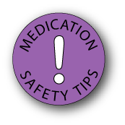
How to be a Safe Patient
Med List
  ALL medications, including OTCs and herbals!
  Share with all providers and pharmacists
  Keep it up to date
  Bring with you to hospital, ER, and travel
    It’s a good idea to keep a copy in your wallet in case of emergency.
Notes:
Important to keep track of everything, as you may not know what is contributing and what might be significant
Keep it up to date- it only works if it’s accurate. Keeping an electronic copy is a good idea so it doesn’t get “messy”.

Slide 15
What to include in a medication list
Have both brand and generic names
Dose of the medication
Instructions on how to take the medication
Reason for taking the medication
Allergies to any medications
Include OTC and herbal medications
Date Started Medication

Slide 16
Medication List Examples
Insert a medlist picture you like or one from your organization here
Notes:
Here’s one example of the medication list provided by our pharmacy for patients

Slide 17
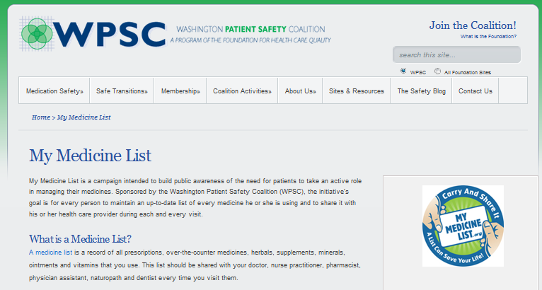
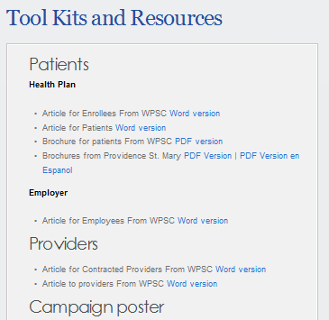
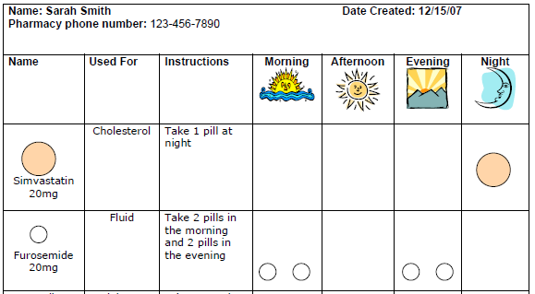
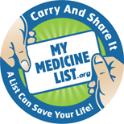
Medication List Examples
www.mymedicinelist.org
Notes:
Here’s another excellent resource from the Washington patient coalition, called “My Medicine List”. This has a series of different examples and tools to use to help construct a medicine list that fits your needs.

Slide 18
Why all this fuss about a medlist?
Medication Reconciliation
  Decrease in medication errors
  Reduction in hospital readmissions
Medication lists help in care transitions
Notes:
One of the biggest reasons is something I mentioned at the very start of this presentation. There’s about 1.2billion reasons to be concerned about MedRec.
Medication Reconciliation – This is a major incentive and focus for all hospitals, insurers, health care authorities, etc. Why? Studies have consistently shown that appropriate medication reconciliation reduces medications discrepancies, it results in reduction of adverse events, results in reduction of “potential” errors.

Slide 19
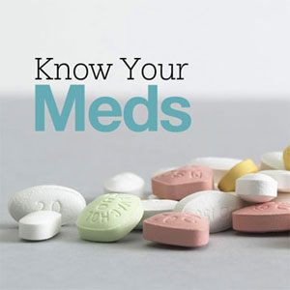
How to be a Safe Patient
Taking Medications
  Involve your doctor and pharmacist in adding or changing herbals and OTC’s
  Involve them in stopping medications
  Know your meds
    What are they treating?
    What should I monitor for?
Notes:
Involve your RPh in discontinuing medications: Especially meds that do not work or have side effects
RPH’s can make it easier to discontinue a med
Know your meds – understanding signs and symptoms and how to monitor efficacy of your medications is important. Ex. Cholesterol medicine – is it working, what’s my cholesterol? SE, Bilateral muscle pain not otherwise explained in the large muscles (arms, chest, legs)

Slide 20
How to be a Safe Patient
Keep one week of all meds on hand at all times
Fill early a few months in a row to build up 7 days of all prescription medications
Swap out your back up meds regularly
Notes:
Why to keep a week of meds on hand: this includes rx and OTC meds
In case of emergency, you are prepared
If you run out and are waiting for refills you have a back up supply.
Filling early: most insurance plans will pay for your refill 3 to 7 days before it is due. Fill your rx’s a few days early for a few months to build up a weeks supply.
Why swap out back up meds??
Expiration
Dosage changes
New medications, discontinued medications
If you have an updated medlist, this process is easier to monitor

Slide 21
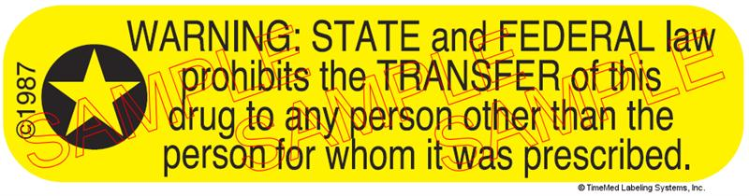
How to be a Safe Patient
Storage of Medications
  Avoid extreme temperatures (do not leave in car, travel with them in carry on luggage)
  Avoid humidity (bathroom)
  Pay attention to special storage needs (e.g. refrigeration)
Do not share medications!

Slide 22
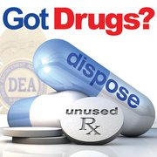
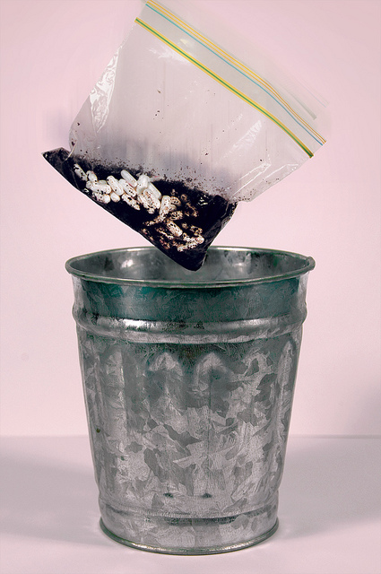
How to be a Safe Patient
Disposal
  Narcotics
    DEA Take back Day: When: April 27, 2013 10:00AM - 2:00PM
    Police
  Safe Return boxes
    Takebackyourmeds.org for locations
  Kitty litter or coffee in the trash
Notes:
When disposing of medication in the garbage you should remove them from their original container and mix them with an undesirable substance such as used coffee grounds or kitty litter. Adding the medication to these substances deters children and animals from accidentally eating the medication. This mixture should then be placed into a sealable bag and added to your normal garbage. It is a good idea to use this practice not only for your prescription medications, but also for OTC’s.
Most group health locations have drop boxes, no controls. Many Bartells also have boxes, closest is upper Queen anne.

Slide 23
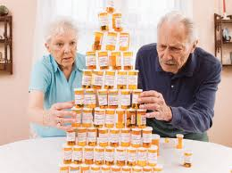
Ease your medication burden

Slide 24

Help Your Pharmacy Help You:
Ways to Avoid Delays and Frustration
Limit yourself to only one or two pharmacies
Know your pharmacist
Allow three days for refills
  Refill request, insurance, prior authorizations, etc.
Counseling
Ask questions
Notes:
For example, one mail order pharmacy and one local pharmacy. Or a pharmacy near your doctor’s office and a pharmacy near home.
The better you know your pharmacist, the better your pharmacist will know you. With a closer relationship your pharmacist will be able to meet more of your needs and help you with any health concerns.
Every time you get a prescription for a new medication your pharmacist will want to talk to you. This time is important, your pharmacist wants to make sure you understand how to take your medication and any risks associated with it. They more you learn from your pharmacist while they counsel you the more prepared you will be to be a safe patient. Not only that, but counseling is yet another way you can make sure you’re getting the right medication for you. Errors are often found during counseling that might otherwise have been missed. Perhaps in the electronic system the doctor had your profile on the screen while seeing the patient after you, and so he sent that patient’s prescription with your name to your pharmacy. There’s no reason for the pharmacist when they receive it to assume anything is wrong. However, in counseling, it’s determined this medication for gout doesn’t make sense since you weren’t seen for gout and don’t have gout.
If you every have medications questions, about prescription or over the counter medications, for yourself or for other, you can ask your pharmacist. If you are not at the pharmacy, feel free to call and a pharmacist will gladly answer your questions.

Slide 25
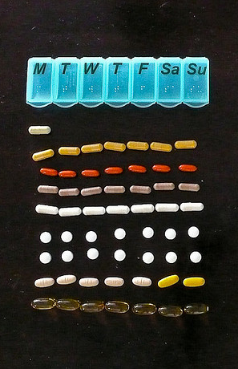
Options to make taking your meds easier
Medisets/Bubble packs
Pill boxes
Medication List
Medication synchronization
Automatic Cycle filling
Liquid forms and compounding
Long acting forms
Med reminders, alerts, monitors, etc.
***Customize this slide to reflect services available to your patients***
Notes:
Medisets - Everything is laid out and easy to take. Great if you have caregivers or difficulty remembering if you took a dose
Med List – Instead of calling in and asking for “everything I take”, have your list so both you and your pharmacist know the expectations
MedSync – Instead of having meds all throughout the month, synchronization eases your burden, travel, effort, wait time, etc.
Automatic cycle – takes the burden out of remembering to call refill requests, gives you an opportunity to review with the pharmacist monthly on changes.
Compounding example---difficulty cutting little pills, reformulate into easier to dose syrup
Long-acting forms – Instead of taking meds 2 or 3 times a day, perhaps there’s a longer acting form for once daily dosing! Unfortunately, this is typically branded and represents a higher copay on your insurance plan.
Phone apps, calendars, alarms, med dost reminders, etc. that can help ease the burden
If you are having problems with one of your medications, talk to your pharmacist! They might have ideas about how to help.

Slide 26
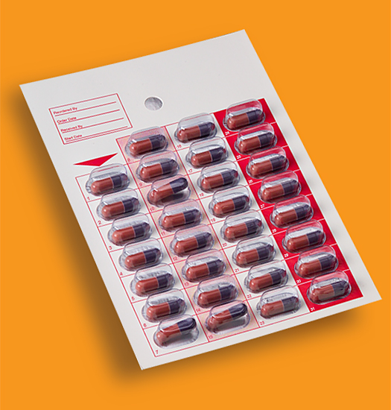
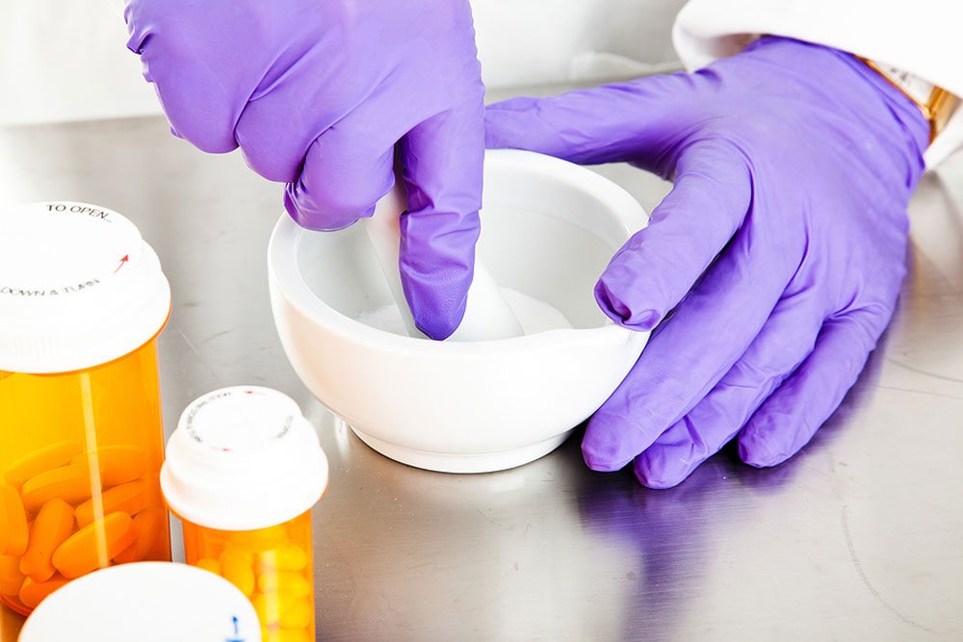
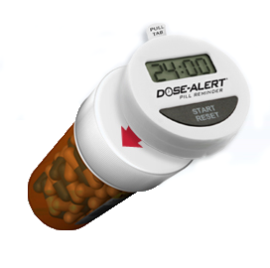
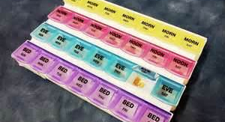
Medication Aids
Notes:
There are lots of options your pharmacist can help you with for remembering to take medicines, or if it’s difficult to take one. For example, if it’s difficult to swallow a pill, a pharmacist can help put the medicine into a different form, such as a liquid or a chewable tablet. These are some examples of reminders also.

Slide 27

Other Pharmacist Services
Medication Therapy Management (MTM)
Vaccinations
Travel Medications
Notes:
MTM is the process by which you have a full medication review to evaluate what medications you are taking, how you’re taking them, why you’re taking them, and receiving education on these medications. Furthermore, this process often can result in recommendations for cost saving alternatives, review of risk/benefit of medications, review of monitoring parameters for medications, and recommedations for improvement in medication regimen (i.e. changing medication, d/c medication).
Vaccinations – Pharmacist can provide many of the important vaccines you may need. Now, with the new Washington Immunization Registry, and pharmacist can even look-up your vaccination schedule to check on all your needed vaccines. For many elderly patients, both zostavax and pneumococcal are recommended and are generally available at your pharmacy.

Slide 28

Success with a med list!
My mother is 87 years-old with multiple medical conditions. She manages her own medications and routinely takes around 15 pills a day plus multiple doses of insulin (2 types). She visits several specialty physicians regularly and is asked on each visit to validate her medications.
Several years ago we created a medication list where we recorded all her medications with dose, frequency, and indication, along with her medication allergies & a list of all her conditions and prior procedures. She carries this around with her and brings a fresh copy to each physician visit.
The physicians’ office staff all LOVE her organized, clear and concise list which helps them keep accurate records for her. Whenever they comment about her list she proudly announces, ‘Well, my daughter is a nurse!’”

Slide 29
Conclusions
Medication lists can be used to improve your healthcare across settings
Your pharmacist can be a valuable resource in managing your medications

Slide 30
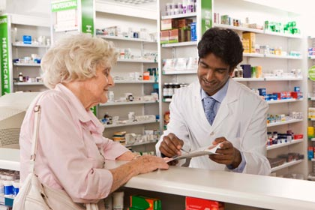
Resources
www.mymedicinelist.org
www.wapatientsafety.org
Pharmacist
Doctor’s Office
Family members
MySwedish, MyGroupHealth, UW Ecare, etc.
Notes:
Many health systems now offer online profiles where you can access you health information including your medication list.
Many doctor’s offices will give you an updated med list when you visit.

Slide 31
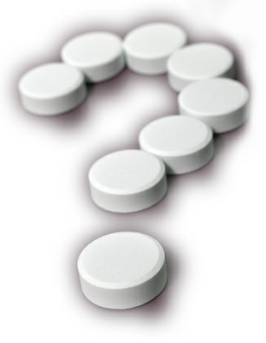
Questions

Slide 32
References
Tamblyn R, Huang A, Meguerditchian A, Winslade N, Rochefort C, Forester A, et al. Using novel Canadian resources to improve medication reconciliation at discharge: study protocol for a randomized control trial. Trials [Internet]. 2012 [cited 21 Jan 2013]; 13(50):1-13. Available from: http://www.trialsjournal.com/content/13/1/150
The American Geriatrics Society 2012 Beers Criteria Update Expert Panel. American Geriatrics Society Updated Beers Criteria for Potentially Inappropriate Medication Use in Older Adults. J Am Geriatr Soc [Internet]. 2012[cited 21 Jan 2013]; 1-13.
Olesen, C., Harbig, P., Barat, I. and Damsgaard, E. M. (2012), Absence of ‘over-the-counter’ medicinal products in on-line prescription records: a risk factor of overlooking interactions in the elderly. Pharmacoepidem. Drug Safe.. doi: 10.1002/pds.3362
Takebackyourmeds.org
www.deadiversion.usdoj.gov/drug_disposal/takeback

Slide 33
**Why do my pills change shape and color?
manufacturer shortages
different generic manufacturers
lowest cost
different doses
Notes:
These are some of the common questions we anticipated for the presentation.

Slide 34
**Why does one generic seem to work better than another?
Most generic drugs are required to be 80-110% of the potency of the brand name medication.
  In some very narrow therapeutic window medications some patients who are more sensitive to medications may notice a difference.
Different fillers
Pills physically formed differently
Notes:
Picture of many different forms of same drug

Slide 35
**Why can’t all my drugs be made in domestically? Are medications from other countries safe to use?
America doesn't’t have the manufacturing infrastructure to produce all drugs. If only domestically manufactured medications were allowed we would face sever drug shortages.
The cost of meds would soar!
All medications legally imported into US are held to the same standards of manufacturing as domestically produced meds

Slide 36
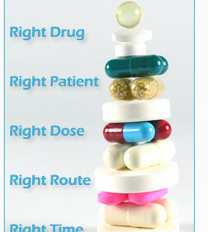
Why does it take so long to fill an rx?
Verify all patient info is correct: name, DOB, address, phone, insurance, other meds
Verify that prescription has all necessary info
Verify if this prescription is the right med at the right dose for you
  DDI, reasons for lower doses, disease state concerns
Insurance problems
  Sometimes your insurance has changed and you don’t have the new card, it takes a while to call
  Prior authorization and waiting for the MD
Type prescription, fill with correct amount of correct medication
  This process requires extra time for controlled substances
Verify that right med is in bottle for you
Counsel
  If you don’t know how to take your medication it will not work as well
  Patients need to be prepared to watch for adverse reactions so that they can advocate for their own health and safety.

