Slide 1
Medication Reconciliation
Definitions & Drivers
WPSC Medication Safety Project
April 27, 2011

Slide 2
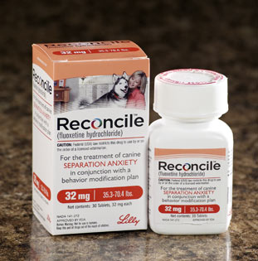
Medication… Reconciliation?

Slide 3
Med Rec
Value

Slide 4
Patient Safety
“Medication errors are one of the leading causes of injury to hospital patients, and chart reviews reveal that over half of all hospital medication errors occur at the interfaces of care.“
Rozich JD, Resar RK. Medication Safety: One Organization’s Approach to the Challenge.
JCOM. 2001;8(10):27-34.

Slide 5
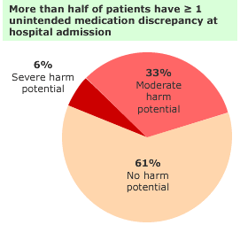
Patients at Risk
Studies have shown that unintended medication discrepancies occur in nearly one-third of patients at admission, a similar proportion at the time of transfer from one site of care within a hospital, and in 14% of patients at hospital discharge.
Cornish PL, Knowles SR, Marchesano R, et al. Unintended medication discrepancies at the time of hospital admission. Arch Intern Med. 2005;165:424-429.

Slide 6
Medication Reconciliation
Definitions, etc

Slide 7
Medication Reconciliation: A Definition?
No standard exist.
Consensus document from 2010 TJC publication recommends “a consortium of clinical, quality, and regulatory stakeholders” address the issue.
The process of verifying that a patient’s current list of medications (including dose, route, and frequency) is correct and that the medications are currently medically necessary and safe.
Greenwald et al. Making inpatient medication reconciliation patient centered, clinically relevant, and implementable: a consensus statement on key principles and necessary first steps. Jt Comm J Qual Patient Saf. 2010 Nov;36(11):504-13, 481.

Slide 8
TJC 2005 NPSG #8
Goal: Accurately and completely reconcile medications across the continuum of care.
Standard 8a: Develop a process for obtaining and documenting a complete list of the patient’s current medications upon the patient’s admission to the organization and with the involvement of the patient.
Standard 8b: A complete list of the patient’s medications is communicated to the next provider of service when it refers or transfers the patient to another setting, service, practitioner, or level of care within and outside the organization.

Slide 9
TJC - Medication Reconciliation (2007)
The process of comparing a patient's medication orders to all of the medications that the patient has been taking.
This reconciliation is done to avoid medication errors such as omissions, duplications, dosing errors, or drug interactions.
It should be done at every transition of care in which new medications are ordered or existing orders are rewritten.
Transitions in care include changes in setting, service, practitioner or level of care.

Slide 10
AHRQ and Med Recon
Unintended inconsistencies in medication regimens occur with any transition in care….
Medication reconciliation refers to the process of avoiding such inadvertent inconsistencies by reviewing the patient's current medication regimen and comparing it with the regimen being considered for the new setting of care.

Slide 11
ASHP-APhA
Med Recon Consensus Statement
Medication reconciliation:
The comprehensive evaluation of a patient’s medication regimen any time there is a change in therapy in an effort to avoid medication errors such as omissions, duplications, dosing errors, or drug interactions, as well as to observe compliance and adherence patterns.
This process should include a comparison of the existing and previous medication regimens and should occur at every transition of care in which new medications are ordered, existing orders are rewritten or adjusted, or if the patient has added non-prescription medications to their self-care.

Slide 12
ASHP-APhA Med Recon Goals
Medication reconciliation should be a patient-centered process, taking into account the patient’s level of health literacy, cognitive and physical ability, and willingness to engage in his or /her personal health care.
The goal of medication reconciliation is improvement in patient well-being through education, empowerment, and active involvement in the accurate transfer of medication information throughout transitions along the healthcare continuum. By promoting communication among patients and healthcare providers, medication reconciliation can resolve discrepancies in medication regimens and improve patient safety.

Slide 13
Med Rec: The Process
Collect
Clarify
Verify
Reconcile
Communicate

Slide 14
Medication Reconciliation: Not So Simple!
DISCHARGE PROCESS
ADMISSION PROCESS
COMMUNITY PROCESS
Medication
Info Sources
Pt & Family
Clarification/Verification
Physicians
Pharmacies
Pre-Admit Outpt Medication List
Pre-Admit Outpt Medication List
Pre-Admit Outpt Medication List
Pt & Family
Care Facilities
Physicians
Outpatient Medication List
Medical Records
Pharmacies
Inpatient Med List
Inpatient Med List
Care Facilities
3rd Party Vendors
Patient condition & diagnosis
Discharge Medication Reconciliation

Slide 15
The TJC Med Rec Journey
2005
2006
2007
2008
2009
2010
TJC introduces NPSG 8
“Med Rec” required for accreditation
NPSG minor revisions
NPSG major revisions planned
Scoring suspended and some simplification
New standards created & released

Slide 16
Med Rec
Current Status and Key Initiatives

Slide 17
TJC 2011 Medication Reconciliation
Moved to NPSG 3: Improve the safety of using medications
New numbering
  NPSG.03.06.01: Maintain and communicate accurate patient medication information
Implementation effective July 1, 2011
Five Elements of Performance (EPs)
Applies to:
  Hospitals, including Critical Access Hospitals
  Ambulatory Care
  Office (Ambulatory) Surgery
  Home Care
  Long-term Care
  Behavioral Health

Slide 18
NPSG.03.06.01
“Maintain and communicate accurate patient medication information”
EP1
Obtain information on medications the patient is currently taking on admission (or at the beginning of an episode of care). Document!
EP2
When applicable, define types of medication information to be obtained in non-24-hour settings and different patient circumstances.
Compare the medication information the patient brought to the hospital or organization with the medications ordered for the patient by the hospital/organization in order to identify and resolve discrepancies.
EP3
For organizations that prescribe medications: Provide the patient with written information on medications to be taken after discharge or the end of patient encounter (i.e. name, dose, route, frequency, purpose)
EP4
For organizations that prescribe medications: Explain importance of managing medication information to patient at discharge or the end of patient encounter.
EP5
Notes:
Notable changes:
1 safety goal (vs 4) and 5 Eps
No hospital internal tx med rec
‘good faith’ effort to obtain this information
allows the hospital to define for itself the minimum amount of medication information that must be captured in non-24-hour settings
Including the purpose of a medication can be very useful for patient education, but stating this as an example of the information that should be provided to the patient is a new expectation, and one that may cause some confusion
EP 4 includes a second concept from the minimal use portion of the previous safety goal that allows a hospital to supply the patient with just their new short-term medication(s) in a list, if nothing else has been changed.
A significant requirement has been removed from this stage in the process, as the hospital is no longer required to directly send discharge medication reconciliation information to primary care physicians. EP 5 places a degree of responsibility on patients by requiring they bring their medication lists to their doctors at the next visit

Slide 19
What’s new?
One vs 4 separate NPSGs
No hospital internal transfer med rec step
Providers expected to make ‘good faith’ effort to obtain drug information
Allows the hospital to define for itself the minimum amount of medication information that must be captured in non-24-hour settings
“Purpose” of a medication is a new expectation, and one that may cause some confusion
EP 4 allows a hospital to supply the patient with just their new short-term medication(s) in a list, if nothing else has been changed.
Discharge communication: hospital is no longer required to directly send discharge med rec information to “next provider”. EP 5 places a degree of responsibility on patients by requiring they bring their medication lists to their doctors at the next visit

Slide 20
The Patient Protection and Affordable Care Act (H.R. 3590)
Value-Based Purchasing (VBP)
AMI, PNE, HF
SCIP/HOP
CLABSI
SSI
Hospital Consumer
Assessment of Healthcare
Providers and Systems (HCAHPS)
(Section 3001)
Core Measures
(Section 3001)
Healthcare-Associated
Infections (HAI)
(Section 3001)
At Risk: 1% in FY2013 growing annually to 2% in FY2017
(70% Core Measures + HAI and 30% HCAHPS)
Medicare Reimbursement
CAUTI, Vascular Catheter
Associated Infections, Poor
Glycemic Control
At Risk: 1% reduction
beginning FY2015
At Risk: 1% reduction in FY2013 and will
Rise to 3% by FY2015
Hospital Acquired
Conditions (HAC)
(Section 3008)
Readmission Rates
(Section 3025)
Foreign Object Postop,
Air Embolism, Blood
Incompatibility, Pressure
Ulcer, Falls/Trauma
COPD, CABG,
PTCA, etc.
AMI, PNE, HF
5

Slide 21
IHI STAAR Initiative
Reduce Hospital Readmissions
I. Perform Enhanced Admission Assessment for Post-Hospital Needs
Include family caregivers and community providers as full partners in completing standardized assessments, planning discharge, and predicting home-going needs.
Reconcile medications upon admission.
Initiate a standard plan of care based on the results of the assessment.
II. Provide Effective Teaching and Enhanced Learning
Identify all learners on admission.
Customize the patient education process for patients, family caregivers
Use “Teach Back” daily in the hospital and during follow-up phone calls
III. Conduct Real-Time Patient & Family-Centered Communication
Reconcile medications at discharge.
Provide customized, real-time critical information to the next care provider(s).
IV. Ensure Post-Hospital Care Follow-Up
Risk stratify patients and ensure appropriate follow-up (in-person, telephone) as indicated within 5-7 days.

Slide 22
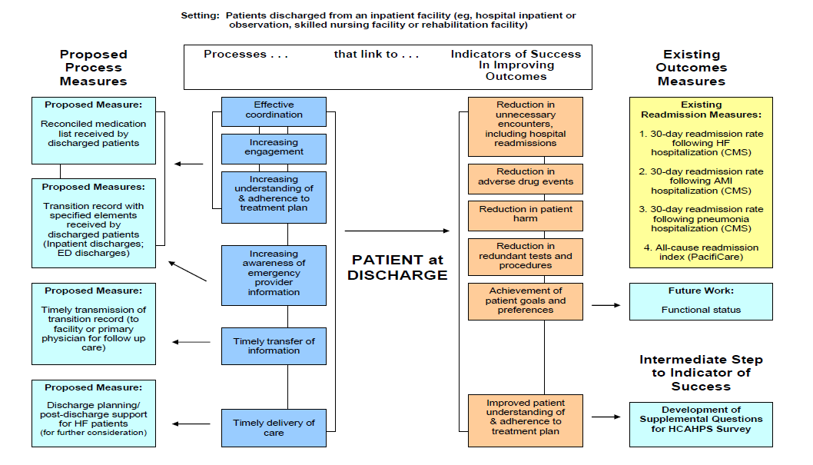
Physician Consortium for Performance Improvement® (PCPI)
Care Transitions Performance Measurement Set
Sponsored by ACP/SHM

Slide 23
HEDIS Med Rec Measure
Medication reconciliation post-discharge: percentage of discharges from January 1 to December 1 of the measurement year for members 65 years of age and older for whom medications were reconciled on or within 30 days of discharge
National Committee for Quality Assurance (NCQA). HEDIS® 2010: Healthcare Effectiveness Data & Information Set. Vol. 1, Narrative. Washington (DC): National Committee for Quality Assurance (NCQA); 2009 Jul. 90

Slide 24
CMS 2010 PQRI Measures
Medication Reconciliation: Reconciliation After Discharge from an Inpatient Facility
Percentage of patients aged 65 years and older discharged from any inpatient facility (eg, hospital, skilled nursing facility, or rehabilitation facility) and seen within 60 days following discharge in the office by the physician providing on-going care who had a reconciliation of the discharge medications with the current medication list in the medical record documented

Slide 25
Meaningful Use
  ARRA provides reimbursement incentives for successful users
  To use technology
  to enable the
  exchange and
  use of health
  information to
  best inform clinical
  decisions at the
  point of care
Stage 1 2011
Stage 2 2013
Stage 3 2015
Achieving Meaningful Use
2011 Capture/share data
2013
Advanced care processes with decision support
2015 Improved Outcomes

Slide 26
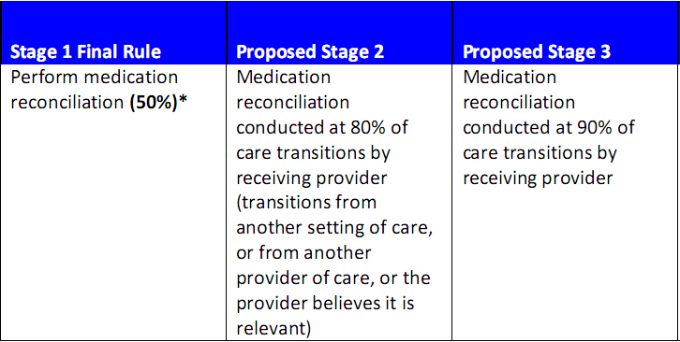
Meaningful Use Med Rec Requirement for Eligible Providers & Hospitals

Slide 27
Opportunities

Slide 28
We’re On The Right Track
EP 5: Explain importance of managing medication information to patient at discharge or end of patient encounter.
Examples include:
Carrying information in event of an emergency
Updating list when changes are made
Providing the list to primary care physician

