Slide 1
Core Clinical Metrics 2019-2020

Slide 2
2019-2020 OB COAP Dashboard Metrics:
1A: Birth Without Intervention (by parity)
1B: More Liberal Birth Without Intervention (by parity)
2: Exclusive Breastfeeding at Discharge (by parity)
3: Postpartum Maternal Readmission
4: Robson Ten Group Classification for Cesarean Birth
5: Treatment of Severe Hypertension Within 1 Hour
6: Indicated Cord Gases
7: 3rd or 4th Degree Laceration (by parity)
8: Severe Maternal Morbidity (by parity)
9: Maternal Blood Transfusion (by parity)
10: Maternal ICU Admit or Blood Transfusion > 4 units (by parity)
11: NICU Admission/Newborn Transfer at > 37 Wks on Del (by parity)
Maternal & Newborn Rare/Serious Outcomes (by level, not by site)
This is a place to start…you may or may not use them all…we welcome suggestions

Slide 3
Understanding the Dashboards

Slide 4
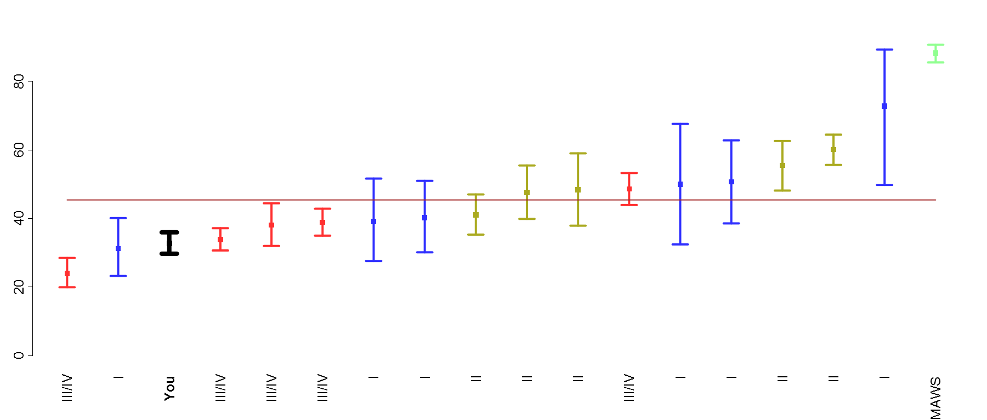
Metric 1. Birth without intervention (Multip)
Metric number & name
Metric strata
OBCOAP wide rate
95% CI for your site’s rate
Rate at your site by quarter
Period | n/N | Rate
Q1 | 88/261 | 33.7
Q2 | 81/258 | 31.4
Q3 | 75/217 | 34.6
Q4 | 51/164 | 31.1
All 2018 | 295/900 | 32.8
OBCOAP | 2606/5741 | 45.4
Numerator, denominator and rate for your site by quarter and over whole year, and OBCOAP wide rate for the year
MAWS rates* are in green
Level I Hospital rates are in blue
Level II Hospital rates are in yellow
Level III/IV Hospital rates are in red
Your site is in black
OBCOAP wide rate
Rate and 95% confidence intervals for each OBCOAP site over previous year
Sites identified by level of neonatal and maternal care
* MAWS = Midwives Assoc. of WA State, which are the planned Community Births. These rates are not included in every metric

Slide 5
OB COAP-Wide Aggregate Dashboard

Slide 6
Metric 1A: Birth Without Intervention
Based on ACOG’s reVITALize definition of physiological birth
Metric 1B: More Liberal Birth Without Intervention
Based on feedback from attendees at the 2019 OB COAP Annual Meeting (does not include AROM or epidural as interventions)

Slide 7
Metric 1A: Birth Without Intervention
Definition:
Birth without intervention in spontaneous singleton > 37 week births
Denominator:
Spontaneous singleton > 37 week births Exclusions: intrapartum transfers into facility, fetal anomalies.
Numerator: No intervention
Spontaneous vaginal birth / No oxytocin / No AROM / No epidural / No episiotomy / No forceps / No vacuum / No cesarean
Strata:
Parity (Nulliparous/Multiparous)

Slide 8
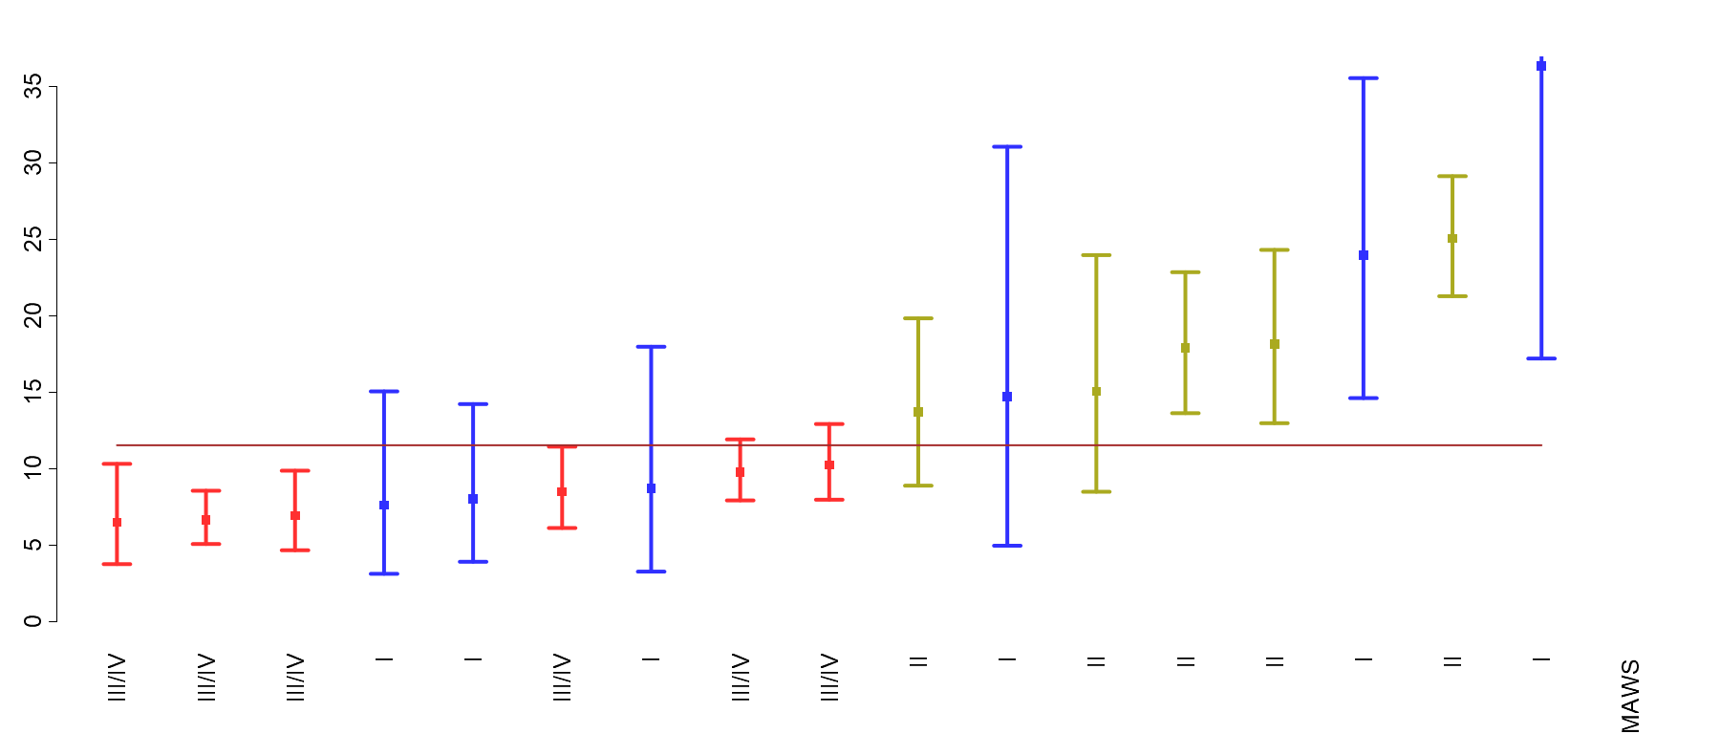
Metric 1A: Birth Without Intervention - Nulliparas
Period | n/N | Rate
Q1 | 124/1346 | 9.2
Q2 | 141/1324 | 10.6
Q3 | 156/1312 | 11.9
Q4 | 168/1128 | 14.9
All 2018 | 589/5110 | 11.5
© Foundation for Health Care Quality (FHCQ), 2019 - OB COAP is an approved Coordinated Quality Improvement Program protected under Washington State Law, RCW 43.70.510. Unauthorized use or reproduction is strictly prohibited.

Slide 9
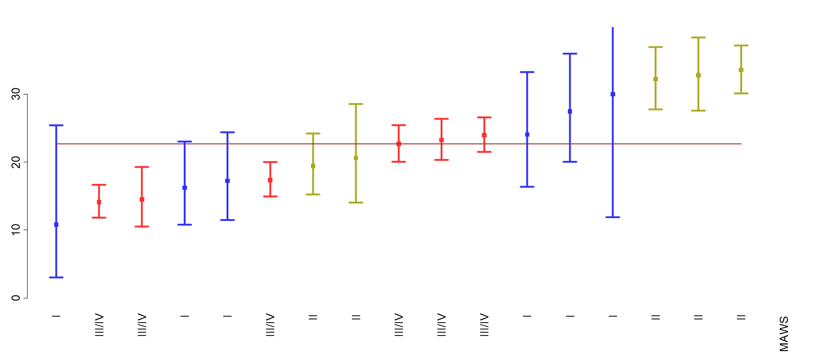
Metric 1A: Birth Without Intervention - Multiparas
Period | n/N | Rate
Q1 | 384/1835 | 20.9
Q2 | 385/1872 | 20.6
Q3 | 505/1968 | 25.7
Q4 | 395/1682 | 23.5
All 2018 | 1669/7357 | 22.7
© Foundation for Health Care Quality (FHCQ), 2019 - OB COAP is an approved Coordinated Quality Improvement Program protected under Washington State Law, RCW 43.70.510. Unauthorized use or reproduction is strictly prohibited.

Slide 10
Metric 1B: More Liberal Birth Without Intervention
Definition:
More liberal birth without intervention in spontaneous singleton > 37 week births
Denominator:
Spontaneous singleton > 37 week births Exclusions: intrapartum transfers into facility, fetal anomalies.
Numerator: No intervention
Spontaneous vaginal birth / No oxytocin / No episiotomy / No forceps / No vacuum / No cesarean
Strata:
Parity (Nulliparous/Multiparous)

Slide 11
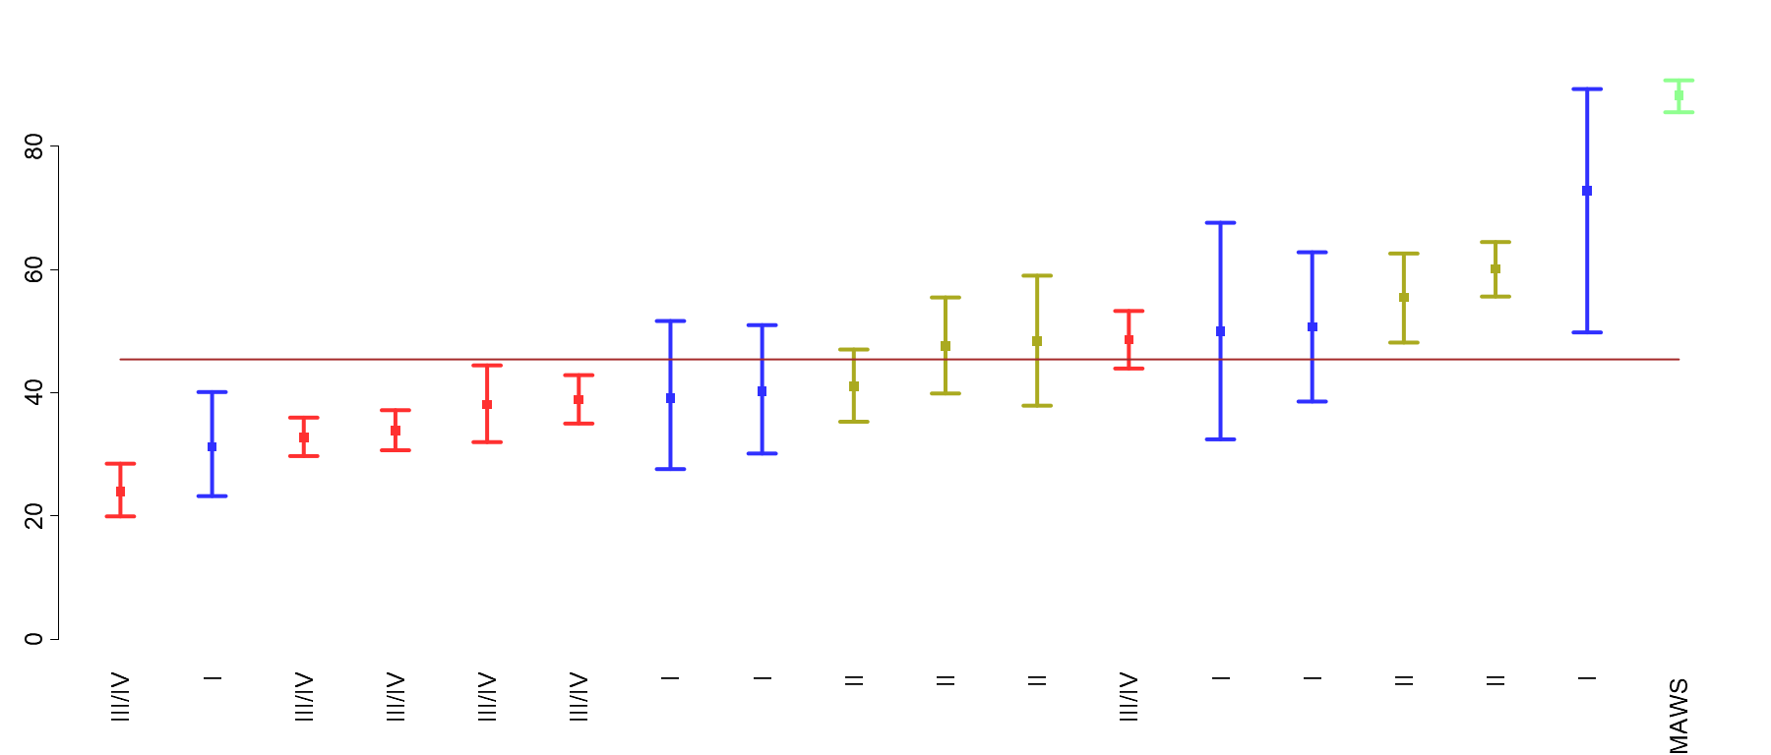
Metric 1B: Liberal Birth Without Intervention - Nulliparas
Period | n/N | Rate
Q1 | 679/1511 | 44.9
Q2 | 642/1496 | 42.9
Q3 | 675/1468 | 46.0
Q4 | 610/1266 | 48.2
All 2018 | 2606/5741 | 45.4
© Foundation for Health Care Quality (FHCQ), 2019 - OB COAP is an approved Coordinated Quality Improvement Program protected under Washington State Law, RCW 43.70.510. Unauthorized use or reproduction is strictly prohibited.

Slide 12
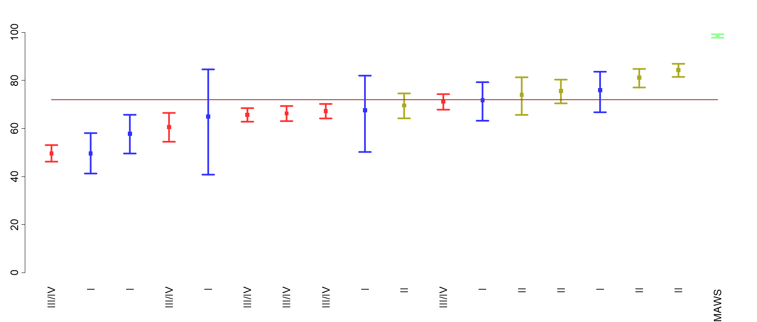
Metric 1B: Liberal Birth Without Intervention - Multiparas
Period | n/N | Rate
Q1 | 1543/2145 | 71.9
Q2 | 1497/2157 | 69.4
Q3 | 1688/2277 | 74.1
Q4 | 1412/1950 | 72.4
All 2018 | 6140/8529 | 72.0
© Foundation for Health Care Quality (FHCQ), 2019 - OB COAP is an approved Coordinated Quality Improvement Program protected under Washington State Law, RCW 43.70.510. Unauthorized use or reproduction is strictly prohibited.

Slide 13
Metric 2: Exclusive Breastfeeding at Discharge

Slide 14
Metric 2: Exclusive Breastfeeding at Discharge
Definition:
Exclusive breastfeeding at the time of discharge
Denominator:
Liveborn > 37 week newborns Exclusions: fetal anomalies, intrapartum transfers into the facility, antepartum, intrapartum and neonatal deaths
Numerator:
Exclusive breastfeeding at the time of discharge from hospital
Strata:
Parity (Nulliparous/Multiparous)

Slide 15
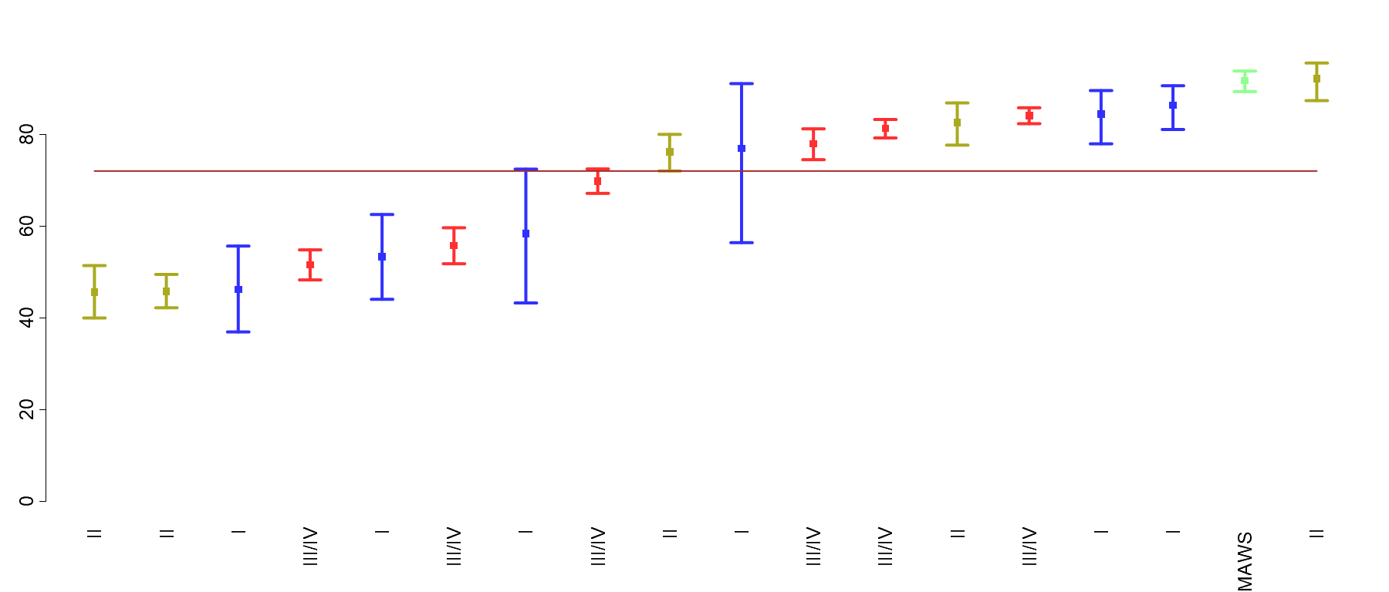
Metric 2: Exclusive Breastfeeding at Discharge - Nulliparas
Period | n/N | Rate
Q1 | 1789/2503 | 71.5
Q2 | 1845/2533 | 72.8
Q3 | 1847/2547 | 72.5
Q4 | 1662/2342 | 71.0
All 2018 | 7143/9925 | 72.0
© Foundation for Health Care Quality (FHCQ), 2019 - OB COAP is an approved Coordinated Quality Improvement Program protected under Washington State Law, RCW 43.70.510. Unauthorized use or reproduction is strictly prohibited.

Slide 16
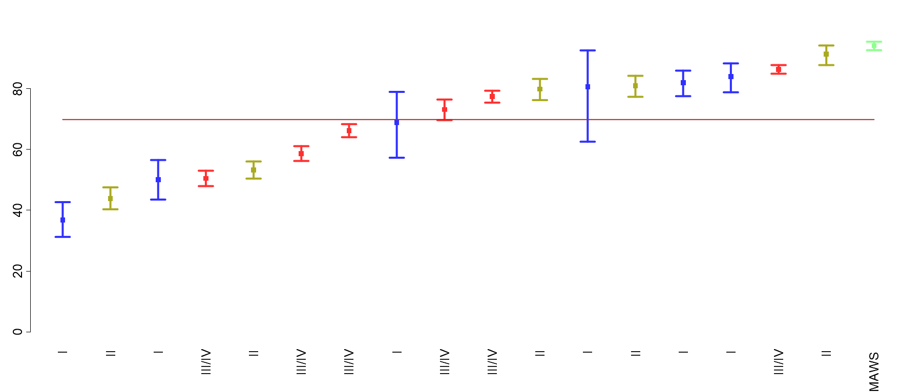
Metric 2: Exclusive Breastfeeding at Discharge - Multiparas
Period | n/N | Rate
Q1 | 2645/3866 | 68.4
Q2 | 2780/3906 | 71.2
Q3 | 2924/4147 | 70.5
Q4 | 2573/3727 | 69.0
All 2018 | 10922/15646 | 69.8
© Foundation for Health Care Quality (FHCQ), 2019 - OB COAP is an approved Coordinated Quality Improvement Program protected under Washington State Law, RCW 43.70.510. Unauthorized use or reproduction is strictly prohibited.

Slide 17
Metric 3: Postpartum Maternal Readmission

Slide 18
Metric 3: Postpartum Maternal Readmission
Definition:
Maternal readmission to hospital within 30 days of giving birth
Denominator:
All childbearing persons who gave birth at the facility Exclusions: none
Numerator:
Maternal readmission to hospital within 30 days of giving birth*
Strata:
Parity (Nulliparous/Multiparous)
*Readmission may not be captured in all cases particularly if maternal readmission is to a different facility

Slide 19
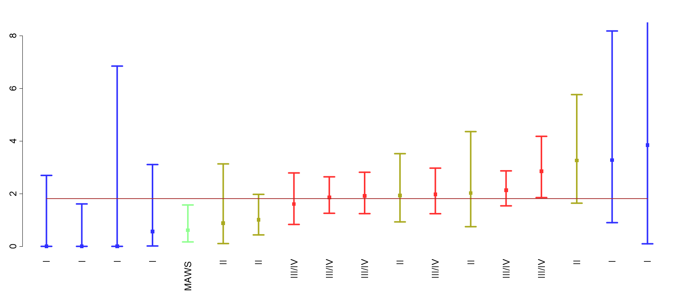
Metric 3: Postpartum Maternal Readmission - Nulliparas
Period | n/N | Rate
Q1 | 41/2799 | 1.5
Q2 | 53/2854 | 1.9
Q3 | 65/2891 | 2.2
Q4 | 44/2647 | 1.7
All 2018 | 203/11191 | 1.8
© Foundation for Health Care Quality (FHCQ), 2019 - OB COAP is an approved Coordinated Quality Improvement Program protected under Washington State Law, RCW 43.70.510. Unauthorized use or reproduction is strictly prohibited.

Slide 20
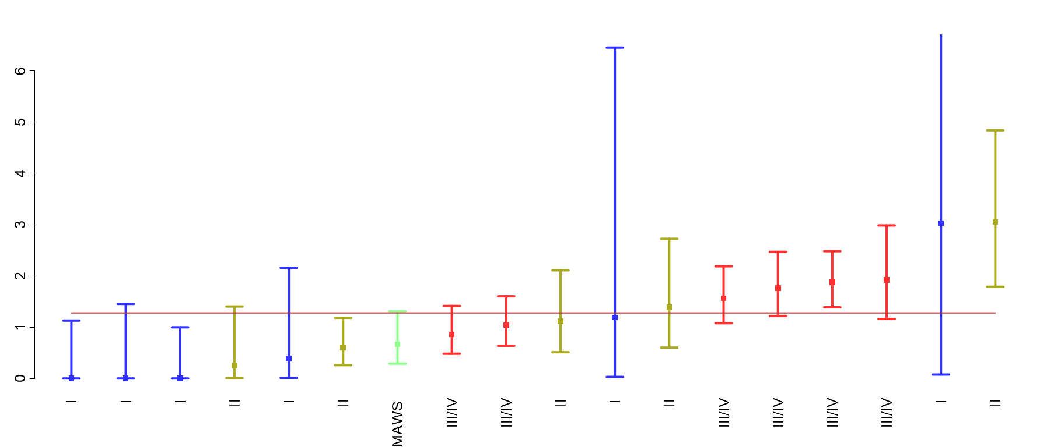
Metric 3: Postpartum Maternal Readmission - Multiparas
Period | n/N | Rate
Q1 | 49/4290 | 1.1
Q2 | 52/4301 | 1.2
Q3 | 71/4626 | 1.5
Q4 | 50/4157 | 1.2
All 2018 | 222/17374 | 1.3
© Foundation for Health Care Quality (FHCQ), 2019 - OB COAP is an approved Coordinated Quality Improvement Program protected under Washington State Law, RCW 43.70.510. Unauthorized use or reproduction is strictly prohibited.

Slide 21
Metric 4: Robson Ten Group Classification for Cesarean Birth

Slide 22
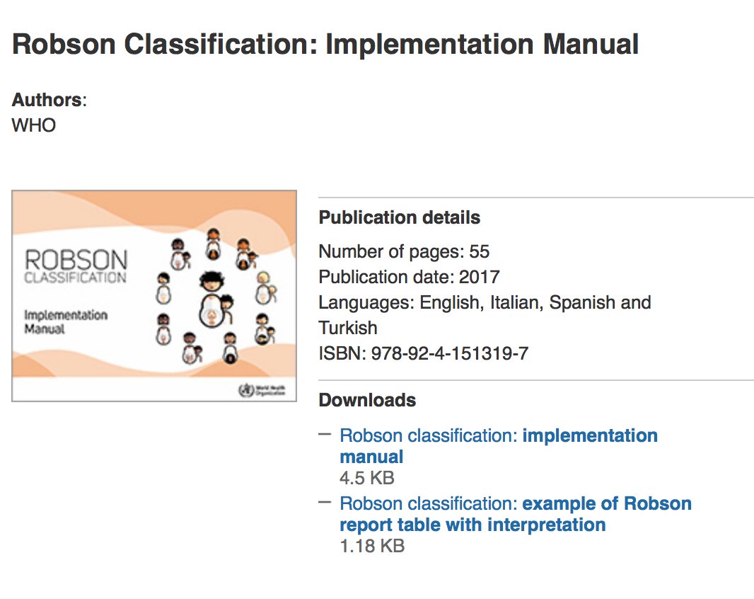
Metric 4: Robson Ten Group Classification for Cesarean Birth
Robson Group
1 Nulliparous, single cephalic, ≥37 weeks, spontaneous labor
2 Nulliparous, single cephalic, ≥37 weeks, induced or no-labor cesarean
3 Multiparous (excluding previous cesareans), single cephalic, ≥37 weeks, spontaneous labor
4 Multiparous, single cephalic, ≥37 weeks, induced or no-labor cesarean
5 Previous cesarean, single cephalic ≥37 weeks
6 All nulliparous breeches
7 All multiparous breeches (including previous cesareans)
8 All multiple pregnancies (including previous cesareans)*
9 All abnormal lies (including previous cesareans)
10 All single cephalic, <37 weeks (including previous cesareans)
Non-classifiable

Slide 23
Robson Contribution Table
Robson Group | Number of births | Percent of births | Number of Cesareans | Cesarean rate (%) | Percent of Cesareans | Cesarean contribution (%)
Robson group 1 | 5157 | 19.7 | 857 | 16.6 | 10.5 | 3.3
Robson group 2 | 3764 | 14.4 | 1560 | 41.4 | 19.0 | 6.0
Robson group 3 | 6630 | 25.3 | 187 | 2.8 | 2.3 | 0.7
Robson group 4 | 3575 | 13.7 | 417 | 11.7 | 5.1 | 1.6
Robson group 5 | 3901 | 14.9 | 3170 | 81.3 | 38.7 | 12.1
Robson group 6 | 492 | 1.9 | 473 | 96.1 | 5.8 | 1.8
Robson group 7 | 506 | 1.9 | 477 | 94.3 | 5.8 | 1.8
Robson group 8 | 430 | 1.6 | 309 | 71.9 | 3.8 | 1.2
Robson group 9 | 99 | 0.4 | 92 | 92.9 | 1.1 | 0.4
Robson group 10 | 1630 | 6.2 | 647 | 39.7 | 7.9 | 2.5
All cases | 26184 | 100.0 | 8189 | 31.3 | 100.0 | 31.3
© Foundation for Health Care Quality (FHCQ), 2019 - OB COAP is an approved Coordinated Quality Improvement Program protected under Washington State Law, RCW 43.70.510. Unauthorized use or reproduction is strictly prohibited.

Slide 24
Robson Group 1: NTSV Spontaneous Labor

Slide 25
Robson Group 1: NTSV Spontaneous Labor
Definition:
Cesarean rate for nulliparous, singleton, cephalic, ≥37 weeks, in spontaneous labor
Denominator:
All nulliparous, singleton, cephalic, ≥37 weeks, in spontaneous labor
Numerator:
Cesarean births Exclusions: Intrapartum transfers into the facility
Strata:
None

Slide 26
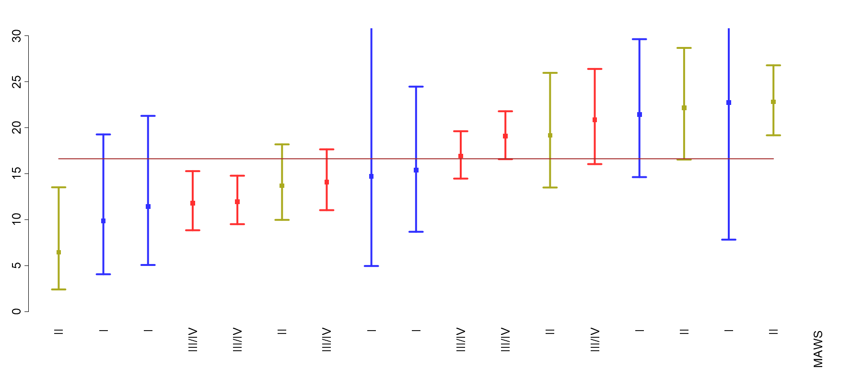
Robson Group 1: NTSV Spontaneous Labor
Period | n/N | Rate
Q1 | 231/1351 | 17.1
Q2 | 229/1334 | 17.2
Q3 | 220/1329 | 16.6
Q4 | 177/1143 | 15.5
All 2018 | 857/5157 | 16.6
© Foundation for Health Care Quality (FHCQ), 2019 - OB COAP is an approved Coordinated Quality Improvement Program protected under Washington State Law, RCW 43.70.510. Unauthorized use or reproduction is strictly prohibited.

Slide 27
Robson Group 2: NTSV Induced Labor or No-Labor CS

Slide 28
Robson Group 2: NTSV Induced Labor or No-Labor CS
Definition:
Cesarean rate for nulliparous, single cephalic, ≥37 weeks, induced or no-labor cesarean*
Denominator:
All nulliparous, singleton, cephalic, ≥37 weeks, induced or no-labor cesarean
Numerator:
Cesarean birth Exclusions: intrapartum transfers into the facility
Strata:
None
* Cesarean without attempting vaginal birth

Slide 29
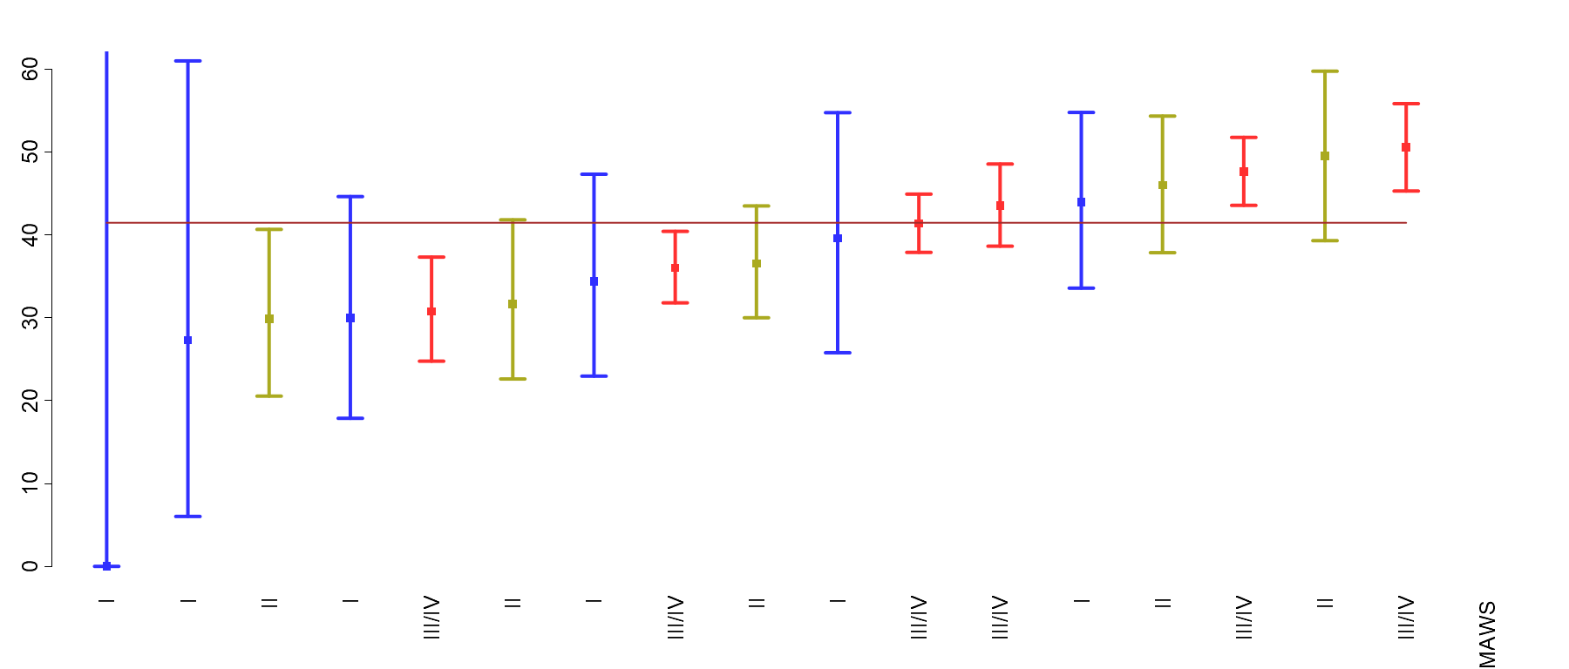
Robson Group 2: NTSV Induced Labor or No-Labor CS
Period | n/N | Rate
Q1 | 357/883 | 40.4
Q2 | 394/939 | 42.0
Q3 | 412/978 | 42.1
Q4 | 397/964 | 41.2
All 2018 | 1560/3764 | 41.4
© Foundation for Health Care Quality (FHCQ), 2019 - OB COAP is an approved Coordinated Quality Improvement Program protected under Washington State Law, RCW 43.70.510. Unauthorized use or reproduction is strictly prohibited.

Slide 30
Robson Group 3: Multiparous (No Prior Cesarean) TSV Spontaneous Labor

Slide 31
Robson Group 3: Multiparous (No Prior Cesarean) TSV Spontaneous Labor
Definition:
Cesarean rate for multiparous, single cephalic, ≥37 weeks, spontaneous labor and no history of cesarean
Denominator:
All multiparous, singleton, cephalic, ≥37 weeks, spontaneous labor and no history of cesarean
Numerator:
Cesarean births Exclusions: intrapartum transfers into the facility
Strata:
None

Slide 32
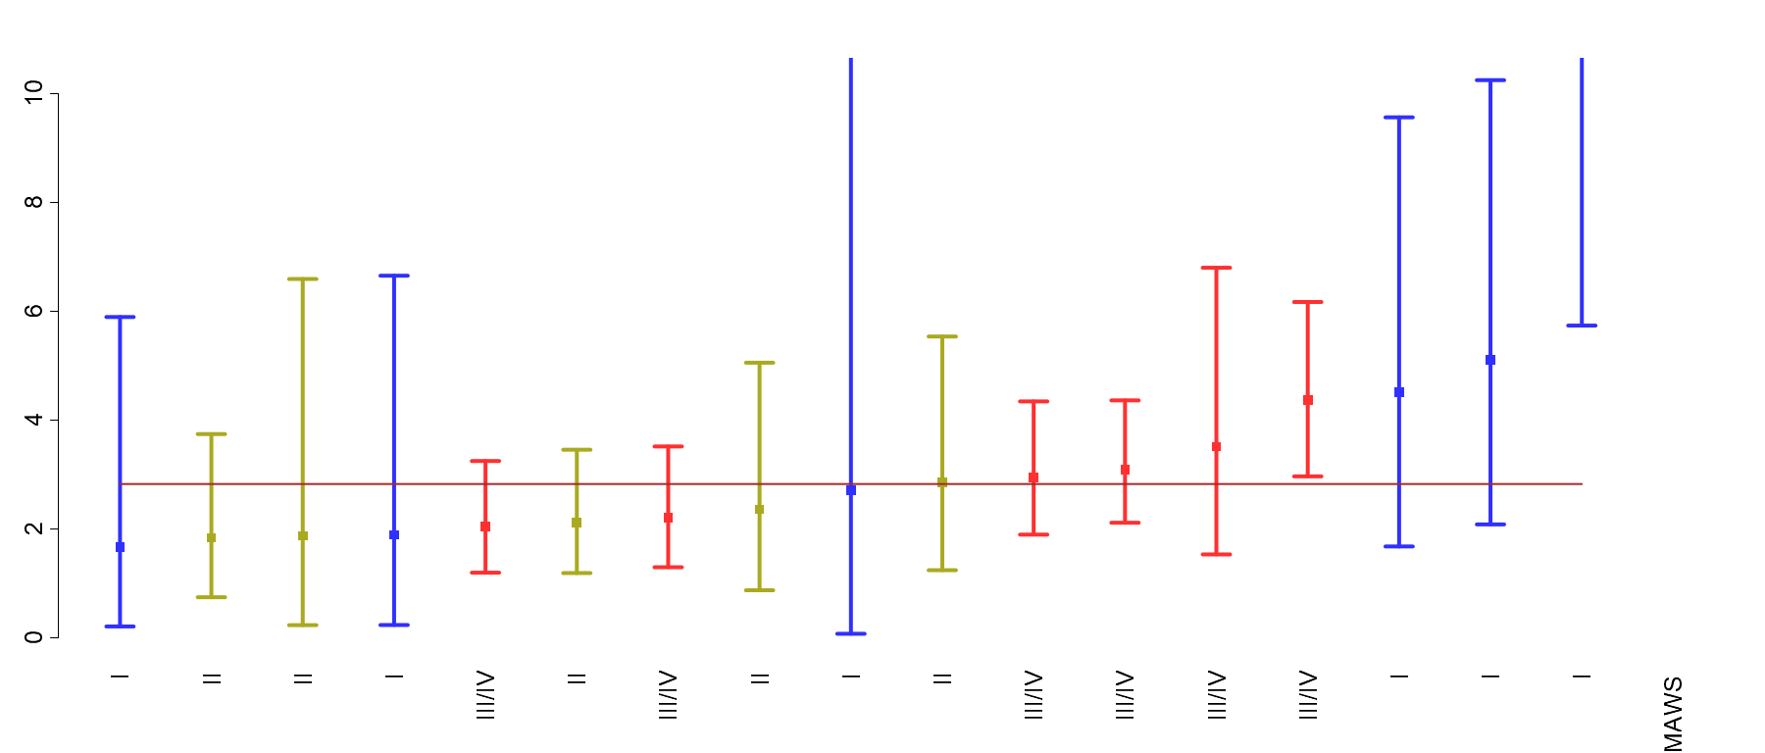
Robson Group 3: Multiparous (No Prior Cesarean) TSV Spontaneous Labor
Period | n/N | Rate
Q1 | 46/1672 | 2.8
Q2 | 53/1685 | 3.1
Q3 | 48/1760 | 2.7
Q4 | 40/1513 | 2.6
All 2018 | 187/6630 | 2.8
© Foundation for Health Care Quality (FHCQ), 2019 - OB COAP is an approved Coordinated Quality Improvement Program protected under Washington State Law, RCW 43.70.510. Unauthorized use or reproduction is strictly prohibited.

Slide 33
Robson Group 4: Multiparous (No Prior Cesarean) TSV Induced Labor or No-Labor CS

Slide 34
Robson Group 4: Multiparous (No Prior Cesarean) TSV Induced Labor or No-Labor CS
Definition:
Cesarean rate for multiparous, single cephalic, ≥37 weeks, induced or no-labor cesarean*
Denominator:
All nulliparous, singleton, cephalic, ≥37 weeks, induced or no-labor cesarean
Numerator:
Cesarean birth Exclusions: intrapartum transfers into the facility
Strata:
None
*Cesarean without attempting vaginal birth

Slide 35
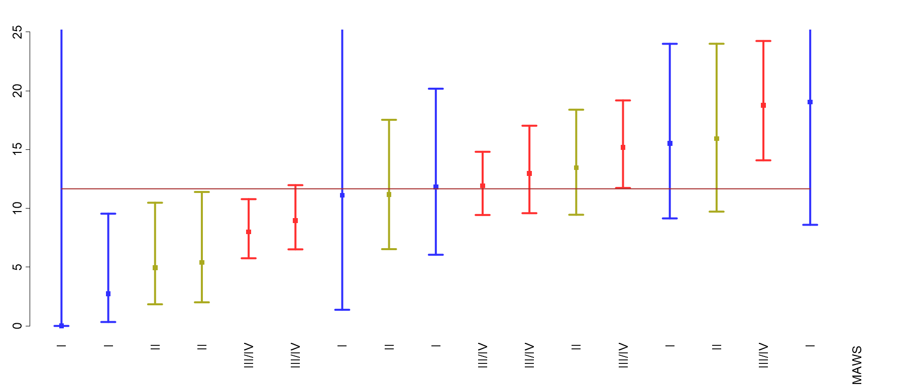
Robson Group 4: Multiparous (No Prior Cesarean) TSV Induced Labor or No Labor CS
Period | n/N | Rate
Q1 | 101/825 | 12.2
Q2 | 100/868 | 11.5
Q3 | 108/967 | 11.2
Q4 | 108/915 | 11.8
All 2018 | 417/3575 | 11.7
© Foundation for Health Care Quality (FHCQ), 2019 - OB COAP is an approved Coordinated Quality Improvement Program protected under Washington State Law, RCW 43.70.510. Unauthorized use or reproduction is strictly prohibited.

Slide 36
Robson Group 5: Previous Cesarean TSV

Slide 37
Robson Group 5: Previous Cesarean TSV
Definition:
Cesarean rate for previous cesarean, singleton, cephalic, ≥37 weeks at birth
Denominator:
Previous cesarean, singleton, cephalic, ≥37 weeks at birth
Numerator:
Cesarean births Exclusions: intrapartum transfers into the facility
Strata:
None

Slide 38
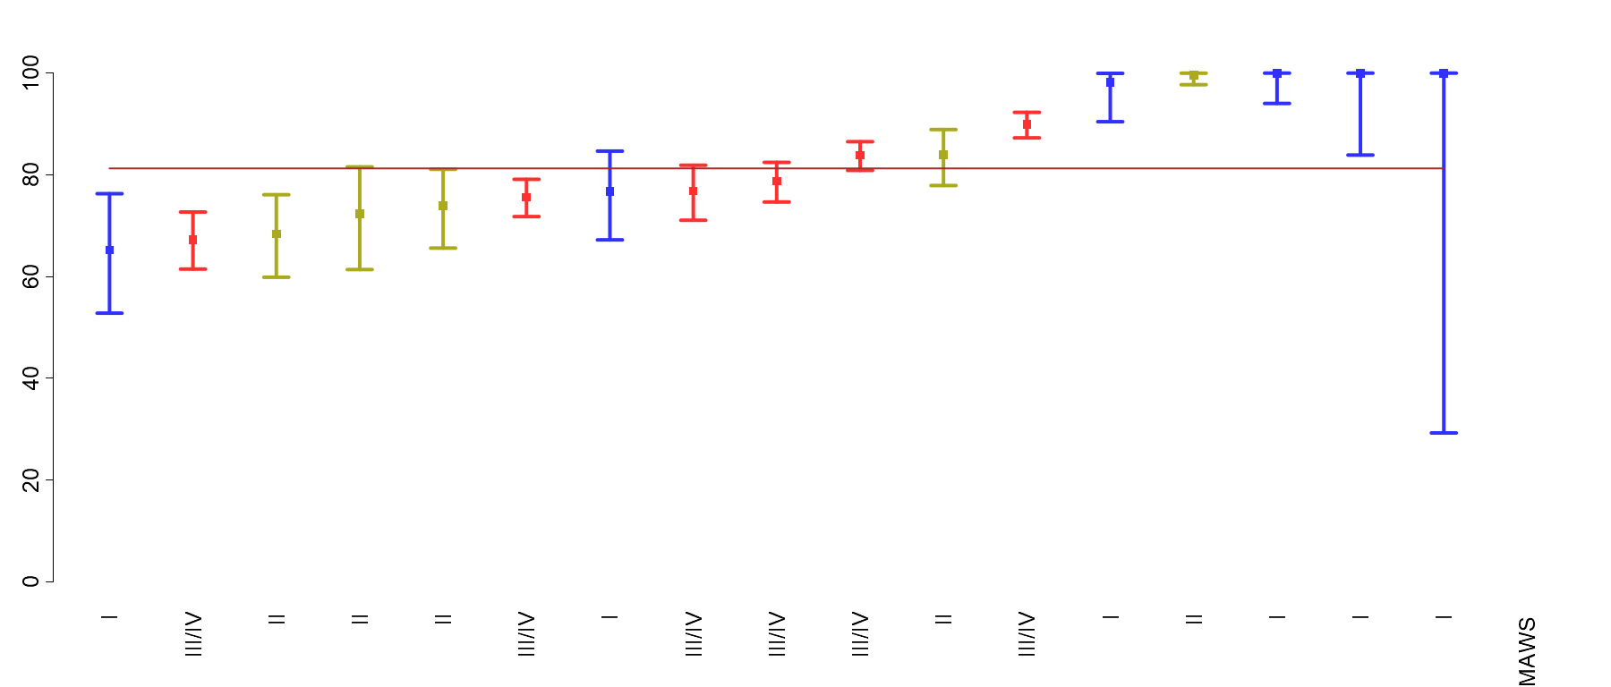
Robson Group 5: Previous Cesarean TSV
Period | n/N | Rate
Q1 | 769/933 | 82.4
Q2 | 802/1002 | 80.0
Q3 | 827/1017 | 81.3
Q4 | 772/949 | 81.3
All 2018 | 3170/3901 | 81.3
© Foundation for Health Care Quality (FHCQ), 2019 - OB COAP is an approved Coordinated Quality Improvement Program protected under Washington State Law, RCW 43.70.510. Unauthorized use or reproduction is strictly prohibited.

Slide 39
Robson Group 6: All Nulliparous Breeches

Slide 40
Robson Group 6: All Nulliparous Breeches
Definition:
Cesarean rate for all singleton nulliparous breeches
Denominator:
Nulliparous, singleton, breech presentations
Numerator:
Cesarean births Exclusions: intrapartum transfers into the facility
Strata:
None

Slide 41
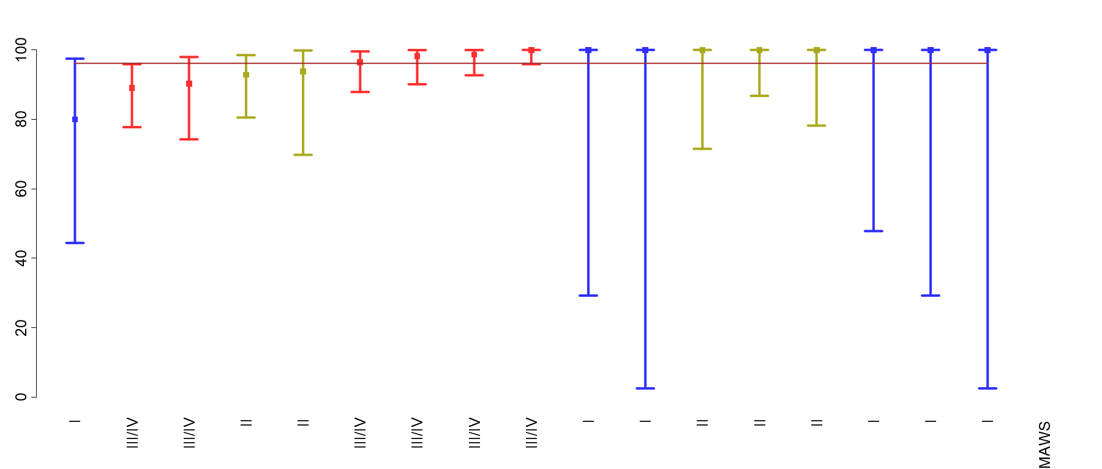
Robson Group 6: All Nulliparous Breeches
Period | n/N | Rate
Q1 | 121/127 | 95.3
Q2 | 112/118 | 94.9
Q3 | 125/130 | 96.2
Q4 | 115/117 | 98.3
All 2018 | 473/492 | 96.1
© Foundation for Health Care Quality (FHCQ), 2019 - OB COAP is an approved Coordinated Quality Improvement Program protected under Washington State Law, RCW 43.70.510. Unauthorized use or reproduction is strictly prohibited.

Slide 42
Robson Group 7: All Multiparous Breeches

Slide 43
Robson Group 7: All Multiparous Breeches
Definition:
Cesarean rate for all singleton multiparous breeches
Denominator:
Multiparous, singleton, breech presentations (including previous cesareans)
Numerator:
Cesarean births Exclusions: intrapartum transfers into the facility
Strata:
None

Slide 44
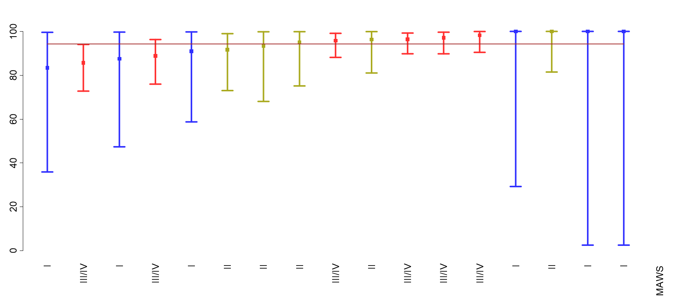
Robson Group 7: All Multiparous Breeches
Period | n/N | Rate
Q1 | 133/143 | 93.0
Q2 | 102/110 | 92.7
Q3 | 134/141 | 95.0
Q4 | 108/112 | 96.4
All 2018 | 477/506 | 94.3
© Foundation for Health Care Quality (FHCQ), 2019 - OB COAP is an approved Coordinated Quality Improvement Program protected under Washington State Law, RCW 43.70.510. Unauthorized use or reproduction is strictly prohibited.

Slide 45
Robson Group 8: All Multiple Pregnancies

Slide 46
Robson Group 8: All Multiple Pregnancies
Definition:
Cesarean rate for all multiple pregnancies (including previous cesareans)
Denominator:
Multiple pregnancies (including previous cesareans)
Numerator:
Cesarean births for Baby A* Exclusions: intrapartum transfers into the facility
Strata:
None
*Cesarean rates in this group do not include cesareans for Baby B when Baby A is born vaginally and Baby B is born by cesarean. These rates can be requested separately.

Slide 47
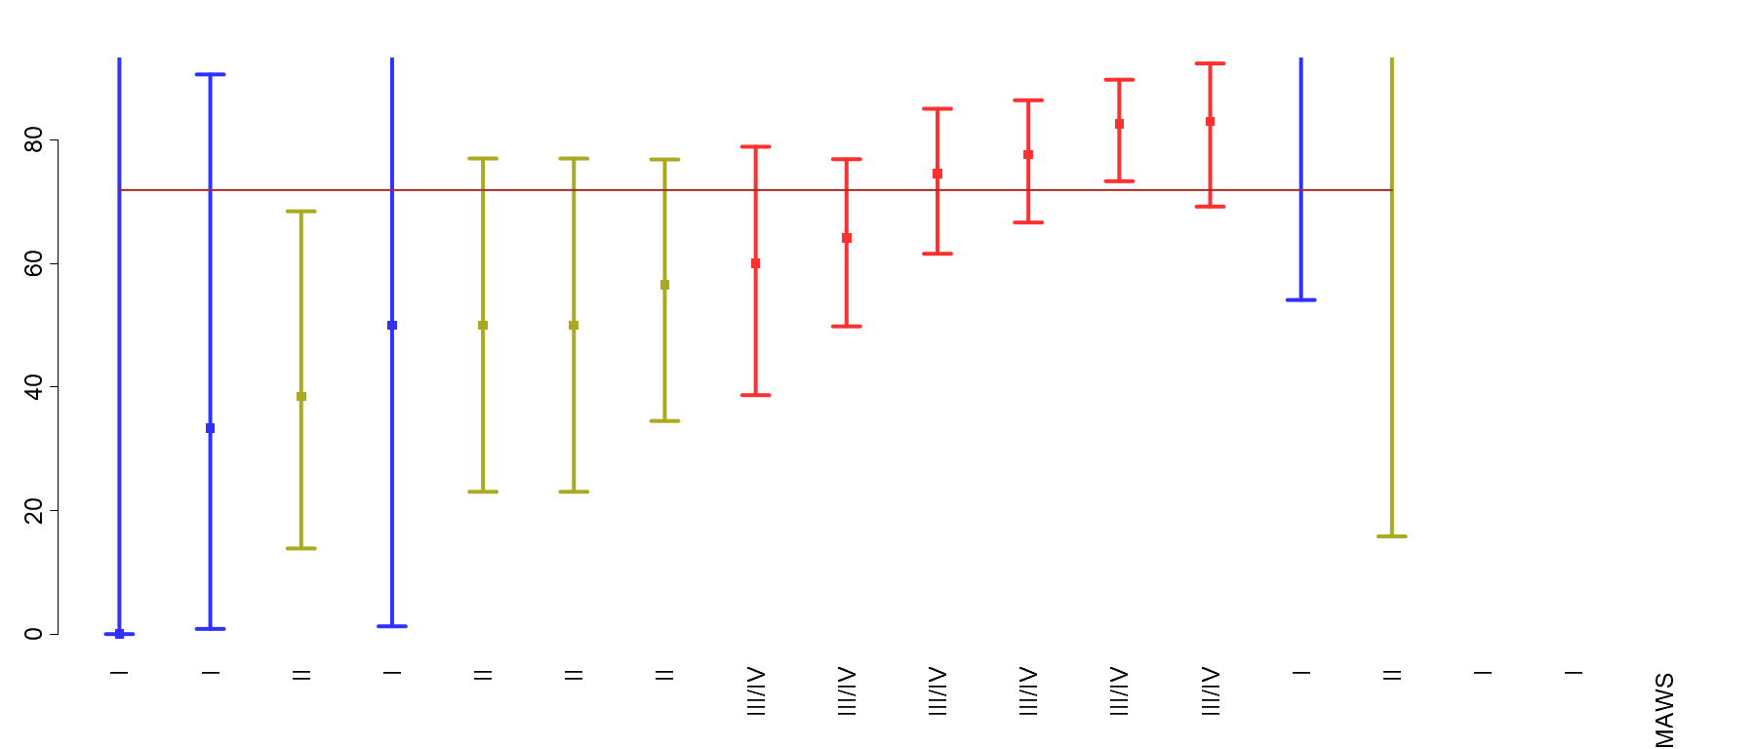
Robson Group 8: All Multiple Pregnancies
Period | n/N | Rate
Q1 | 74/107 | 69.2
Q2 | 73/100 | 73.0
Q3 | 71/106 | 67.0
Q4 | 91/117 | 77.8
All 2018 | 309/430 | 71.9
© Foundation for Health Care Quality (FHCQ), 2019 - OB COAP is an approved Coordinated Quality Improvement Program protected under Washington State Law, RCW 43.70.510. Unauthorized use or reproduction is strictly prohibited.

Slide 48
Robson Group 9: All Abnormal Lies

Slide 49
Robson Group 9: All Abnormal Lies
Definition:
Cesarean rate for all singleton, abnormal lies* (including previous cesareans)
Denominator:
All singleton pregnancies with abnormal lie* (including previous cesareans)
Numerator:
Cesarean births Exclusions: intrapartum transfers into the facility
Strata:
None
*Abnormal lies included are transverse, oblique, and unstable lies.
Please note that brow and face presentations are classified as cephalic.

Slide 50
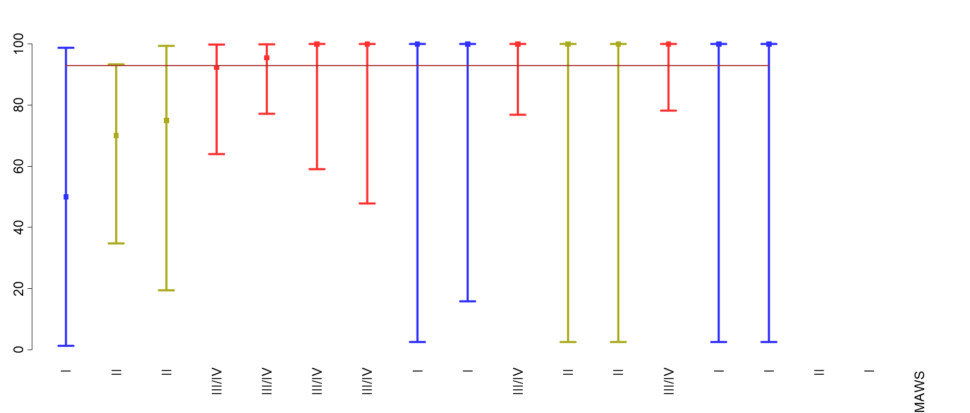
Robson Group 9: All Abnormal Lies
Period | n/N | Rate
Q1 | 33/36 | 91.7
Q2 | 20/20 | 100.0
Q3 | 19/22 | 86.4
Q4 | 20/21 | 95.2
All 2018 | 92/99 | 92.9
© Foundation for Health Care Quality (FHCQ), 2019 - OB COAP is an approved Coordinated Quality Improvement Program protected under Washington State Law, RCW 43.70.510. Unauthorized use or reproduction is strictly prohibited.

Slide 51
Robson Group 10: All Preterm Singleton Cephalic

Slide 52
Robson Group 10: All Preterm Singleton Cephalic
Definition:
Cesarean rate for all singleton, cephalic preterm (<37 week births), including previous cesareans
Denominator:
All singleton cephalic births at <37 weeks (including previous cesareans)
Numerator:
Cesarean births Exclusions: intrapartum transfers into the facility
Strata:
None

Slide 53
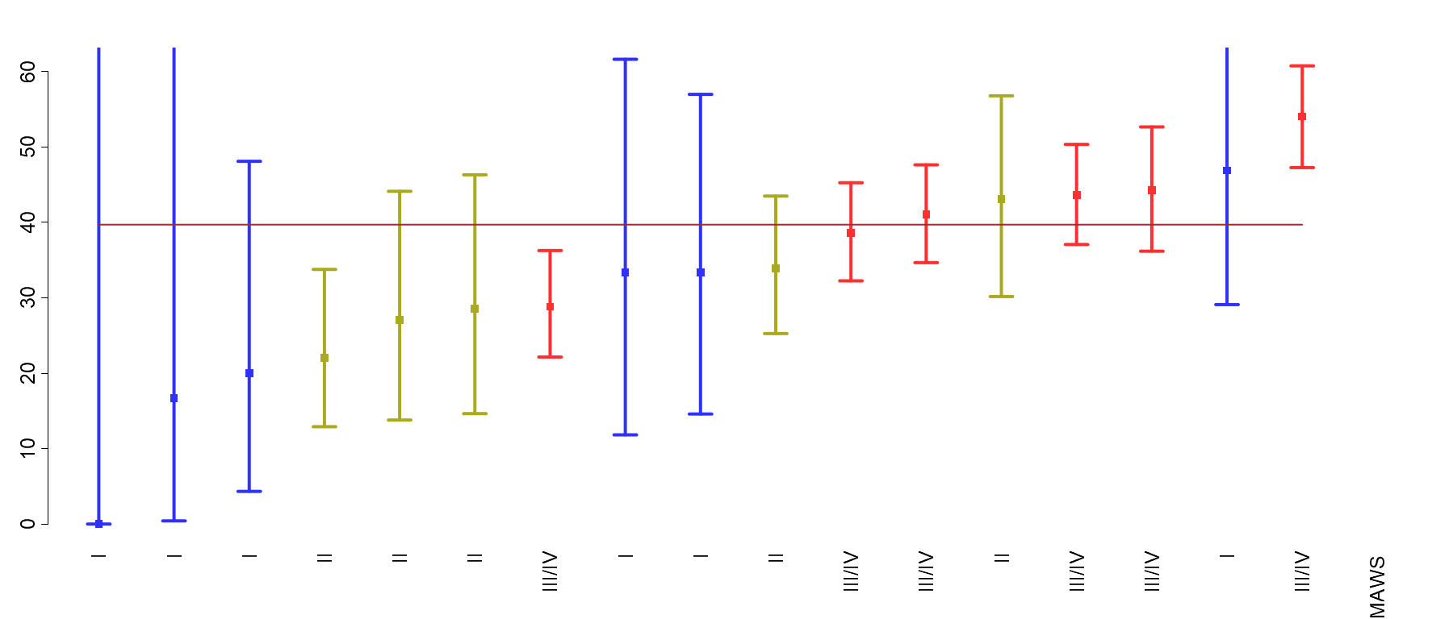
Robson Group 10: All Preterm Singleton Cephalic
Period | n/N | Rate
Q1 | 152/384 | 39.6
Q2 | 159/386 | 41.2
Q3 | 177/442 | 40.0
Q4 | 159/418 | 38.0
All 2018 | 647/1630 | 39.7
© Foundation for Health Care Quality (FHCQ), 2019 - OB COAP is an approved Coordinated Quality Improvement Program protected under Washington State Law, RCW 43.70.510. Unauthorized use or reproduction is strictly prohibited.

Slide 54
Metric 5: Treatment of Severe Hypertension Within 1 Hour

Slide 55
Metric 5: Treatment of Severe Hypertension Within 1 Hour
Definition:
Antihypertensive treatment within one hour of diagnosis of severe hypertension
Denominator:
All childbearing people diagnosed with severe hypertension (>110 diast / >160 syst) during their hospital stay (antepartum or postpartum period)
Numerator:
Treated with an antihypertensive within 1 hour of diagnosis Exclusions: none
Strata:
None

Slide 56
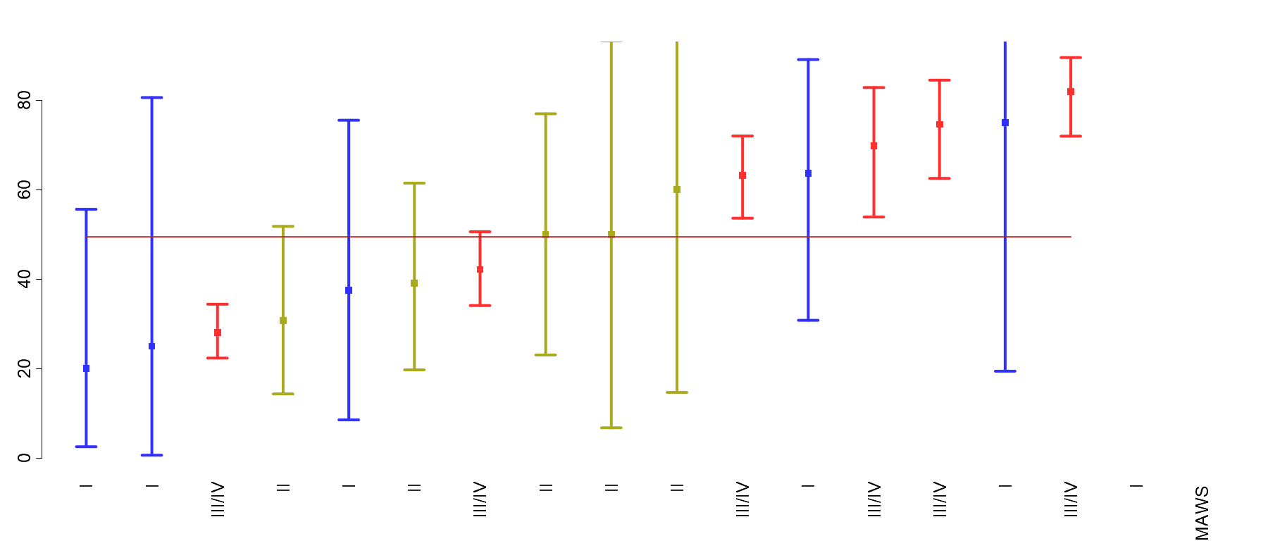
Metric 5: Treatment of Severe Hypertension Within 1 Hour
Period | n/N | Rate
Q1 | 100/202 | 49.5
Q2 | 78/165 | 47.3
Q3 | 105/224 | 46.9
Q4 | 108/200 | 54.0
All 2018 | 391/791 | 49.4
© Foundation for Health Care Quality (FHCQ), 2019 - OB COAP is an approved Coordinated Quality Improvement Program protected under Washington State Law, RCW 43.70.510. Unauthorized use or reproduction is strictly prohibited.

Slide 57
Metric 6: Indicated Cord Gases

Slide 58
Metric 6: Indicated Cord Gases
Definition:
Cord pH recorded in chart if indicated by a 5 minute Apgar <5 or operative delivery performed for concern for fetal status in > 37 week births*
Denominator:
>37 week babies with a 5min APGAR < 5 and / or an operative delivery (cesarean, forceps, or vacuum) performed for concerns for the fetal status. Exclusions: antepartum stillbirths
Numerator:
Cord pH (arterial or venous) recorded in the chart.
Strata:
None
* These are obviously not the only indications to check cord pH but they are the cases we are focusing on for the current core metrics

Slide 59
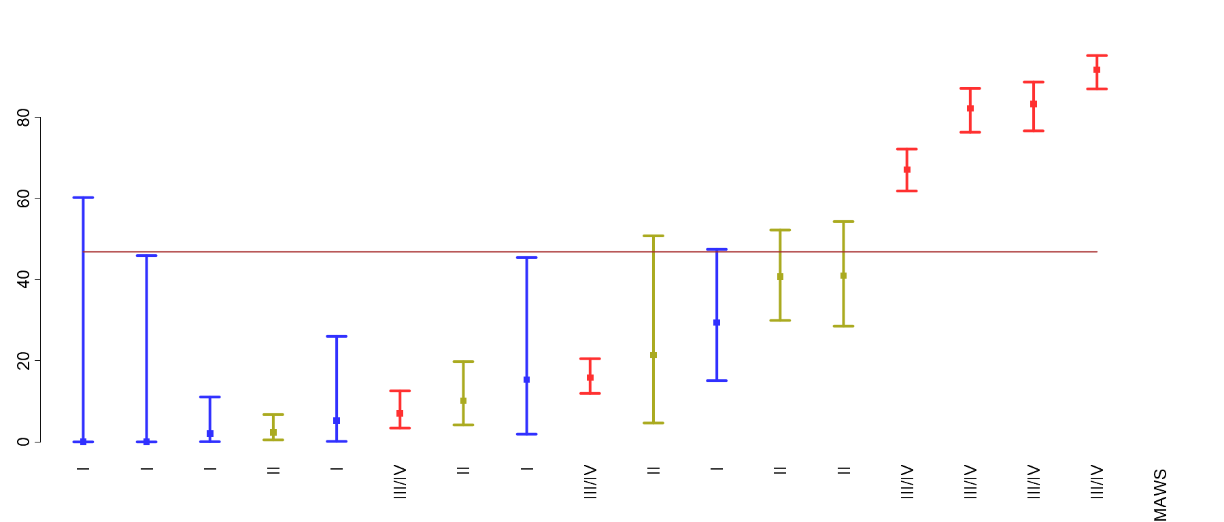
Metric 6: Indicated Cord Gases
Period | n/N | Rate
Q1 | 228/434 | 52.5
Q2 | 190/458 | 41.5
Q3 | 235/486 | 48.4
Q4 | 200/442 | 45.2
All 2018 | 853/1820 | 46.9
© Foundation for Health Care Quality (FHCQ), 2019 - OB COAP is an approved Coordinated Quality Improvement Program protected under Washington State Law, RCW 43.70.510. Unauthorized use or reproduction is strictly prohibited.

Slide 60
Metric 7: 3rd or 4th Degree Laceration

Slide 61
Metric 7: 3rd or 4th Degree Laceration
Definition:
3rd or 4th degree laceration
Denominator:
All childbearing people with singleton > 37 week vaginal births.
Numerator:
3rd or 4th degree perineal laceration at delivery Exclusions: intrapartum transfers into the facility
Strata:
Parity

Slide 62
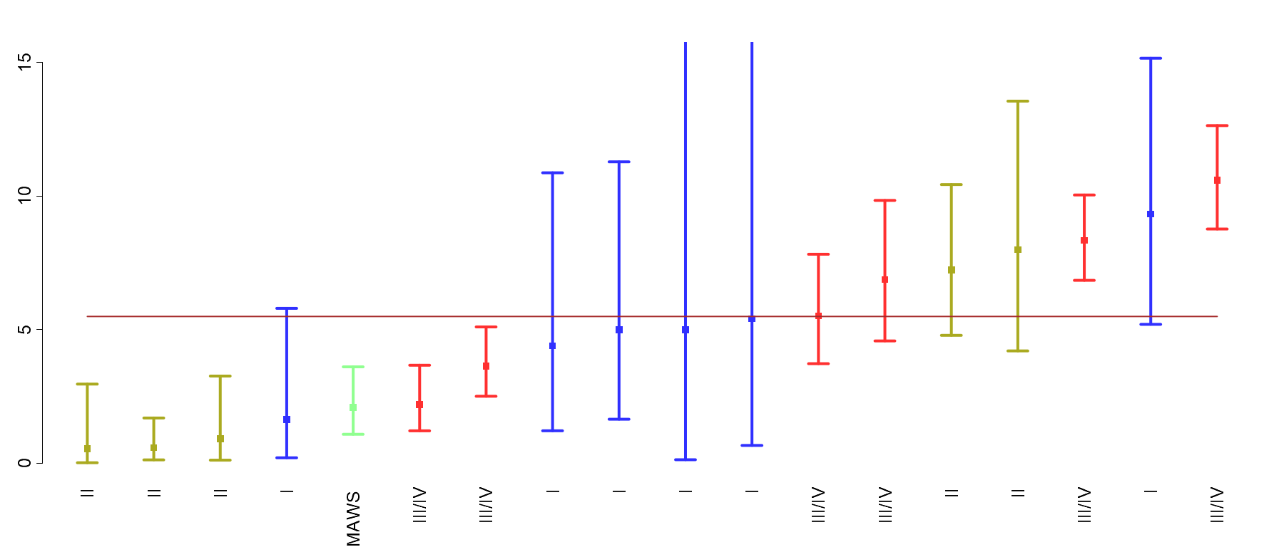
Metric 7: 3rd or 4th Degree Laceration - Nulliparas
Period | n/N | Rate
Q1 | 88/1830 | 4.8
Q2 | 110/1835 | 6.0
Q3 | 99/1844 | 5.4
Q4 | 98/1683 | 5.8
All 2018 | 395/7192 | 5.5
© Foundation for Health Care Quality (FHCQ), 2019 - OB COAP is an approved Coordinated Quality Improvement Program protected under Washington State Law, RCW 43.70.510. Unauthorized use or reproduction is strictly prohibited.

Slide 63
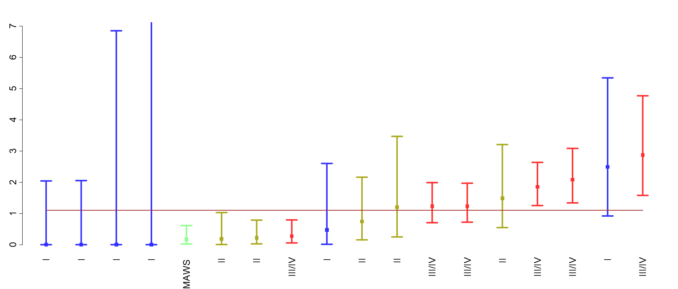
Metric 7: 3rd or 4th Degree Laceration - Multiparas
Period | n/N | Rate
Q1 | 31/2862 | 1.1
Q2 | 32/2910 | 1.1
Q3 | 35/3105 | 1.1
Q4 | 30/2746 | 1.1
All 2018 | 128/11623 | 1.1
© Foundation for Health Care Quality (FHCQ), 2019 - OB COAP is an approved Coordinated Quality Improvement Program protected under Washington State Law, RCW 43.70.510. Unauthorized use or reproduction is strictly prohibited.

Slide 64
Metric 8: Severe Maternal Morbidity

Slide 65
Metric 8: Severe Maternal Morbidity
Definition:
Rate of severe maternal morbidity (SMM)* per childbearing person
Denominator:
All childbearing people Exclusions: None
Numerator:
Any childbearing person with blood transfusion / eclampsia / thromboembolism / DIC / hysterectomy / amniotic fluid embolism
Strata:
Parity
* The OB COAP SMM metric captures 6 of the CDC’s 18 diagnostic categories for severe maternal morbidity.

Slide 66
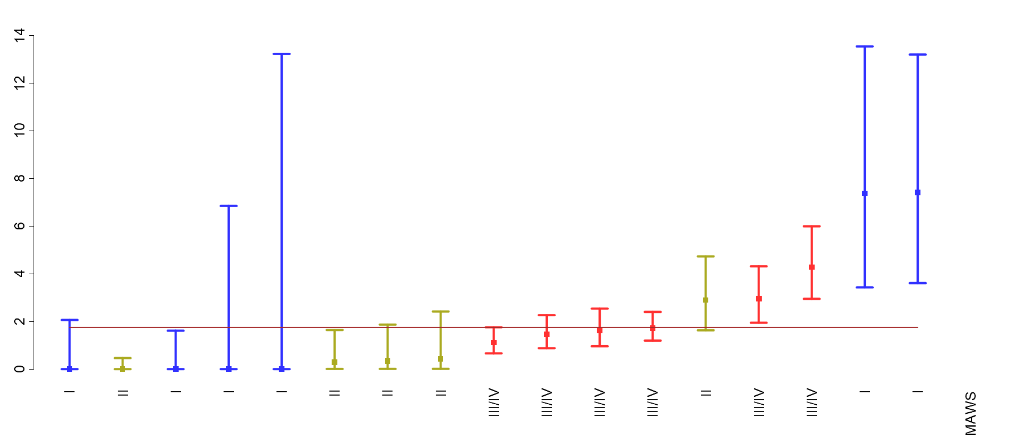
Metric 8: Severe Maternal Morbidity - Nulliparas
Period | n/N | Rate
Q1 | 44/2630 | 1.7
Q2 | 46/2676 | 1.7
Q3 | 50/2732 | 1.8
Q4 | 44/2505 | 1.8
All 2018 | 184/10543 | 1.7
© Foundation for Health Care Quality (FHCQ), 2019 - OB COAP is an approved Coordinated Quality Improvement Program protected under Washington State Law, RCW 43.70.510. Unauthorized use or reproduction is strictly prohibited.

Slide 67
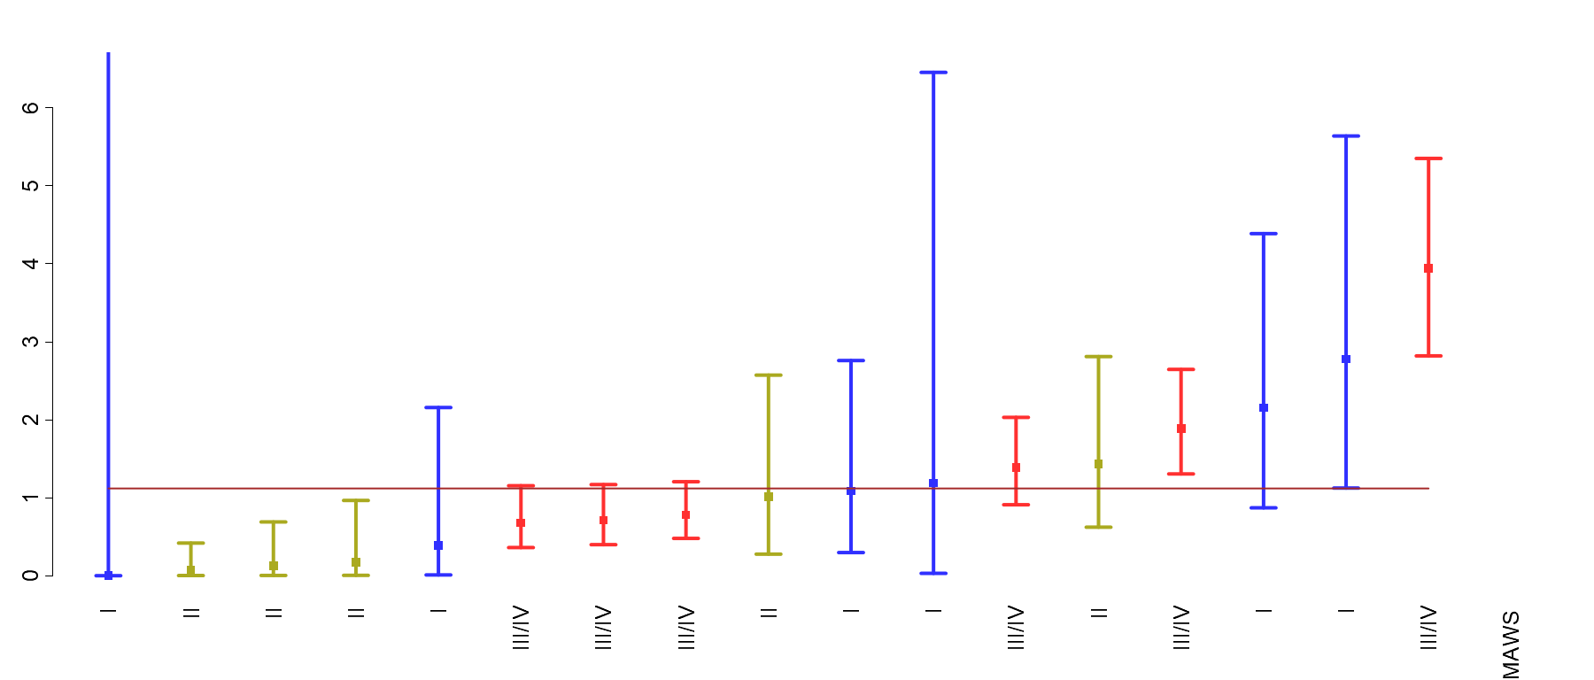
Metric 8: Severe Maternal Morbidity - Multiparas
Period | n/N | Rate
Q1 | 51/3974 | 1.3
Q2 | 43/4011 | 1.1
Q3 | 43/4308 | 1.0
Q4 | 44/3882 | 1.1
All 2018 | 181/16175 | 1.1
© Foundation for Health Care Quality (FHCQ), 2019 - OB COAP is an approved Coordinated Quality Improvement Program protected under Washington State Law, RCW 43.70.510. Unauthorized use or reproduction is strictly prohibited.

Slide 68
Metric 9: Maternal Blood Transfusion

Slide 69
Metric 9: Maternal Blood Transfusion
Definition:
Maternal blood transfusion
Denominator:
All childbearing people
Numerator:
Any childbearing person who received a one or more units of blood
Strata:
Parity (Nulliparous/Multiparous)

Slide 70
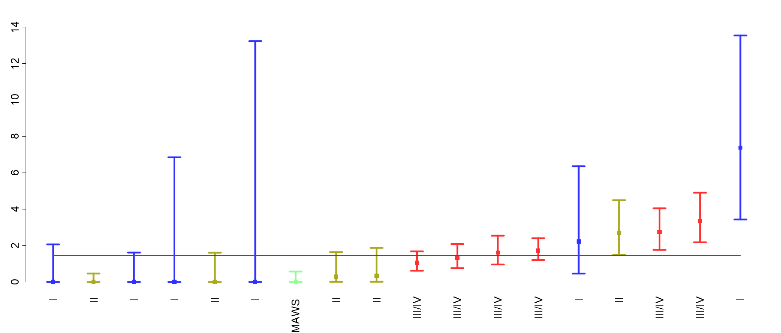
Metric 9: Maternal Blood Transfusion - Nulliparas
Period | n/N | Rate
Q1 | 39/2799 | 1.4
Q2 | 41/2854 | 1.4
Q3 | 44/2891 | 1.5
Q4 | 39/2647 | 1.5
All 2018 | 163/11191 | 1.5
© Foundation for Health Care Quality (FHCQ), 2019 - OB COAP is an approved Coordinated Quality Improvement Program protected under Washington State Law, RCW 43.70.510. Unauthorized use or reproduction is strictly prohibited.

Slide 71
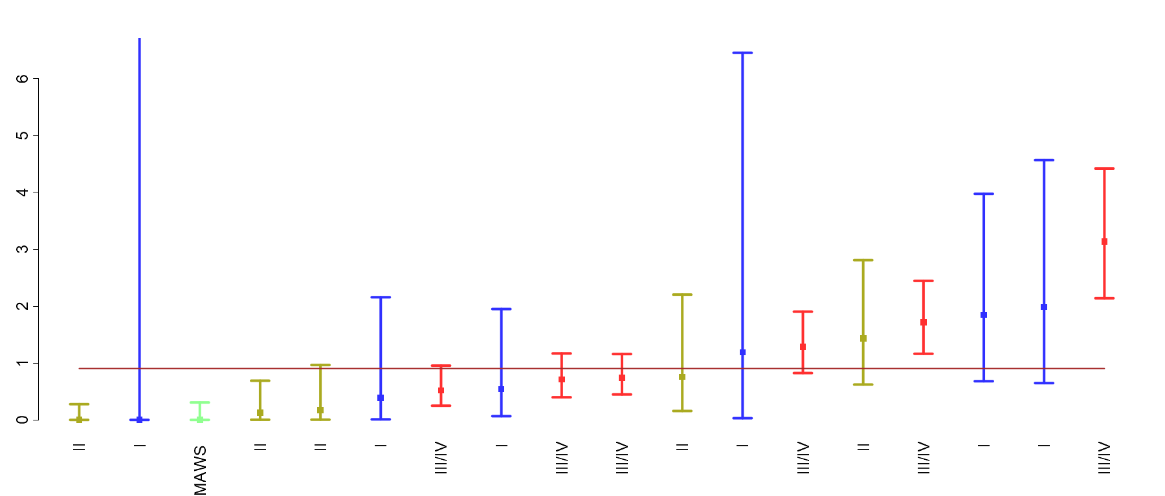
Metric 9: Maternal Blood Transfusion - Multiparas
Period | n/N | Rate
Q1 | 45/4290 | 1.0
Q2 | 38/4301 | 0.9
Q3 | 36/4626 | 0.8
Q4 | 38/4157 | 0.9
All 2018 | 157/17374 | 0.9
© Foundation for Health Care Quality (FHCQ), 2019 - OB COAP is an approved Coordinated Quality Improvement Program protected under Washington State Law, RCW 43.70.510. Unauthorized use or reproduction is strictly prohibited.

Slide 72
Metric 10: Maternal ICU Admit or Blood Transfusion > 4 units

Slide 73
Metric 10: Maternal ICU Admit or Blood Transfusion > 4 Units*
Definition:
Maternal ICU admit or blood transfusion of >4 units
Denominator:
All childbearing people
Numerator:
Any childbearing person who was admitted to ICU or transfused > 4 units of blood
Strata:
Parity (Nulliparous/Multiparous)
* SMFM recommends review of all of these cases

Slide 74
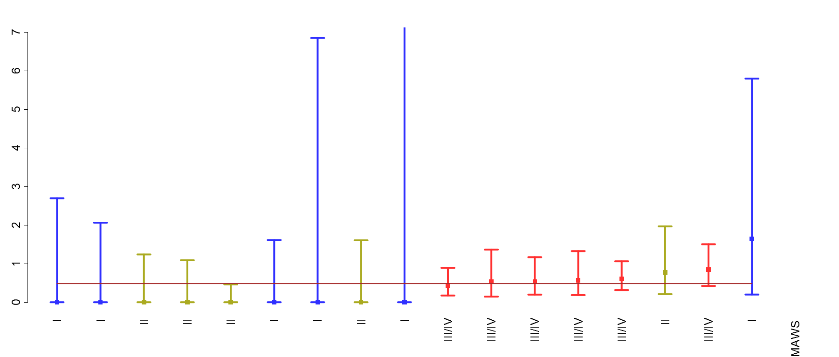
Metric 10: Maternal ICU Admit or Blood Transfusion > 4 units - Nulliparas
Period | n/N | Rate
Q1 | 11/2630 | 0.4
Q2 | 12/2676 | 0.4
Q3 | 18/2732 | 0.7
Q4 | 10/2505 | 0.4
All 2018 | 51/10543 | 0.5
© Foundation for Health Care Quality (FHCQ), 2019 - OB COAP is an approved Coordinated Quality Improvement Program protected under Washington State Law, RCW 43.70.510. Unauthorized use or reproduction is strictly prohibited.

Slide 75
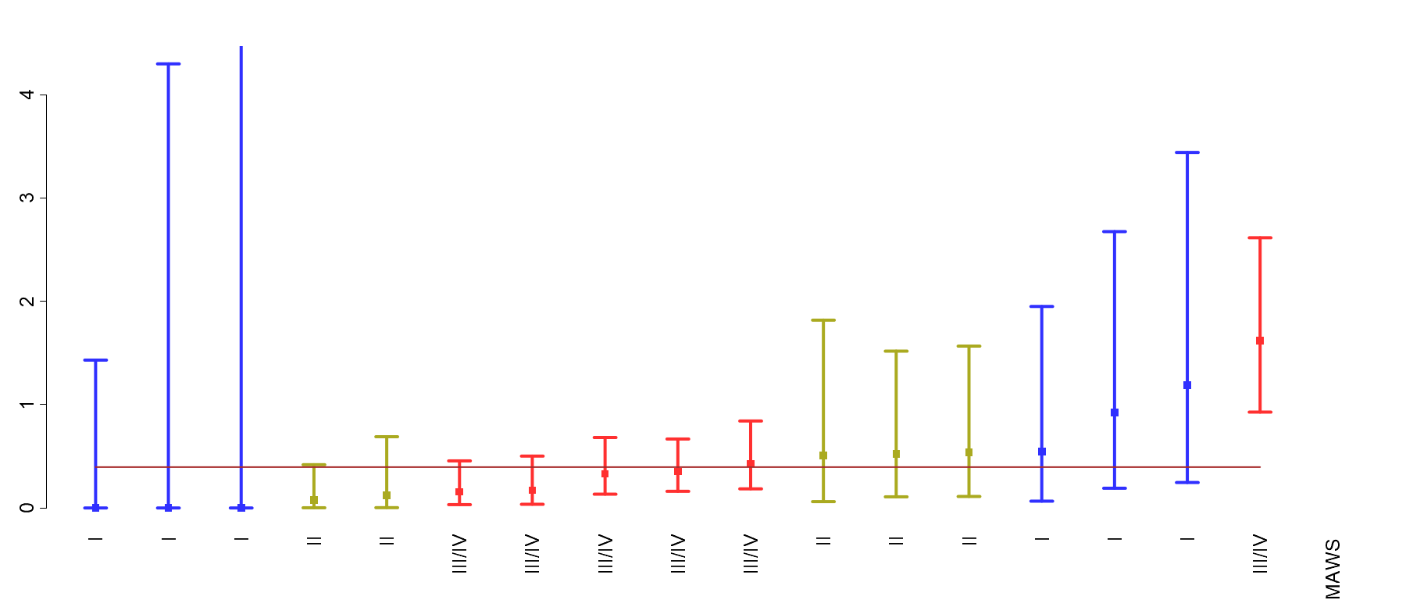
Metric 10: Maternal ICU Admit or Blood Transfusion > 4 units - Multiparas
Period | n/N | Rate
Q1 | 15/3974 | 0.4
Q2 | 18/4011 | 0.4
Q3 | 17/4308 | 0.4
Q4 | 14/3882 | 0.4
All 2018 | 64/16175 | 0.4
© Foundation for Health Care Quality (FHCQ), 2019 - OB COAP is an approved Coordinated Quality Improvement Program protected under Washington State Law, RCW 43.70.510. Unauthorized use or reproduction is strictly prohibited.

Slide 76
Metric 11: NICU Admission or Newborn Transfer at > 37 Weeks on Delivery

Slide 77
Metric 11: NICU Admission or Newborn Transfer at > 37 Weeks on Delivery
Definition:
Rate of NICU admission or transfer to a higher level of care for a neonatal indication.
Denominator:
> 37 week living babies without fetal anomalies or neonatal abstinence syndrome.
Numerator:
Admission to the NICU or transfer to a higher level of care for a neonatal indication. Exclusions: antepartum stillbirths, fetal anomalies, neonatal abstinence syndrome, intrapartum transfers into the facility.
Strata:
Parity

Slide 78
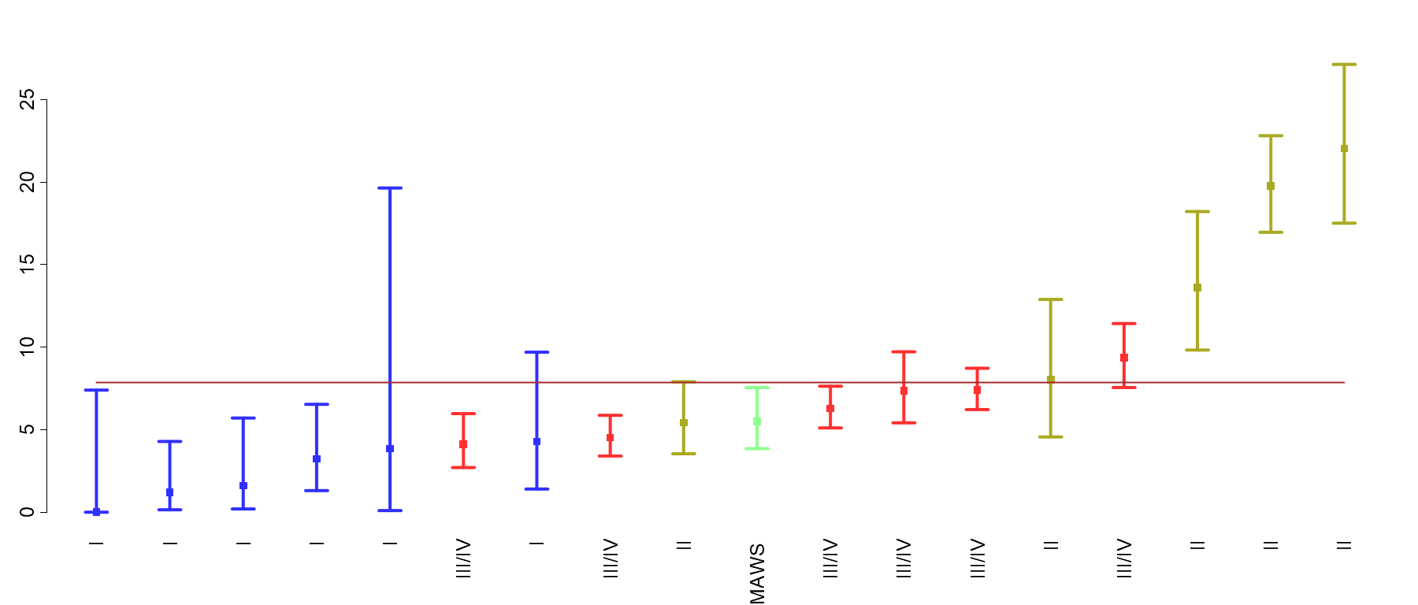
Metric 11: NICU Admission or Newborn Transfer at > 37 Weeks on Delivery - Nulliparas
Period | n/N | Rate
Q1 | 224/2498 | 9.0
Q2 | 197/2523 | 7.8
Q3 | 182/2544 | 7.2
Q4 | 175/2337 | 7.5
All 2018 | 778/9902 | 7.9
© Foundation for Health Care Quality (FHCQ), 2019 - OB COAP is an approved Coordinated Quality Improvement Program protected under Washington State Law, RCW 43.70.510. Unauthorized use or reproduction is strictly prohibited.

Slide 79
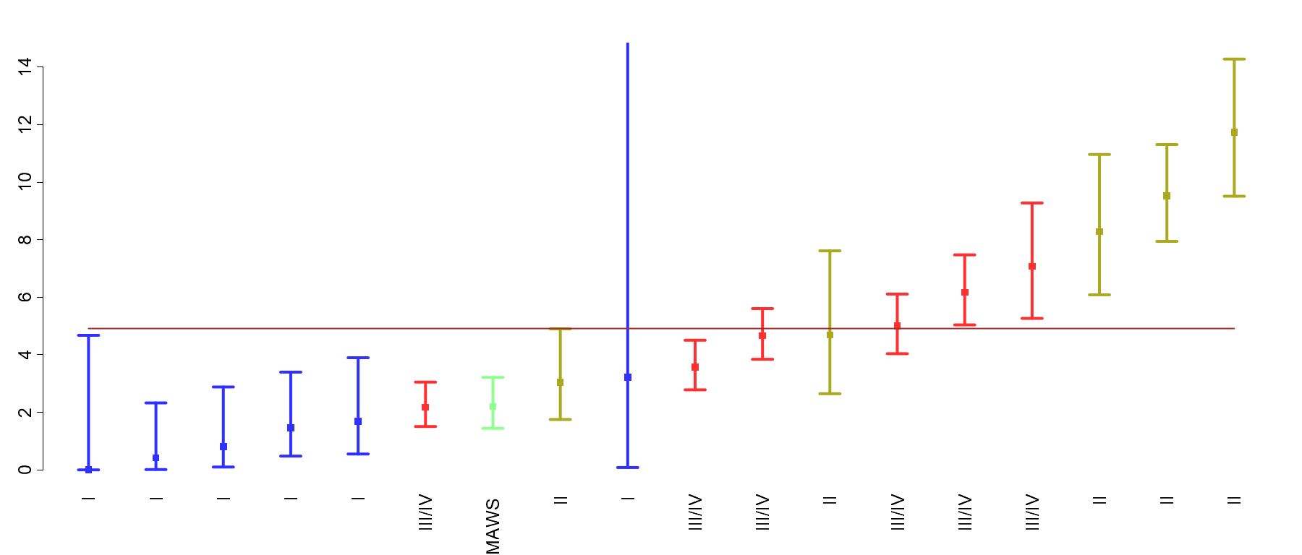
Metric 11: NICU Admission or Newborn Transfer at > 37 Weeks on Delivery - Multiparas
Period | n/N | Rate
Q1 | 194/3836 | 5.1
Q2 | 195/3885 | 5.0
Q3 | 187/4124 | 4.5
Q4 | 188/3703 | 5.1
All 2018 | 764/15548 | 4.9
© Foundation for Health Care Quality (FHCQ), 2019 - OB COAP is an approved Coordinated Quality Improvement Program protected under Washington State Law, RCW 43.70.510. Unauthorized use or reproduction is strictly prohibited.

Slide 80
Rare and Serious Outcomes Dashboard
Many important adverse outcomes are rare. A quarterly table of adverse outcomes are presented by level of NICU care, and not by individual site.
Maternal Adverse Outcomes
Uterine rupture with TOLAC
Hysterectomy
Eclampsia
ICU admit / maternal transfers
Newborn Adverse Outcomes
Antepartum stillbirth
Intrapartum stillbirth
Neonatal death
Cord pH<7.1
Brachial plexus injury
Subgaleal hemorrhage

Slide 81
Rare and Serious Outcomes Dashboard - Maternal
Metric | level I | level II | level III/IV | All
Uterine Rupture with TOLAC | 0.00% | 0.00% | 0.95% | 0.73%
 | (0/56) | (0/201) | (8/839) | (8/1096)
Hysterectomy | 0.05% | 0.00% | 0.13% | 0.10%
 | (1/2054) | (0/5776) | (24/18463) | (25/26293)
Eclampsia (AP/PP) | 0.63% | 0.05% | 0.09% | 0.12%
 | (13/2054) | (3/5776) | (16/18463) | (32/26293)

Slide 82
Rare and Serious Outcomes Dashboard - Newborn
Metric | level I | level II | level III/IV | All
Antepartum Stillbirth | 0.29% | 0.29% | 0.33% | 0.32%
 | (6/2055) | (17/5798) | (61/18292) | (84/26145)
Intrapartum Stillbirth | 0.10% | 0.02% | 0.00% | 0.01%
 | (2/2049) | (1/5781) | (0/18231) | (3/26061)
Neonatal Death | 0.05% | 0.07% | 0.10% | 0.09%
 | (1/2047) | (4/5780) | (18/18231) | (23/26058)
Brachial Plexus Injury | 0.05% | 0.02% | 0.02% | 0.02%
 | (1/2066) | (1/5842) | (3/18825) | (5/26733)
Subgaleal Hemorrhage | 0.05% | 0.00% | 0.03% | 0.02%
 | (1/2066) | (0/5842) | (5/18825) | (6/26733)
Cord PH < 7.1 | 20.00% | 10.50% | 3.40% | 3.94%
 | (6/30) | (19/181) | (104/3063) | (129/3274)

Slide 83
Variation in Rates
Variation in rates may be influenced by differences in a number of factors including:
Clinical practice
Patient population
Documentation
Abstraction

Slide 84
In Conclusion…
OB COAP is a continuous quality improvement program
OB COAP holds a wealth of data on obstetric care
The 2019/2020 metrics are just the start
Let us know what you like/ don’t like/ want to see!
Use it to understand and improve care!

Slide 85
Contact Information
Vivienne Souter, MD – vsouter@qualityhealth.org
Ian Painter, PhD – ipainter@qualityhealth.org
Kristin Sitcov – ksitcov@qualityhealth.org

