Slide 1
Smooth Transitions™
Quality Improvement Program
Improving Hospital Transfers from Planned Community-based Births

Slide 2
Support from:
Foundation for Health Care Quality – OB COAP
Washington State Hospital Association (WSHA)
Midwives’ Association of Washington State (MAWS)
Washington State Obstetrical Association (WSOA)
Washington State Department of Health (DOH)
Washington Affiliate of the ACNM
American Institutes for Research (AIR) grant
Washington Alliance for Responsible Midwifery (WARM)
OB Hospitalist Group, Inc (OBHG)

Slide 3
Smooth Transitions Workgroup
Audrey Levine, LM, CPM (Retired) – Co-Chair
Robin deRegt, MD – Co-Chair
Melissa Denmark, LM, CPM - Program Coordinator
Dale Reisner, MD – Swedish Medical Center
Ali Lewis, MD – Northwest Hospital
Tiffani Buck, MSN, RN – Women’s Health & Perinatal Public Health Nurse Consultant – WA Department of Health
Jamie George, CNM – Providence Regional Medical Center
Brooke Jardine, MD – PeaceHealth St. Joseph Medical Center
Rachel Wortman-Morris, PhD - Health Care Consumer/Advocate
Beth Arcese, LM, CPM
Frank Andersen, MD, Clinical Education Director, WSU
Kristin Sitcov, Executive Director, Foundation for Health Care Quality
Christina Long, DO–Medical Director NICU, Valley Medical Center
Meghan Smith, MSN, RNC-OB-Sacred Heart Medical Center
Amy Siedewand, LM, CPM

Slide 4
Smooth Transitions
Mission:
To address our shared responsibility for improving
hospital transfers from planned community-based
births to promote greater patient safety and satisfaction.
Goals:
Improve the safety and efficiency of the transfer process through the establishment of system-wide protocols
Collect and analyze transfer outcome data for the purpose of quality improvement
Build greater collaboration between community-based midwives, EMS, and hospital care team
Enhance the patient experience of care when transfers occur

Slide 5
ACOG Committee Opinion
Although the American College of Obstetricians and Gynecologists believes that hospitals and accredited birth centers are the safest settings for birth, each woman has the right to make a medically informed decision about delivery.
Several factors are critical to reducing perinatal mortality rates and achieving favorable home birth outcomes (including) ready access to consultation and access to safe and timely transport to nearby hospitals.
When antepartum, intrapartum, or postpartum transfer of a woman from home to a hospital occurs, the receiving health care provider should maintain a nonjudgmental demeanor with regard to the woman and those individuals accompanying her to the hospital.
Committee Opinion Number 697, April 2017 (reaffirmed in 2020)

Slide 6
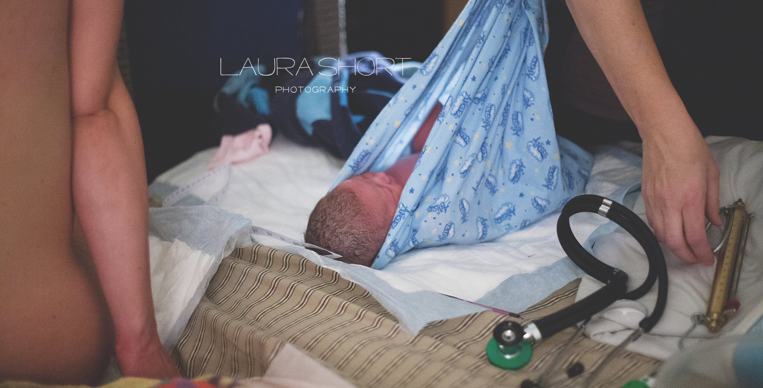

Slide 7
WA State Birth Data (2018)
Total births * 85,842
Hospitals 82,604 96.2%
Freestanding Birth Centers 1,288 1.5%
Home Births 1,828 2.1%
* Includes federal facilities, born on arrival, other unknowns
WA State Department of Health, Center for Health Statistics, Health Utilization Tables (2018)

Slide 8
Community Birth Outcomes MAWS Data in OB COAP 2015 - 2020
11,442 planned community births (at time of labor)
85% of these births (n=9,737) occurred in their intended location (home or birth center)
Overall c-section rate was 5.3% (n=608)
Nulliparous c-section rate was 12.4% (n=507)
Multiparous c-section rate/no prior history of c-section was 1.0% (n=72)
Multiparous c-section rate/labor after prior c-section was 10.7% (n=29)
Spontaneous vaginal birth rate was 93.8% (n=10,733)
Physiologic birth rate was 84.1% (n=9,626)

Slide 9
Community Birth Transfers Data in OB COAP 2015 - 2020
Intrapartum transfer rate 14.9% (1,705)
Nulliparous transfer rate 32.3% (1,326)
Multiparous transfer rate 5.2% (379)
C-section rate for transfers 35.7% (608)
Postpartum transfer rate (<6 hours after birth) 2.9% (284)
Postpartum hospital admissions rate (<6 hours – 30 days PP) 1.0% (117)
Neonatal transfer rate (<6 hours after birth) 2.1% (201)
Neonatal hospital admission rate(>6 hours – 30 days after birth) 2.3% (266)
Perinatal death rate (intrapartum + neonatal < 7 days) 0.87% (10)

Slide 10
Licensed Midwives: Landscape in Washington State
Licensure - RCW 18.50 and WAC 246-834
Education - 3years, 100+ births, NRP, CPR
Insurance Reimbursement – most third-party payers, including Medicaid
Availability of professional liability insurance
Legend drugs and devices – WAC 246-834-250
Quality Management Programs (MAWS, PMA, WARM)
“Indications for Discussion, Consultation, and Transfer of Care in a Home or Birth Center Midwifery Practice”
Mandatory data collection, continuing education, and peer review
Highest integration score in the U.S.

Slide 11
Postpartum & Newborn Care
Care for the newborn for 2 wks postpartum
Home/clinic visits (24hr, 3-5d, 1-2wk), phone calls, and final postpartum visits (6-8 wks in office)
Newborn metabolic screening
CCHD screening
Newborn hearing screening
Weight checks
Jaundice assessment-labs prn
RH negative protocol-RHIG
Hepatitis B Vaccine
Breastfeeding support
Screening for postpartum mood disorders
Referrals to newborn care providers and lactation specialists prn

Slide 12
Getting Started
Identify a clinician champion
Establish a Perinatal Transfer Committee
Develop/adopt transfer tools

Slide 13
Next Steps
Perinatal Transfer Committee Meetings
Meet regularly (2-4x/year)
Examines what’s working/not working, any trends with transfers?
Explores opportunities for interdisciplinary skills training and continuing education based on identified needs
Develop additional QI opportunities (for example: midwife-to-midwife transfers of care; timely access to prenatal ultrasound, ECV, PTL assessments, therapeutic rest)

Slide 14
Taking Quality Improvement to the Next Level
Data collection & Analysis

Slide 15
On the Horizon
Multidisciplinary Protected Case Review

Slide 16
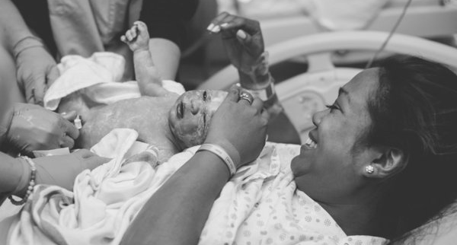

Slide 17
Thank You!
Melissa Denmark
Smooth Transitions Program Coordinator
smoothtransitions@qualityhealth.org
Audrey Levine
Co-Chair, Smooth Transitions Workgroup
audrey.e.levine@gmail.com
qualityhealth.org/smoothtransitions

Slide 18
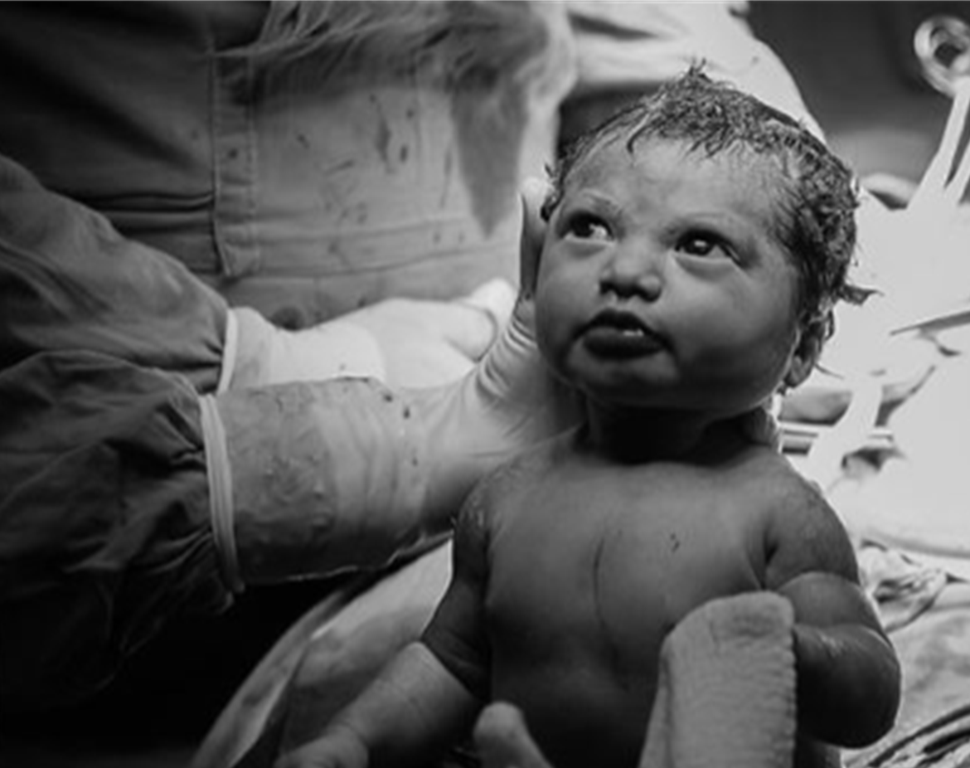
Q & A

