Slide 1


Smooth Transitions™
Quality Improvement Program
How Midwives, Hospitals, EMS, and Birthing Families All Benefit
Hospital Name
Date
Notes:
MELISSA: INTRODUCE OURSELVES
Thank you for inviting us here today. We’re going to introduce Smooth Transitions to you, a quality-improvement program at the Foundation for Health Care Quality, based in Seattle, WA, designed to enhance the safety of hospital transfers from planned home and birth center births in Washington State. NEXT SLIDE, please.

Slide 2

National Context
From 2019 – 2020, there was a 19.5% increase in community births across the United States. Greatest increase was among Black birthing people.
MacDorman, M. et al. United States Community Births Increased by 20% from 2019 to 2020. Birth. 25 February 2022
“Expanding access to care in community birth settings is a cost-effective solution to providing higher quality care and better birth outcomes, and – with intentional focus – to advancing birth equity.”
National Partnership for Women & Families. Improving Our Maternity Care Now Through Community Birth Settings. Policy Report issued April 2022
Notes:
DALE: Before we talk about Smooth Transitions, we wanted to give you some context, nationally, as well as in Washington state. The rate of community birth is rising. According to a recent CDC report, between 2019 and 2020 there was an almost 20% increase in community birth. Some of this increase was likely due to COVID, with families choosing to give birth in settings where they’d be less likely exposed to the virus and where there were no restrictive policies about the number of people who could be present to provide labor support. Notably, the greatest increase in community birth was among Black birthing people. This should not be surprising, given widespread media reports about the higher rates of maternal and newborn mortality for Black mothers and babies, as well as the growing number of Black midwives seeking to address this crisis by providing culturally matched care in their own communities.
In April of 2022, the National Partnership for Women & Families released a policy report noting that “expanding access to care in community birth settings is a cost-effective solution to providing higher quality care and better birth outcomes, and…to advancing birth equity.” And, indeed, the WA State Health Care Authority is developing a Maternal Care Model that includes promoting greater access to midwives in all birth settings.

Slide 3
ACOG Committee Opinion
Although the American College of Obstetricians and Gynecologists believes that hospitals and accredited birth centers are the safest settings for birth, each woman has the right to make a medically informed decision about delivery.
Several factors are critical to reducing perinatal mortality rates and achieving favorable home birth outcomes (including) ready access to consultation and access to safe and timely transport to nearby hospitals.
When antepartum, intrapartum, or postpartum transfer of a woman from home to a hospital occurs, the receiving health care provider should maintain a nonjudgmental demeanor with regard to the woman and those individuals accompanying her to the hospital.
Committee Opinion Number 697, April 2017 (reaffirmed in 2020)
Notes:
DALE: Regardless of how one might feel about families choosing to give birth outside of a hospital, it’s a care option that is becoming more popular. Over the past two decades, ACOG’s position on home birth has not fundamentally changed—the College continues to maintain that “hospitals and accredited birth centers are the safest settings for birth.” However, what has shifted significantly, is the recognition that ”each woman has the right to make a medically informed decision about her delivery,” and that hospital-based providers have an important role to play in helping to reduce perinatal mortality rates and achieving favorable home birth outcomes by ensuring ready access to consultation and access to safe and timely transport when necessary. And ACOG’s most recent Committee Opinion emphasizes that, when these transfers of care occur, the receiving health care provider should maintain a nonjudgmental demeanor with regard to the patient and anyone who accompanies them to the hospital. NEXT SLIDE, please.

Slide 4
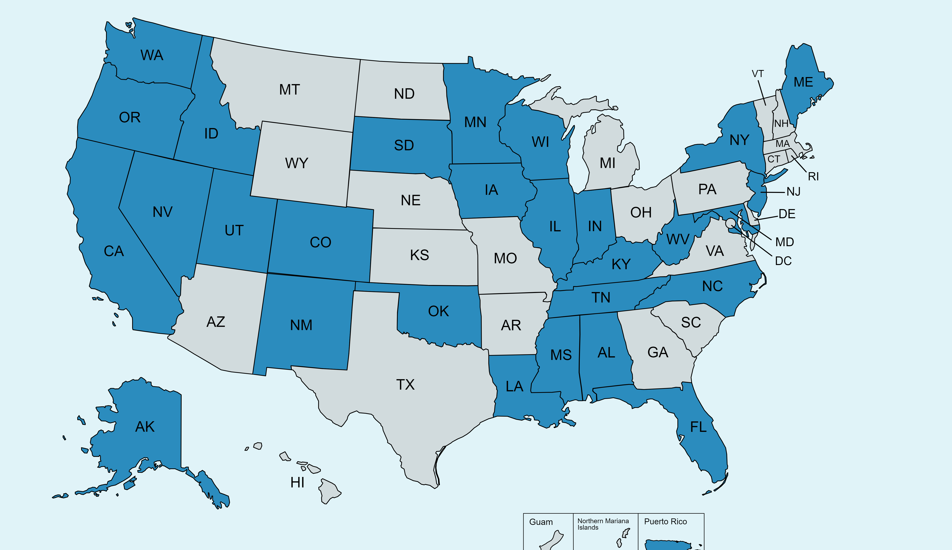
Notes:
MELISSA: Nationally, as we see shifts towards community birth, there are concerted efforts happening across the US to ensure timely and safe access to hospital-based care when necessary. Since publishing an article about Smooth Transitions in the JMWH article in 2022, more states have reached out to us. We have consulted with ~25 other states and jurisdictions looking to replicate the program. In response, we developed recommendations on how to do this work which can be found on our website. Additionally, we meet twice a year with representatives from these states in a Round Table format where we discuss challenges and successes, share resources, and problem-solve together.
We’ve been making more national presentations and are consulting with CA Maternal Quality Care Collaborative (CMQCC) on their transfer improvement efforts, as well as, partnering with AIM, creating a resource kit of national recommendations for hospital transfers from planned community birth.
In order to preserve the integrity of the model, we have trademarked our name but many resources are freely available online. NEXT SLIDE, PLEASE

Slide 5

Smooth Transitions Quality Improvement Program
Launched in 2009 under the auspices of the Washington State Perinatal Collaborative
Since 2018, it has been housed at the Foundation for Health Care Quality
24 hospitals currently participating in the program
Notes:
DALE: Smooth Transitions was launched back in 2009, under the auspices of the Washington State Perinatal Collaborative. The program was created by a workgroup comprising community midwives, OBs, a consumer, and a representative from the WA State DOH. This history of ST speaks to the importance of midwives having a seat at the PQC table. The workgroup addressed concerns about vicarious liability and subsequently developed a transfer guideline, called “Indications for Discussion, Consultation, and Transfer of Care in a Community Based Midwifery Practice.”
In 2018, the program was moved to the Foundation for Health Care Quality in Seattle, a neutral 501(c)3 entity that houses several other quality improvement programs.
There are currently around 24 hospitals participating in Smooth Transitions at various levels of involvement. Some have expressed interest and are waiting schedule an initial presentation, some are busy working on protocols, while others are actively moving through the program steps and are building strong relationships. It’s worth mentioning that a number of the hospitals that we’re onboarding this year are in rural parts of the state where access to perinatal services are limited. These 24 hospitals currently account for 50% of the total births occurring in WA state, however, we’re onboarding 5 more hospitals this year which would increase that to ~70% of births. . NEXT SLIDE, PLEASE.

Slide 6
Participating Hospitals & CNM Partners
Evergreen Health Medical Center
Jefferson Healthcare
Kittitas Valley HealthCare
Legacy Salmon Creek Medical Center
MultiCare Auburn Medical Center
Olympic Medical Center
Skagit Valley Medical Center
Overlake Medical Center
PeaceHealth St. Joseph Medical Center-Bellingham
PeaceHealth Southwest Medical Center
Providence Regional Medical Center
Virginia Mason Medical Center-VMFH
Providence St. Peter Hospital
Cascade Valley Hospital
St. Michael Medical Center
The Vancouver Clinic
St. Elizabeth’s-VMFH
UW Northwest Hospital
UW Valley Medical Center
Yakima Valley Memorial Hospital
Mid Valley Hospital
St. Joseph’s MC-Tacoma
Kadlec Regional Medical Center
MultiCare Capital Medical Center
Notes:
DALE: Here are those hospitals and a CNM practice.

Slide 7

Foundation for Health Care Quality – OB COAP
Washington State Hospital Association (WSHA)
Midwives’ Association of Washington State (MAWS)
Washington State Obstetrical Association (WSOA)
Washington Chapter of AWHONN
Washington State Department of Health (DOH)
Washington Affiliate of the ACNM
American Institutes for Research (AIR) grant
Washington Alliance for Responsible Midwifery (WARM)
OB Hospitalist Group, Inc (OBHG)
Skyline Foundation (formerly Yellow Chair Foundation)
George Kaiser Family Foundation (GKFF)
Notes:
KATE: These are the groups that support the work of ST, not all contribute financially, some provide in-kind contributions, such as free tables at their conferences. I would like to highlight the importance of multi-stakeholder “buy in” especially from state level groups, it helps validate the program, gives it exposure, and helps with funding opportunities. Smooth Transitions is led by an interdisciplinary group that meets quarterly and provides direction to the program. There is representation from OB, CNMs, EMS, LMs, WSHA, PEDs, Neonatology, MFM, NURSING, the DOH, the Health Care Authority (HCA), a doula, and a consumer. NEXT SLIDE, please.

Slide 8

Mission:
To address our shared responsibility for improving
hospital transfers from planned community-based
births to promote greater patient safety and satisfaction.
Goals:
Improve whole person safety* and efficiency of the transfer process through the establishment of system-wide protocols
Collect and analyze transfer outcome data for the purpose of quality improvement
Build greater collaboration between community-based midwives, EMS, and hospital care team
Enhance the patient experience of care when transfers occur
Notes:
KATE: Here are the program’s Mission and Goals. We want to make sure you all know that, when we talk about shared responsibility, we really mean it. When we present to hospitals, of course, we focus primarily on what you can do to improve transfers from planned community-based births. But we’re equally committed to engaging midwives in this conversation about best practices with regard to hospital transfers, as well as EMS providers. There’s work to do on all sides.
We recently updated and expanded the 1st goal to include whole person safety which refers to how Smooth Transitions considers “safety” to encompass emotional, psychological, social, cultural, spiritual, and physical processes and outcomes. NEXT SLIDE, please.

Slide 9
Smooth Transitions
Program Components
Initial hospital presentation
Co-creation of transfer protocols
Creative problem-solving to improve quality of care and patient experience
Perinatal Transfer Committee meetings
Qualitative data collection through 360-degree surveys -
Notes:
SARAH: This slide shows the main program components. What we have found is that our entire QI cycle is essential to making the program successful. Each of these basic steps is integral in improving transfers. One of the most important things we seek to do in these hospital presentations is to fill in knowledge gaps about who community midwives are, their scope of practice, what their training is, what kind of medications and equipment they carry, what kinds of guidelines they abide by, etc. The next few slides illustrate some of that information we present to hospitals. To help hospital providers and staff and EMS personnel better understand licensed midwives in WA state, ST developed an infographic to demonstrate education and training, scope of practice, professional information, statistics, and relevant research. It contains live links and a QR code to the resources referenced for hard copy use. This infographic is on our resource page. We hope this is a useful tool to promote greater understanding about the care that community midwives provide to birthing people and their babies. NEXT SLIDE, PLEASE

Slide 10
Licensed Midwives:
Landscape in Washington State
Licensure - RCW 18.50 and WAC 246-834
Education - 3years, 100+ births, NRP, CPR
Insurance Reimbursement – most third-party payers, including Medicaid
Availability of professional liability insurance
Legend drugs and devices – WAC 246-834-250
Quality Management Programs (MAWS, PMA, WARM)
“Indications for Discussion, Consultation, and Transfer of Care in a Home or Birth Center Midwifery Practice”
Mandatory data collection, continuing education, and peer review
Highest integration score in the U.S.
Notes:
MELISSA:
LICENSURE: Community-based midwives in WA are licensed under RCW 18.50 and regulated by the Secretary of Health.
EDUCATION: The majority of Licensed Midwives in WA have graduated either with a Master’s degree from Bastyr University or with a certificate from the Seattle Midwifery School which was founded in 1978 and merged with Bastyr University in 2010. There are also several other out-of-state, accredited midwifery programs now recognized by the WA State Department of Health. The training is 3 years, which includes both a didactic and a clinical component, including attendance at 100 births, 30 in the role of primary midwife under supervision.
INSURANCE REIMBURSEMENT: LMs in WA can contract with most third-party payers as well as Medicaid.
LIABILITY INSURANCE: Not all LMs in WA carry malpractice insurance, but most do. The policies have the same 1 million/3 million limits as the policies of physicians.
LEGEND DRUGS AND DEVICES: When we do these presentations, we’ve found that folks are often surprised to hear that LMs carry and administer uterotonics to treat PPH, oxygen, IV fluids, IV antibiotics for GBS prophylaxis, RHIG, emergency medications, including magnesium sulfate, terbutaline, and epinephrine (pending transport), as well as ophthalmic ointment and vitamin K for newborns. And that we do newborn metabolic screening, CCHD screening, and hearing screens.
**In 2022, the WA legislature passed a scope expansion, granting LMs the authority to prescribe, obtain and administer abx for common infxs in pregnancy and PP AND the ability to administer some hormonal and non-hormonal family planning methods. In 2024, the rules process was completed and many LMs are currently obtaining the education and training necessary to be ready to practice to their full scope.
QUALITY MANAGEMENT PROGRAMS: There are three professional midwifery associations in WA and each one has its own QI program with both peer and incident review. MAWS is the most well-established, and out of the 200 LMs in the state, approximately 145 are members of MAWS.
MAWS document: Created in the 1990s, collaboratively with leaders in the OB community, this “living” evidence-based Indications document gets updated every 2-3 years and is used by the Department of Health in their disciplinary process to determine whether the midwife’s care was within the community standard.
MANDATORY DATA COLLECTION: In 2014, MAWS successfully lobbied for mandatory data collection for all licensed midwives in WA. And the data from all MAWS members is now being captured in OB COAP, alongside hospital-based data. And we’re excited to share with you that, this spring, the Foundation for Health Care Quality will unveil the Community Birth Data Repository which is intended to capture outcomes on all planned community-based births in WA, not just those attended by members of MAWS. This will enable us to better track transfer outcomes. In addition, because the data points in this repository align closely with the information that hospitals in OB COAP collect, we’ll be able to directly compare community birth outcomes in WA with outcomes of similarly low-risk hospital patients.
INTEGRATION: A recent study assessed the degree to which midwives in all 50 states are integrated into the maternity care system and concluded that a higher degree of integration was associated with better perinatal outcomes. WA State had the highest integration score of any state (61 out of 100—so there’s still room for improvement!) (Vedam S, Stoll K, MacDorman M, Cramer R, Cheyney M, Declercq E, Rubashkin N, Fisher T, Spence R, Butt E, Gaston T. Mapping midwifery integration across the United States: impact on access, equity, and outcomes)
Talk about the infographic here-To help hospital providers and staff and EMS personnel better understand licensed midwives in WA state, ST developed an infographic to demonstrate education and training, scope of practice, professional information, statistics, and relevant research. It contains live links and a QR code to the resources referenced for hard copy use. The infographic is up on our resource page. We hope this is a useful tool to promote greater understanding about the care that community midwives provide to birthing people and their babies. NEXT SLIDE, please.

Slide 11

Postpartum & Newborn Care
Complete newborn exam at birth
Care for the newborn (up to 2 weeks)
Home/clinic visits (24hr, 3-5d, 1-2wk), phone calls, & final postpartum visits at 6-8 wks
Newborn metabolic screening
CCHD screening
Newborn hearing screening
Weight checks
Jaundice assessment-labs prn
RH negative protocol-RHIG
Hepatitis B Vaccine
Breastfeeding support
Screening for postpartum mood disorders
Referrals to newborn care providers & lactation specialists prn
Notes:
MELISSA: I want to highlight the comprehensive care that LMs provide to newborns and postpartum parents. Understanding this care model is helpful for hospital providers discharging patients back into midwifery care after a transfer.
NEXT SLIDE, PLEASE

Slide 12

WA State Birth Data (2022)
Total births * 82,986
Hospitals 79,102 95.3%
Freestanding Birth Centers 1,639 2.0%
Home Births 2,142 2.6%
* Includes federal facilities, born on arrival, other unknowns
WA State Department of Health, Center for Health Statistics, (1/19/24) personal communication, Justin Weisser, Epidemiologist, Washington State Department of Health (2022)
Notes:
KATE: We think its important to understand how prevalent community birth is in WA state. This data is from 2022 Vital Statistics and shows community birth makes up 4.6% of total births in the state. The rate in WA state is almost triple the national rate. NEXT SLIDE, PLEASE.

Slide 13
Community Birth Outcomes
MAWS Data in OB COAP 2015 - 2020
11,442 planned community births (at time of labor)
  85% of these births (n=9,737) occurred in their intended location (home or birth center)
  Overall c-section rate was 5.3% (n=608)
    Nulliparous c-section rate was 12.4% (n=507)
    Multiparous c-section rate/no prior history of c-section was 1.0% (n=72)
    Multiparous c-section rate/labor after prior c-section was 10.7% (n=29)
  Spontaneous vaginal birth rate was 93.8% (n=10,733)
  Physiologic birth rate was 84.1% (n=9,626)
  Nethery, Elizabeth MSC, MSM; Schummers, Laura ScD; Levine, Audrey BA; Caughey, Aaron B. MD, PhD; Souter, Vivienne MBChB, MD; Gordon, Wendy DM, MPH Birth Outcomes for Planned Home and Licensed Freestanding Birth Center Births in Washington State, Obstetrics & Gynecology: November 2021 - Volume 138 - Issue 5 - p 693-702 doi: 10.1097/AOG.0000000000004578
Notes:
KATE: Taking a closer look at WA state community birth and I’d like to share some outcome data that was published in the Green Journal in Nov 2021 (some of you may have seen it). The study took place over a 5 ½-year period and looked at 11,442 planned community births in WA attended by midwives who are professional members of MAWS (the Midwives’ Association of Washington State). This data comes from the OB Clinical Outcomes Assessment Program (OB COAP) also based at the Foundation for Health Care Quality. It is important to emphasize that 85% of these births occurred in their intended setting and that the overall c-section rate was 5.3% (12.4% for nulliparas and 1.0% for multiparas with no prior c-section).
The overall rate of physiologic birth was 84.1%, using ACOG’s reVITALize definition of “spontaneous labor and spontaneous vaginal delivery without epidural, other pharmaceutical pain medication or augmentation of labor with oxytocin” although we allowed for AROM in this analysis because this variable wasn’t captured in our dataset. The physiologic birth rate associated with community birth is notable because it’s SO much higher than the physiologic birth rate in OB COAP hospitals, even compared with CNM-led care. Not only is physiologic birth a quality metric that is getting greater attention nationally, but according to the most recent Listening to Mothers in California report, birthing people are increasingly wanting to avoid birth interventions unless necessary. NEXT SLIDE, PLEASE

Slide 14
Community Birth Transfers
Data in OB COAP 2015 - 2020
Intrapartum transfer rate 14.9% (1,705)
Nulliparous transfer rate 32.3% (1,326)
Multiparous transfer rate 5.2% (379)
C-section rate for transfers 35.7% (608)
Postpartum transfer rate (<6 hours after birth) 2.9% (284)
Postpartum hospital admissions rate (<6 hours – 30 days PP) 1.0% (117)
Neonatal transfer rate (<6 hours after birth) 2.1% (201)
Neonatal hospital admission rate(>6 hours – 30 days after birth) 2.3% (266)
Perinatal death rate (intrapartum + neonatal < 7 days) 0.87% (10)
Nethery, Elizabeth MSC, MSM; Schummers, Laura ScD; Levine, Audrey BA; Caughey, Aaron B. MD, PhD; Souter, Vivienne MBChB, MD; Gordon, Wendy DM, MPH Birth Outcomes for Planned Home and Licensed Freestanding Birth Center Births in Washington State, Obstetrics & Gynecology: November 2021 - Volume 138 - Issue 5 - p 693-702 doi: 10.1097/AOG.0000000000004578
Notes:
KATE: This is what the transfer data looks like from this study. The intrapartum transfer rate was 14.9% and higher for multips. Among those who transfer intrapartum, the c-section rate was 35.7%. According to the lead author on the study that analyzed this data, approximately 60% of the intrapartum transfers were for non-urgent indications (mostly pain relief and/or augmentation of labor). These non-urgent scenarios are ideal for MW2MW transfers, although this is not an option at every hospital. The immediate postpartum transfer rate was 2.9%, the neonatal transfer rate was 2.1%, and the perinatal death rate was 0.87%, identical to the rate ACOG cited as a benchmark against which home birth perinatal mortality should be compared. NEXT SLIDE, PLEASE

Slide 15
Smooth Transitions
Program Components
Initial hospital presentation
Co-creation of transfer protocols
Creative problem-solving to improve quality of care and patient experience
Perinatal Transfer Committee meetings
Qualitative data collection through 360-degree surveys -
Notes:
SARAH: Now that we have touched on some of those knowledge gaps that get filled during an initial hospital presentation, I want to drill down on the other program components. After an initial ST presentation, if a hospital decides to proceed with the program, the next step is for them to identify a clinician or leadership champion; this is someone who is willing to be the point of contact between the hospital, the community midwives, and the Smooth Transitions Program Manager. This person can be an OB or pediatrician, a charge nurse, or a nurse-midwife—the key is that this person is committed to improving transfers and is willing to take on this role. We also establish a similar point person from the midwife community who acts as a liaison between the hospital, the other community midwives, and the Smooth Transitions Program Manager.
We work together with the hospital champion and community midwife liaison to organize small groups that work on co-drafting transfer protocols (or guidelines, work flow, etc.). We create a protocol for the gestational parent and the newborn if the site receives neonatal transfers. The protocols clarify roles, expectations, foundations for communication and really is a place for both sides to set out their needs during a transfer. It is also the beginning of relationship building, working together and having productive discussions. Once the protocols are ready, we begin to have regularly perinatal transfer committee meetings (usually quarterly) with leadership and any providers from the hospital who interface with community birth transfers (typically there is representation from charge nursing, ob, cnms, peds, nicu) Additionally, any and all the community midwives who would potentially transfer there are invited to participate, as well as doulas and EMS personnel. NEXT SLIDE, PLEASE

Slide 16
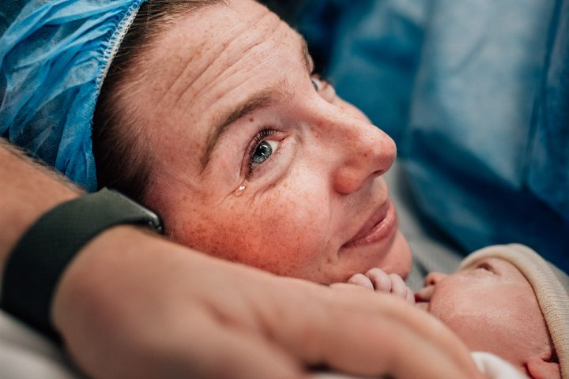
A ca closer look…
Perinatal Transfer Committee Meetings
  Meet regularly (~4x/year)
  Examine what’s working/not working, any trends with transfers?
  Explore opportunities for interdisciplinary skills training, shared continuing education, or resource development - based on identified needs
Notes:
SARAH: As I said before, these PTC meetings typically occur quarterly. There is space for a hospital update, such as new providers, staffing, and capacity. We also see if there are any community midwife updates;for example, there may be a new birth center opening or changing ownership. There is always dedicated time to talk about how transfers are going from both sides, what’s working, what’s not, are there any trends, do we need to update the protocol or guidelines? We prepare a report of the survey data that ST receives which we review. We’ll talk about our surveys in the next slide.
We also explore opportunities for interdisciplinary skills training, shared continuing education, or resource development – all this based on the topics that come up and conversations we have at the PTC meetings. We’re in the process of getting these meetings protected. NEXT SLIDE, PLEASE

Slide 17
Smooth Transitions
Program Components
Initial hospital presentation
Co-creation of transfer protocols
Creative problem-solving to improve quality of care and patient experience
Perinatal Transfer Committee meetings
Qualitative data collection through 360-degree surveys
Notes:
SARAH: ST has developed online survey tools to capture qualitative data on hospital transfers from planned community-based births. We are using the rich data from these surveys to get a 360-degree view on how transfers are going, from the perspective of the nurses, the receiving providers (OB, family MD, or CNM), the community midwife, a doula if present, and the patient. We also have an EMS survey for use when an emergent transfer occurs. This data gets de-identified and reviewed regularly at the PTC meetings. This is a really valuable opportunity to provide and receive feedback. To date, we have received over1000 surveys which are being used to improve quality of care, increase patient satisfaction, and make the transfer process a more efficient, safe and positive experience for everyone. NEXT SLIDE, PLEASE
One of the most important aspects of PTC meetings is the relationship-building, getting to know one another outside the context of transfers which can be stressful or emotional events. What we see, is that over time, and once the transfers are working well, the relationship evolves into developing additional QI opportunities around improving perinatal care and patient experience and we see both groups engaging in creative problem solving. Examples of these efforts are setting up MW2MW transfer, access to prenatal US, ECV, PTL assessment, iron infusion, therapeutic rest, read-only EMR access, early discharge, and collaborative care with higher risk patients. ST has collaborated to create hospital brochures, and a document to better prepare community midwife clients for transfer. NEXT SLIDE, PLEASE

Slide 18
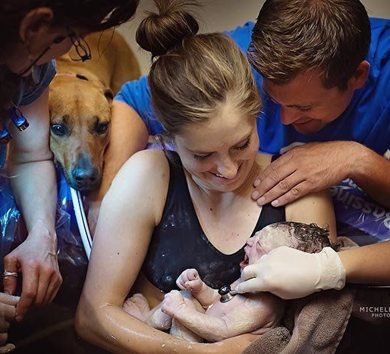

Notes:
SARAH: This is what our ST survey posters look like. Participating hospitals have them in their nursing stations, break rooms, or wherever it works so that nurses and receiving providers can see them and be reminded to fill them out. Community midwives have them in their practices and birth centers and remind their clients to complete surveys when a transfer occurs. NEXT SLIDE, PLEASE

Slide 19

How Sharing Data from Smooth Transitions Surveys Might Advance Equity
Client surveys capture important demographic data on race/ethnicity, gender identity, sexual orientation, language, and SES.
Client surveys ask about abuse/mistreatment, autonomy, respect, and decision-making
Smooth Transitions surveys also ask receiving providers, nurses, and community midwives about whether race/ethnicity and/or gender identity had an impact on their interactions with patients or with one another
Survey data gets de-identified, aggregated, and discussed at Perinatal Transfer Committee meetings with hospital staff and community midwives.
Notes:
KATE: We want to specifically mention that the Smooth Transitions surveys are capturing important demographic data. And our client surveys incorporate very granular questions from validated tools from UBC’s The Birth Place Lab, to measure patient experience of abuse, mistreatment, autonomy, respect, and decision-making. We also ask questions of receiving providers, nurses, doulas, and midwives about whether they feel race/ethnicity and/or gender identity had an influence on their interactions with patients or with one another. Hospitals have been very interested in hearing this data. Our intention is to stimulate conversations about what it means to provide respectful, equitable care, not only for transfer patients but for everyone planning a hospital birth. For hospitals and community midwives who are participating in ST, we can bring various parties together, talk about what went on, look at survey data, and attempt to find solutions together. NEXT SLIDE, PLEASE

Slide 20
What the surveys show
Benefits to Patients:
More respectful care
Continuity of care
Having their trusted provider included as part of the care team
Seamless transition from one venue to another
Patient’s perspective is valued
High quality of communication with hospital provider
Given an opportunity to provide feedback about their transfer experience that will be used for quality improvement
Midwife to midwife transfers
Notes:
KATE: From our survey data, we have pulled out some common themes and quotes that you’ll see on the next several slides. From patients, we hear…..
“It was scary and overwhelming to have to go somewhere else and have treatments I didn’t initially want…But the team made sure I had all the information to make a decision and gave me as much time and space as possible to decide what to do. Then they provided me with exceptional care once the decision was made.”
“Communication between our midwife and the hospital made for a seamless arrival when we got to the unit.”
“Everyone was amazing and caring. I was very pleased with the care we received. An OB who saw me after the birth was so understanding about how disappointing it can be when plans change but reassured me that I would heal well and could still have a birth center birth or a home birth in the future. I felt very good about my birth.”
“I'm so grateful for this opportunity! I would love others to know that birth experiences can still be wonderful despite not going according to plan.”
”I appreciate that my opinions are valued and it feels great to be able to share my experience to help others.” NEXT SLIDE, PLEASE

Slide 21
What the surveys show
Benefits to Community Midwives:
Clear role during the transfer
Know what to expect from the hospital staff
Treated respectfully, as professionals and as part of the care team
High quality of communication with hospital staff
Given an opportunity to provide feedback about their transfer experience that will be reviewed for QI purposes
EMR access to enhance communication around discharge
Notes:
MELISSA: Here are some of the benefits that the Smooth Transitions program confers to community-based midwives. Examples of feedback we’ve received about transfers:
“The receiving staff was wonderful in supporting my client’s needs and the urgency of the situation. Their coordination of care with us at the birth center was also wonderful, including feedback on the transfer discussed on the phone on the same day and updates on how patient was doing.”
“Communication with receiving providers (charge nurse, CNM, MD) - they were responsive, courteous, helpful, accommodating.”
“We love the CNMs! The family is grateful for the fast experience and being able to leave the hospital with early discharge.” NEXT SLIDE, PLEASE

Slide 22
What the surveys show
Benefits to Receiving Providers and Staff:
  Transfers are likely to come in earlier and be less acute
  More timely transfers give providers more care options
  Providers have a better sense of what to expect from transferring midwives
  Patients are better prepared for transfers and likely hospital interventions
  Providers and staff are given an opportunity to provide feedback about their transfer experience that will be reviewed for QI purposes
Notes:
KATE: It’s worth mentioning that not all the feedback we receive through the surveys is positive. In particular, some hospital providers and nurses have indicated that patients could be better prepared by their midwives for the hospital environment and appropriate interventions. This has led to the development of various patient and midwife tools which are available on the Smooth Transitions website, on the Resources page. Here is a sample of responses we’ve received from hospital providers and staff.
“I think the healthy relationship I have with the patient’s midwives helped this patient have an optimal outcome. The midwife continued to be bedside and help with discussion of care options which lead to an uncomplicated non-instrumented vaginal delivery.”
“Appropriate transfer indication. Excellent counseling of the patient by the midwife on what to expect upon hospital transfer in terms of interventions, IV, pain control options, etc.”
“I appreciated a direct call from the community midwife about the situation. I think a provider-to-provider contact is really important in these transfer situations.”
“Best home birth transfer I have managed in 20+ year career. I love the idea of a collaborative relationship, placing patient at the center of care. Patient immediately in MD care when arrived at hospital. Hopefully, CNM's can manage in the future when program is fully up and running.” NEXT SLIDE, PLEASE

Slide 23

CURRENT WORK
Protected Reviews
EMS & community midwives
TeamBirth (Ariadne Labs)
Pilot Project -Tulsa, OK
Consulting - CMQCC
Community Birth Data Registry (CBDR)
Notes:
MELISSA: These are the projects ST is currently working on .
Being able to have community-based midwives participate in varying levels of protected reviews with hospital providers and EMS under the auspices of the WA Department of Health’s Coordinated Quality Improvement Program (CQIP) is a big goal for us. ST now has CQIP protection for 3 different confidential review processes, all of which are intended to be educative and non-punitive
Recognizing the importance of the EMS/community midwife interface, Smooth Transitions is working to develop materials for community midwives to outreach to their local EMS agencies; 2) develop presentations for regional EMS conferences and educational materials for EMS training programs; 3) establish simulation centers where participating EMS, birth centers and hospitals can conduct ongoing simulation/trainings around common OB and neonatal emergency scenarios in a collaborative and supportive way. The expertise and culture of each group can be better understood so that when a real emergency situation happens, there is relationship and trust already established.
We are also partnering with TeamBirth (a national QI program that aims to ensure that patients and their families are included in the decision-making process during labor, birth, and postpartum). As TeamBirth is being incorporated into all WA hospitals, ST is working with them to make sure that community midwives are included in beside huddles when transfers occur, emphasizing the importance of provider to provider, warm handoffs. ST is collaborating on TB resource development as well as collecting qualitative data on TB through our surveys.
OK – GKFF work
Consulting with CMQCC
AIM Resource kit-
Lastly, we helped with the development of the community birth data repository (CBDR) at the Foundation for Health Care Quality that will be able to capture outcomes on births attended by all WA LMs. We’ll be able to directly compare community birth outcomes in WA with outcomes of similarly low-risk hospital patients. The intention is to eventually make the CBDR a repository for community birth data across the US.

Slide 24
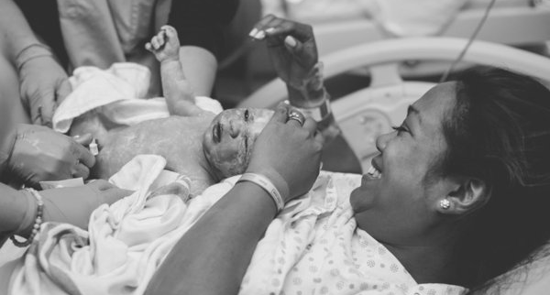
Notes:
MELISSA: In closing, I just want to circle back to the importance of centering our shared patients. When the plan that a family has made for one of the most extraordinary events of their lives goes sideways, a dramatic and sometimes traumatic shift occurs. How that family’s providers navigate the necessary transfer of care can make all the difference, not only in the outcome of the birth, but in the family’s whole experience, no matter the outcome. NEXT SLIDE, PLEASE

Slide 25
Dale Reisner, MD
Co-Chair, Smooth Transitions
dalereisner@gmail.com
Melissa Denmark, MA, LM - retired
Co-Chair, Smooth Transitions
smoothtransitions@qualityhealth.org
Sarah Davidson, MSM, LM - retired
Program Manager, Smooth Transitions
sdavidson@qualityhealth.org
THANK YOU
qualityhealth.org/smoothtransitions
Notes:
MELISSA: We are grateful to have been invited to speak with you all today. This is our contact information and the ST website. Now we can answer any questions and have a discussion.

