Slide 1

Perinatal Transfer Committee Meeting
(Hospital Name)
(Date)

Slide 2
PTC Agenda
Introductions
Smooth Transitions Mission, Goals, Guidelines
Updates (staffing & provider changes, capacity/volumes, new initiatives, EMR changes, etc.)
  Hospital
  Community Midwives
  EMS
  Smooth Transitions
Survey Report – Smooth Transitions team
General transfer discussion
  Protocol edits as needed
  Problem-solving as needed
Specific topic(s) unique to hospital and community (i.e., shared training, resource development, EMR read-only access for midwives, antenatal transfer/inductions, etc.)
Next meeting
  Date & time reminder –
  Agenda topics

Slide 3
Smooth Transitions Mission Statement
To address our shared responsibility for improving hospital transfers from planned community-based births to promote greater patient safety and satisfaction.

Slide 4
Program Goals
Improve the whole person safety* and efficiency of the transfer process through the establishment of system-wide protocols
Collect and analyze transfer outcome data for the purpose of quality improvement
Build greater collaboration between community-based midwives, EMS, and hospital care team
Enhance the patient experience of care when transfers occur
*Smooth Transitions considers “whole person safety” to encompass emotional, psychological, social, cultural, spiritual, and physical processes and outcomes.

Slide 5
Confidentiality and Privacy Reminder
These PTC meetings are meant to be a space for general discussions about transfers, specifically related to systems-level processes and communication.
Discussions around transfer will be addressed in a deidentified, high-level manner with no case-specific details. Please do not self-identify any connection to a specific transfer.
These meetings are not designed to replace a protected case review; that can be done internally at each hospital or by one’s professional midwifery association. Should the discussion trend toward a specific case review, we would respectfully direct to the appropriate avenue.
The intention is to be educative and not punitive.
Please follow common courtesies, such as, being respectful of others, not interrupting, allowing all voices to be heard, and valuing our time together by keeping the meeting productive.
Thank you for your participation and work in improving these transfer situations and interprofessional collaboration.

Slide 6
Conversation Ground Rules By CATALYST www.catalyst.org
1
Assume positive intent.
2
Engage in dialogue – not debate.
3
Hold yourself and others accountable for demonstrating cultural humility.
4
Be open, transparent, and willing to admit mistakes.

Slide 7
Conversation Ground Rules By CATALYST www.catalyst.org
5
Embrace the power of humble listening.
6
Create trusting and safe spaces – where a little bit of discomfort is okay.
7
Commit yourself to having conversations that matter by speaking up to bridge divides.

Slide 8
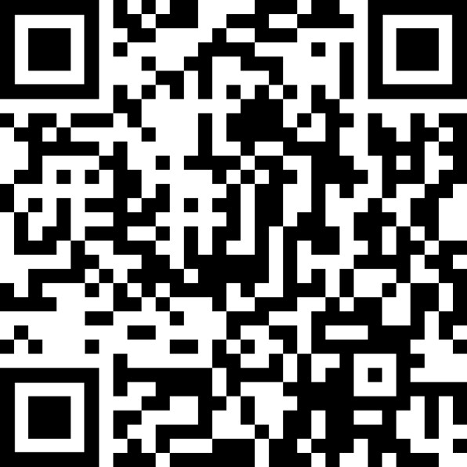
Survey Access:
Smooth Transitions Transfer Surveys
Qualitative transfer experience surveys
Specific surveys for:
  Community Midwives
  Patients/Clients
  Nurses
  Receiving Providers
  Doulas
  EMS
Aggregate survey data reviewed at quarterly PTC meetings
Potential for long term analysis & research
Annual program reviews for:
  Community midwives
  Participating hospitals
Your feedback is appreciated!
Weblink: Surveys | Smooth Transitions (qualityhealth.org)
Printable QR Code PDF
Distributed posters
Found in hospital transfer protocols
QR Code

