Slide 1
Patient Speak Up for Safety – A Pilot Project
Leila Amin, Associate Director Quality and Patient Safety
Sarah Jaaskalinen, Quality and Patient Safety Program Manager
Nov. 12, SCCA Patient Family Advisory Committee
Representing The Washington Patient Safety Coalition and the
Psychological Safety Workgroup
Notes:
About Us: The WPSC is a program of the Foundation for Health Care Quality that acts as a neutral hub uniting a diverse range of healthcare stakeholders to achieve common patient safety goals. A member-based program, the WPSC is made up of 40+ organizations representing healthcare systems, associations, and advocacy groups across the state of Washington. Every two years, we choose a few major initiatives to focus our activities on that represent significant areas for growth in the patient safety and quality space.
Our workgroup: The Psychological Safety Workgroup was created to develop tactics and tools to promote and encourage a culture where patients, families and healthcare team members are encouraged and empowered to speak up and address safety issues without fear of retaliation or hesitation.

Slide 2
Patient Speak up for Safety – Pilot Project
Why Now? In light of current world response to the COVID-19 pandemic, it is more important than ever to create an environment where patients and families can participate as a member of the team and confidently speak up and voice safety concerns.
Project Goal: This project aims to promote patients and families to feel more empowered to speak up in the health care environment which will ultimately lead to safer care environment and improved patient satisfaction.
Today’s meeting objective is to obtain your feedback on the following:
1) Implementation of a baseline assessment for how comfortable patients are speaking up for safety
2) Pilot project details for a speak up for safety campaign

Slide 3
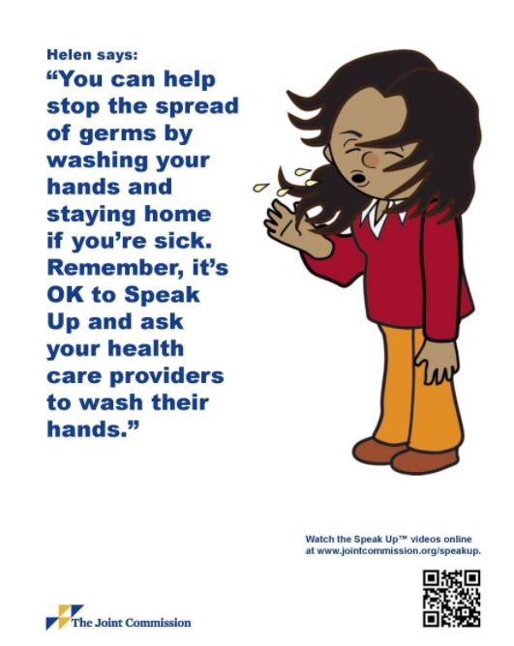
Potential Concerns with Speaking Up
Historically speaking up has not always worked as intended and at times has led to new errors or risk for errors.
“Patients, and often family members, fear that mentioning a problem will result in retaliation or poor care. Many patients are too ill to seek reporting channels. Others are not convinced that reporting will not matter” (Mazor et al., 2016).
Wachter (2018) reports, patients can cross the line that separates being empowered and appropriately skeptical from being aggressive and confrontational. The latter attitude may lead providers to adopt a defensive stance or even generate outright avoidance.

Slide 4

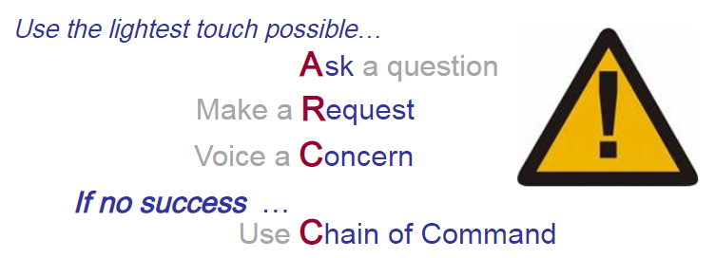
How can we address those concerns?
Providing education to staff to raise awareness of “Patient Speak Up for Safety Campaign” and provide coaching on how to listen and respond to concerns raised by patients
    Speaking Up & Listening Skills Strategies for Interprofessional Teams
Providing patient education on how to “Speak Up for Safety” using the same tools and language as staff would use to raise concerns with one another
  Safety tool education and case examples available on the Patient Safety TogetherNet Page
Notes:
“The responsibility to provide safe care should primarily be borne by providers, healthcare organizations, and policymakers, not patients. However, patents can add an additional layer of “Swiss cheese” to safety layers” (Wachter, 2018).
“It has been found that persons who positively voice their concerns are generally more satisfied with their workplace and exhibit more discretionary efforts to speak up” (Okuyama et al., 2014). Patients voicing concerns with positive response from staff could also lead to higher patient satisfaction.

Slide 5
The Joint Commission’s “Speak Up” Campaign
Speak up if you have questions or concerns. If you still don’t understand, ask again. It’s your body and you have a right to know.
Pay attention to the care you get. Always make sure you’re getting the right treatments and medication by the right healthcare professionals. Don’t assume anything.
Education yourself about your illness. Learn about the medical tests you get, and your treatment plan.
Ask a trusted family member or friend to be your advocate (advisor or supporter).
Know what medicines you take and why you take them. Medicine errors are the most common healthcare mistakes.
Use a hospital, clinic, surgery center, or other type of healthcare organization that has been carefully checked out. For example, the Joint Commission visits hospital to see if they are meeting Joint commissions quality standards.
Participate in all decisions about your treatment. You are the center of the healthcare team.
The Joint Commission supports patients in speaking up in all stages of their health care
Notes:
Several advocacy groups such as the Joint Commission have created campaigns to address ways to ensure patient safety. The Joint Commission created the “Speak Up” campaign to encourage and support patients in speaking up in all stages of their health care.

Slide 6
Errors prevented by SCCA patients:
[Provided 3 examples of incidents reported in our event reporting database]

Slide 7
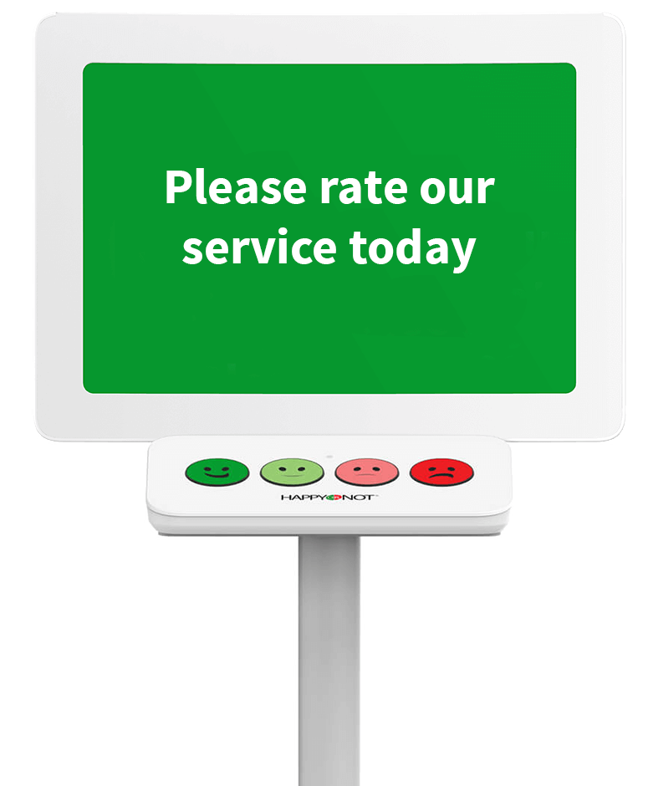
Project Overview
Location:
8 NE: SCCA Hospital beds and UW inpatient beds
Pre-Pilot:
Simple questionnaire that can be asked by a nurse or provider to patients to determine current comfort level regarding speaking up for their safety.
  Use assessment findings to tailor project implementation
  Dissemination of lessons learned, real time quality improvement suggestions and strategies for overcoming barriers
Pilot Project:
Campaign a tool or tools that patients can utilize to speak up for safety concerns that arise
Provide education to healthcare providers on how to receive/respond to feedback

Slide 8
One or more possible areas of focus
About your care
**Hand Hygiene
PSN specific topics
Medication Specific Errors
Chemotherapy administration
Research Studies
Care coordination
Language barriers
Health literacy
Another topic not listed

Slide 9
Request for Feedback
How to evaluate baseline readiness for a speak up for safety campaign
  What are the best questions to ask and how can this be done in the least intrusive way?
  What are the conditions that you feel would make it easiest to speak up?
Focus on patients and their caregivers speaking up?
Focusing on one issue or multiple issues?
“Speaking up” should lead to a timely change whenever possible
  How would you want a provider to respond?
  How would you want to be provided feedback on a more systemic safety issue that has been raised?
How to evaluate success of the pilot?
Notes:
Considerations
Feedback to patient of safety issue disposition
Incorporate a publicity campaign w/in institution to promote/encourage tool
Address fear of retaliation
Consider level of adoption of previous communication tools in institution (e.g. TeamStepps). If adoption isn’t widespread, it may be a barrier.
Inclusive, team approach is important. Include families, care givers, etc.
Patient age, state of mind and culture needs to be considered

Slide 10
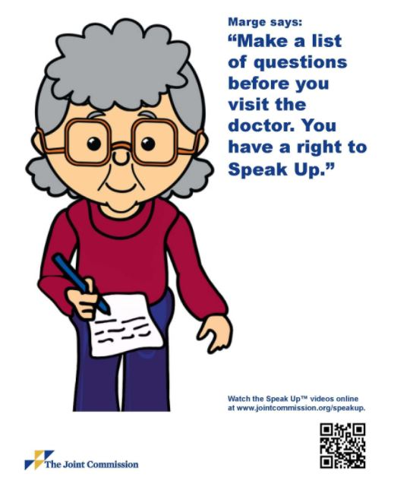
References: https://www.jointcommission.org/en/resources/for-consumers/speak-up-campaigns/
Mazor, Kathleen M., et al. "Speak up! Addressing the paradox plaguing patient- centered care." (2016): 618-619.
Okuyama, A., Wagner, C. & Bijnen, B. Speaking up for patient safety by hospital-based health care professionals: a literature review. BMC Health Serv Res 14, 61 (2014). https://doi.org/10.1186/1472-6963-14-61
Wachter, R. M., & Gupta, K. (2018). Understanding patient safety.

